Slide 1
Training variables crucial to optimize arm/hand training in subacute cervical spinal cord injury
Occupational Therapy Research Symposium
Friday 17th November
Nele Bertels, PhD student, REVAL

Slide 2
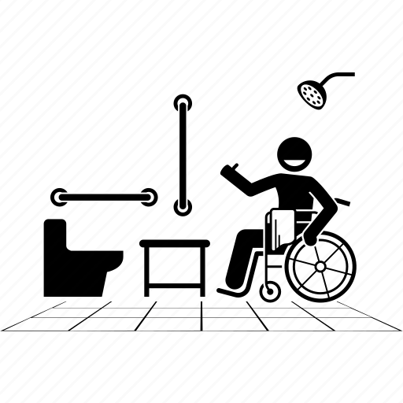
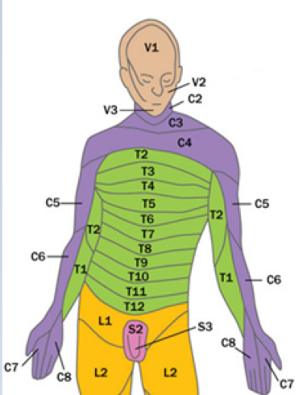
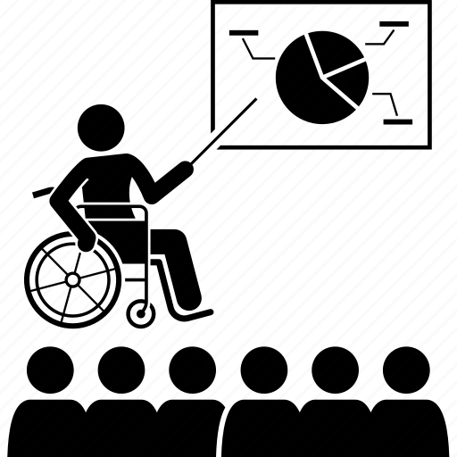
Activities of daily living
Cervical spinal cord injury
Improving arm-hand function
=
Essential part of functional recovery
Participation
Notes:
Upper limb function plays a crucial role in activities of daily living (ADL) and participation. Therefore score people with a cervical spinal cord injury improving AHF and AHSP as essential in their functional recovery. Today I want to define arm/hand function as performing on ICF function level and arm/hand skilled performance performing on ICF activity level.
Spooren et al., 2006; Spooren et al., 2008; Snoek et al., 2004

Slide 3
HOW improving?
Motor training
Kloosterman et al., 2009; Spooren et al., 2009; Lu et al., 2015

Slide 4
HOW to perform?
?

Slide 5
Motor training strategies
Therapy dose dimensions
Motor training
Persons motivation
Dunlop, 2008; Kleim & Jones, 2008

Slide 6
Motor training
Motor training strategies
Therapy dose dimensions
Training modality
Task-oriented training components
Strength training
Analytical training
Endurance training
Skill training
15 components according to Timmermans et al.
Objective therapy dose dimensions
Planned therapy time
Session length
Session density
Subjective therapy dose dimensions
Session difficulty
Session intensity
Session intensity
Notes:
Strength training: training with the aim of increasing muscle strength, a force must be used voluntarily against resistance using various types of muscle contraction (Santos; 2022)
Analytical training: movements, which are movements without a goal, usually occurring in one single movement plane and often occurring in single joints, eg, shoulder flexion
Endurance training:

Slide 7
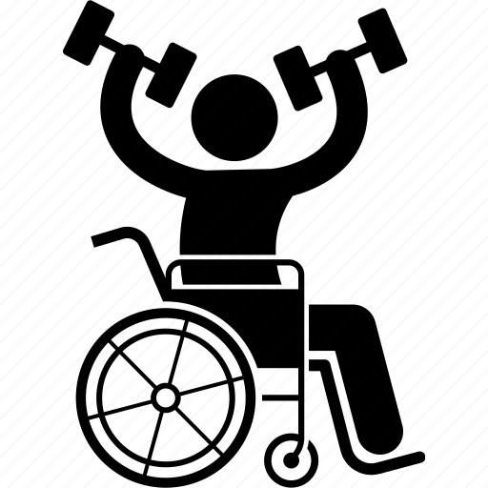
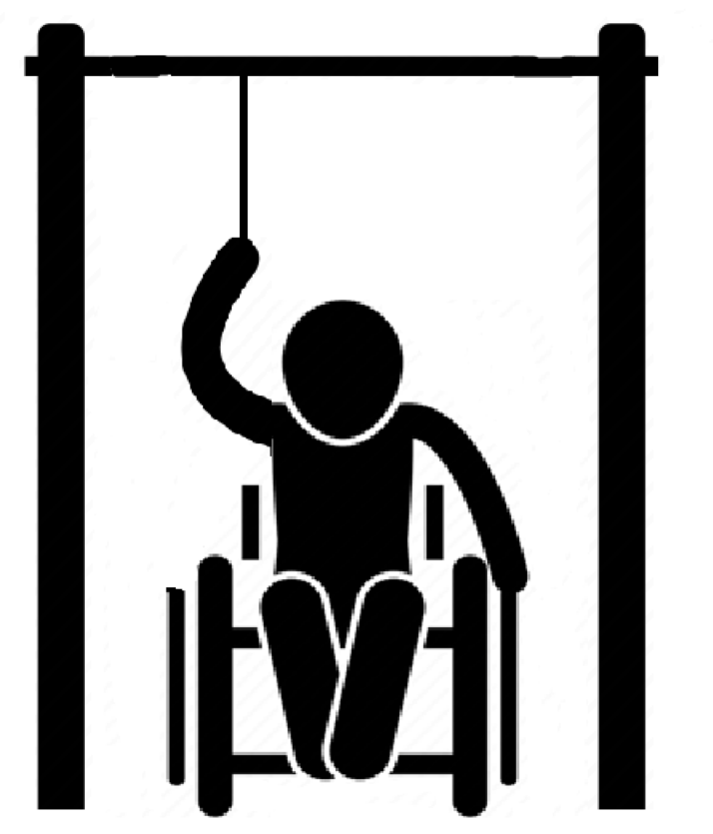
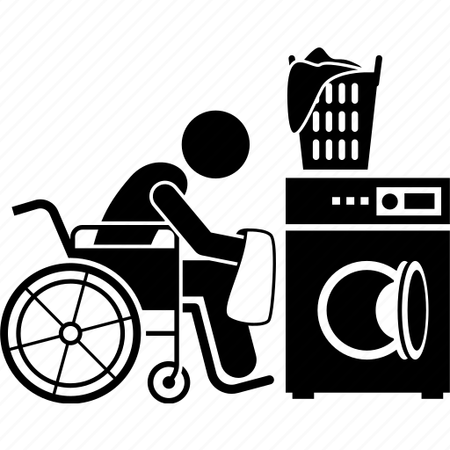
Strength training
Analytical training
Endurance training
Skill training
Notes:
Strength training: training with the aim of increasing muscle strength, a force must be used voluntarily against resistance using various types of muscle contraction (Santos; 2022)
Analytical training: movements, which are movements without a goal, usually occurring in one single movement plane and often occurring in single joints, eg, shoulder flexion
Endurance training: training with the aim to improve aerobic fitness of the upper limb (‘o suilivan)
Skill training

Slide 8
Research project
Systematic review
Multicenter observation study
Qualitative study with exploratory approach

Slide 9
Research project
Systematic review
Multicenter observation study
Qualitative study with exploratory approach

Slide 10
Objective
Motor training
Motor training strategies
Therapy dose dimensions
Training modality
Task-oriented training components
Strength training
Analytical training
Endurance training
Skill training
15 components according to Timmermans et al.
Objective therapy dose dimensions
Planned therapy time
Session length
Session density
Subjective therapy dose dimensions
Session difficulty
Session intensity
Session intensity
Investigate the effect of
Motor training strategies
Therapy dose dimensions
on arm-hand function and arm-hand skilled performance in people with a cervical spinal cord injury in subacute and chronic phase

Slide 11
Method
Motor training programs aiming to improve
Arm-hand function
Arm-hand skilled performance
In participants with
(non)traumatic cervical SCI (C1-Th1)
AIS A-D
Subacute and chronic phase
≥ 16 year
Effect sizes and mean effect sizes with Hedge’s g for both outcomes

Slide 12
Results
1. Arm-hand function
Bertels et al., 2023
Notes:
6 motor training programs

Slide 13
Results
2. Arm-hand skilled performance
Bertels et al., 2023
Notes:
7 motor training programs

Slide 14
Results

Slide 15
Results

Slide 16
Results

Slide 17
Results

Slide 18
Results

Slide 19
Results

Slide 20
Conclusion
Based on limited number of motor training programs:
Training modality skill training alone or combined with strength and endurance
8 task- oriented training components
Functional movements
Clear functional goals
Real-life object manipulation
Multiple movement planes
Minimum training duration of 8 weeks
Total skill practice
Context-specific environment
Exercise variety
Bimanual practice

Slide 21
Research project
Systematic review
Multicenter observation study
Qualitative study with exploratory approach

Slide 22
Objective
Motor training
Motor training strategies
Therapy dose dimensions
Training modality
Task-oriented training components
Strength training
Analytical training
Endurance training
Skill training
15 components according to Timmermans et al.
Objective therapy dose dimensions
Planned therapy time
Session length
Session density
Subjective therapy dose dimensions
Session difficulty
Session intensity
Session intensity
Explore the current motor training strategies and therapy dose dimensions in arm-hand training during rehabilitation in subacute cervical SCI
Clinical Trial Registration no: NCT05452707

Slide 23
Method
At least 25% of time arm/hand training
Given by therapist with at least 2 years of experience in rehabilitation
Inclusion participants
Inclusion sessions
Persons with cervical spinal cord injury
Lesion between C1-Th1
AIS A-D
Between 4 – 8 weeks post injury
MM1
MM2
MM3
4-8 weeks post-injury
12-16 weeks post-injury
20-24 weeks post-injury

Slide 24
Method
 | Observer | Video-recordings | PROM
Motor training strategies
1. Training modality
2. Task-oriented training components
Therapy dose dimensions
1. Planned therapy time
2. Session length
3. Session density
4. Session intensity objectively
5. Session difficulty
6. Session intensity subjectively

Slide 25
Results
N =13
AIS | Lesions | Age (mean ± SD) | Post-injury in weeks (mean ± SD)
B-D | C1-C5 | 54.4 ± 12.9 | 6.7 ± 1.8
N =240
Sessions

Slide 26
Results
Motor training
Motor training strategies
Training modality
Task-oriented training components
Strength training
Analytical training
Endurance training
Skill training
15 components according to Timmermans et al.

Slide 27
Results

Slide 28
Systematic review versus observation study

Slide 29
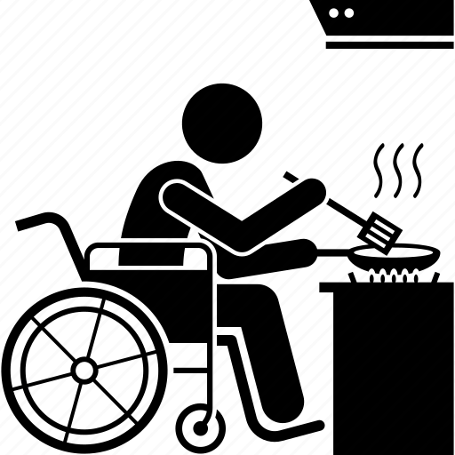
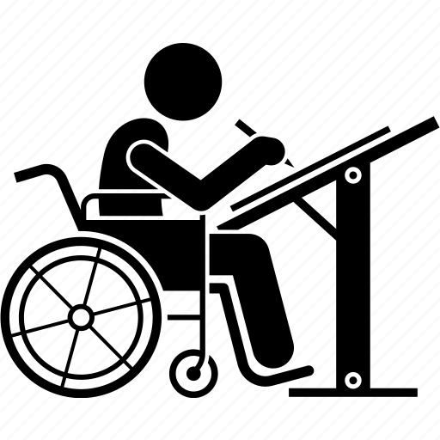
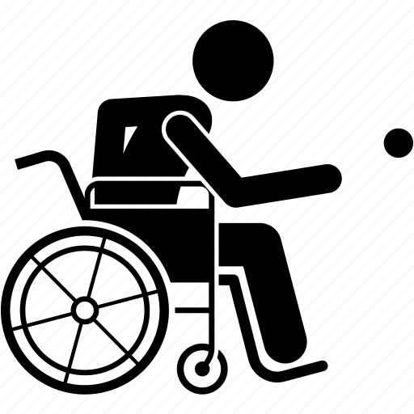
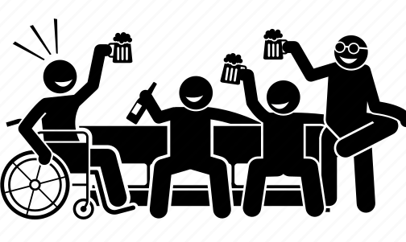
Basic skill training
Complex skill training
Sitting balance
Washing oneself
Dressing
Preparing meals
Fine hand use
Caring for body parts
Eating
Doing housework
Hand arm use
Toileting
Drinking
Notes:
Single tasks

Slide 30
Results

Slide 31
Results

Slide 32
Systematic review versus observation study

Slide 33
Results
Motor training
Therapy dose dimensions
Objective therapy dose dimensions
Planned therapy time
Session length
Session density
Subjective therapy dose dimensions
Session difficulty
Session intensity
Session intensity

Slide 34
Results
Notes:
Median 01:00:00 00:47:00 00:37:00 00:20:52

Slide 35
Results
Subjective therapy dose dimensions

Slide 36
Conclusion
High amount of analytical training compared to other training modalities
Skill training mostly basic skill training
Little use of task-oriented training components:
Overload
Real-life object manipulation
Context-specific environment
Total skill practice
Low subjective therapy dose dimensions scores

Slide 37
Research project
Systematic review
Multicenter observation study
Qualitative study with exploratory approach

Slide 38
Objective
Motor training
Motor training strategies
Therapy dose dimensions
Training modality
Task-oriented training components
Objective therapy dose dimensions
Subjective therapy dose dimensions
To explore therapists’ perspectives on the current practical application of arm-hand rehabilitation in people with cervical SCI.

Slide 39
Method
Three focus groups included
Occupational therapists
Physiotherapists
with at least 2 years experience in rehabilitation
Data-collection by 4 female researchers with a background in occupational science
Data-analysis with inductive thematic analysis

Slide 40
Results
Motor training strategies
Training modality
Task-oriented training components
As soon as possible training on ICF activity level using skill training
However pre-acquisitions are necessary

Slide 41
Results
Motor training strategies
Training modality
Task-oriented training components
As soon as possible training on ICF activity level using skill training
However pre-acquisitions are necessary
Doing total skill practice with real-life objects in the context-specific environment is important but we don’t do it enough

Slide 42
Results
Therapy dose dimensions
Objective therapy dose dimensions
Subjective therapy dose dimensions
Important to individualize motor training
However difficult to estimate the objective and subjective therapy dose dimensions

Slide 43
Discussion
Systematic review
Literature
Qualitative study
Therapists
Training modalities
Skill training combined with strength and endurance training
Analytical training used as a pre-acquisitions
Task-oriented training components
Functional goals with functional movements
Real-life object manipulation in context-specific environment
Total skill practice by bimanual training and using multiple movement planes
Exercise variety
Therapy dose dimensions
?
Observation study
Usual care
Does not match

Slide 44
Discussion
Evidence-based practice
Clinical expertise
Patient
Literature
Notes:
Complexity and realities of clinical practice

Slide 45
Discussion
What want patients?
What is the core business of OT?
Improving activities of daily living
Improving participation

Slide 46
Conclusion
More individualized arm-hand training with attention to
Skill training (basic and complex) combined with endurance and strength training
Including more task-oriented training components
Objective therapy dose with more active time
Subjective therapy dose with higher difficulty and intensity level

Slide 47
Next steps
Proposing a framework to individualize arm/hand rehabilitation in people with cervical SCI
With practical application of tools to guide the therapists

Slide 48
Thank you!
Supervisor and co-supervisor
Prof. Annemie Spooren, Hasselt University REVAL
Prof. Henk Seelen, Maastricht University, Adelante Center of Expertise in Rehabilitation and Audiology
Participants and therapists
Students and neuro-rehab team of REVAL
Dr. van Laake-Geelen and team
Dr. Borgions and team
Prof. Oostra and team

