Slide 1
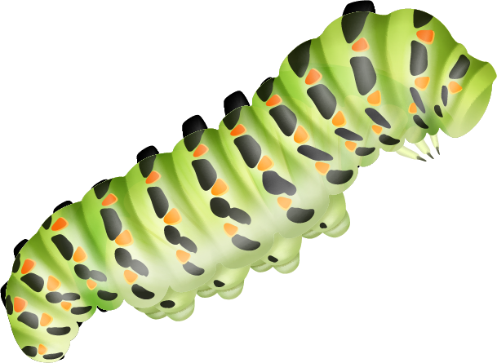
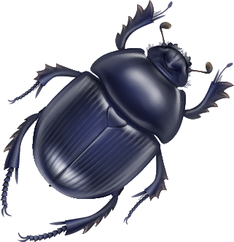
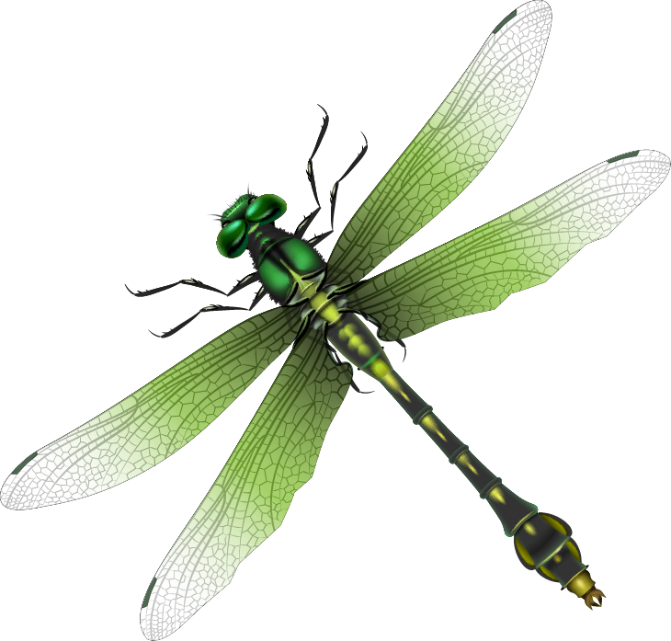
The Legal Protection of Insects: Discrepancy between Ecological Needs and Protection Priorities
Siemen Kalders
Hasselt University

Slide 2
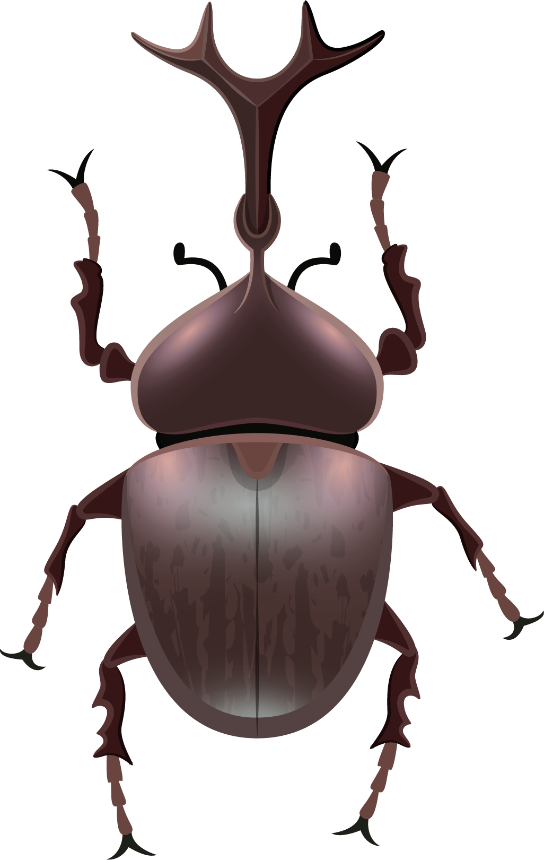
Table of contents
01.
02.
03.
04.
Insects
Insect Conservation
Trends and Benefits
Listing and Observations
Pesticides
The Future
Criteria and Requirements
Recommendation
05.
Methodology
06.
Ecological Functionality
Objectives and Criteria
Concept and Application

Slide 3
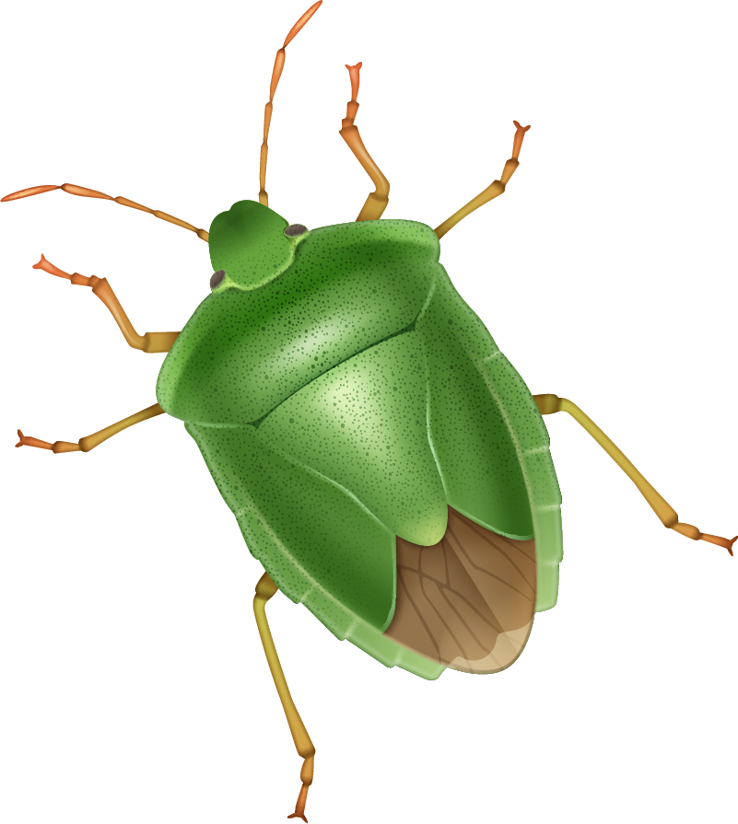
01.
Insects

Slide 4
5-10 million
75%
Estimated number of insect species
Percentage of animal species that are insects

Slide 5
Why Protect Insects?
Trends
Benefits

Slide 6
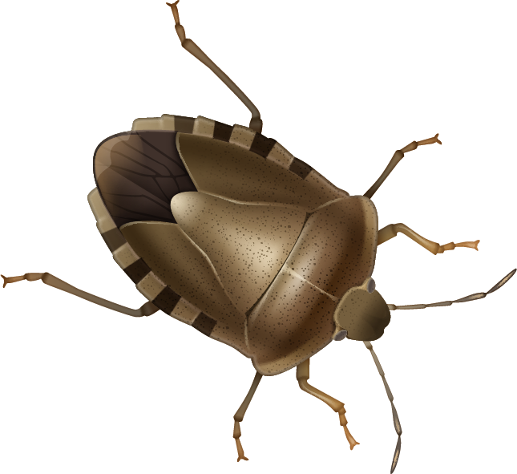
Trends
Butterflies
Dragonflies
19 out of 64 indigenous species went extinct during the 20th century in Flanders (BEL)
21 out of 64 evaluated species are threatened in Flanders (BEL)
Beetles
75% of ground beetles declined in Environmental Change Network, half of which declined more than 30% (UK)

Slide 7
Benefits
Ecosystem Services:
Pollination
Pest control
Dung burial
Wildlife nutrition
Losey and Vaughan: $60 billion in the US in 2006

Slide 8
02.
Insect Conservation

Slide 9
Historical Overview
1992
1997
2006
2013
Annex II
36 insects
54 insects
99 insects
100 insects
Annex IV
46 insects
46 insects
90 insects
91 insects

Slide 10
Observations
Low Number
Focus
Omissions
Underrepresented
in the Annexes
Beetles and butterflies
77% of II and 72% of IV
No bees, hoverflies, ants, etc.
Enlargement
Science
EU enlargement in 2006 and 2013
Only for scientific reasons in 1997

Slide 11
03.
Pesticides

Slide 12
Pesticides
Approval criteria for active substances
Authorisation requirements for
Plant protection products
Biocidal products
Supposed to consider animal species
However, in practice…
E.g. glyphosate

Slide 13
04.
The Future

Slide 14
05.
Methodology

Slide 15
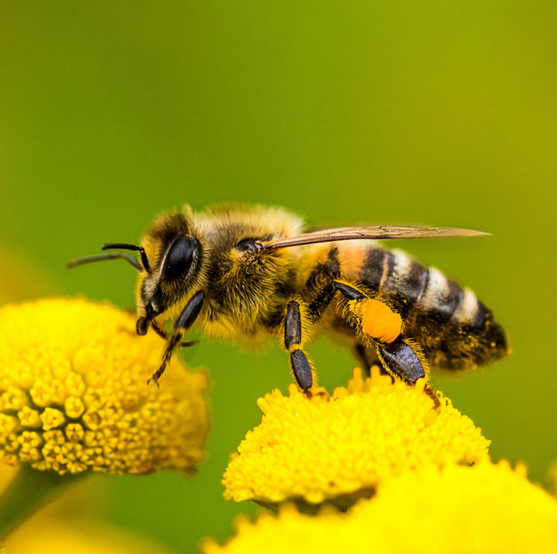
Research Objectives and Questions
Recommendatory Objective
How should insects be legally
protected in order to reflect their ecological functionality and necessity for the environment, other
species and humans?

Slide 16
Characteristics
Hierarchical
Specific and Framework
Order of ranking
Detailed rules and general guidelines
Facet
Focused on specific aspects of a legal construct

Slide 17
Normative Criteria
Internal
External
Derived from the legal system
Derived from other disciplines
Complexity
No Background
Information
A group characterized by abundance and diversity
Only a legal background, no scientific knowledge
There is a lack of scientifically viable and validated information

Slide 18
06.
Ecological Functionality

Slide 19
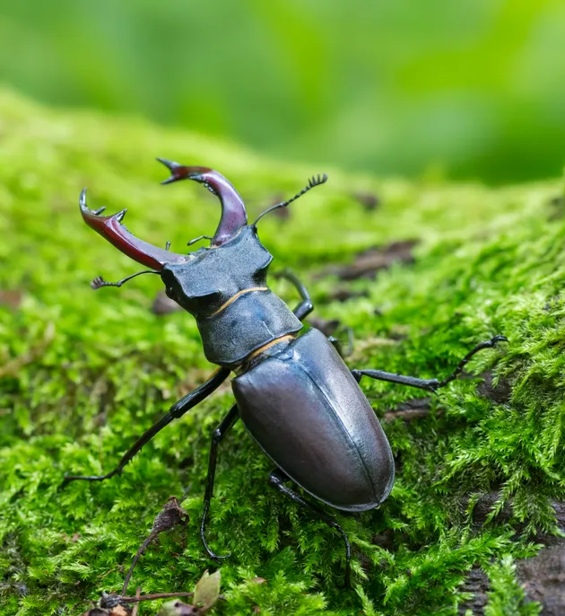
Ecological functionality
=a species interaction or ecological role whereby a species or group of species provide benefits to the environment, other species, and humans
Also a criterion in the IUCN Green List of recovered species

Slide 20
Statement 1
legal studies within environmental law should, to some extent, incorporate biology within their research methodology, especially when formulating a recommendation that should be scientifically sound and viable
Statement 2
the complexity of insect biology and ecology warrants a fortiori the integration of entomological-ecological criteria
Statement 3
the lack of an academic background in a discipline other than law does not hinder the adoption of an interdisciplinary research approach

Slide 21
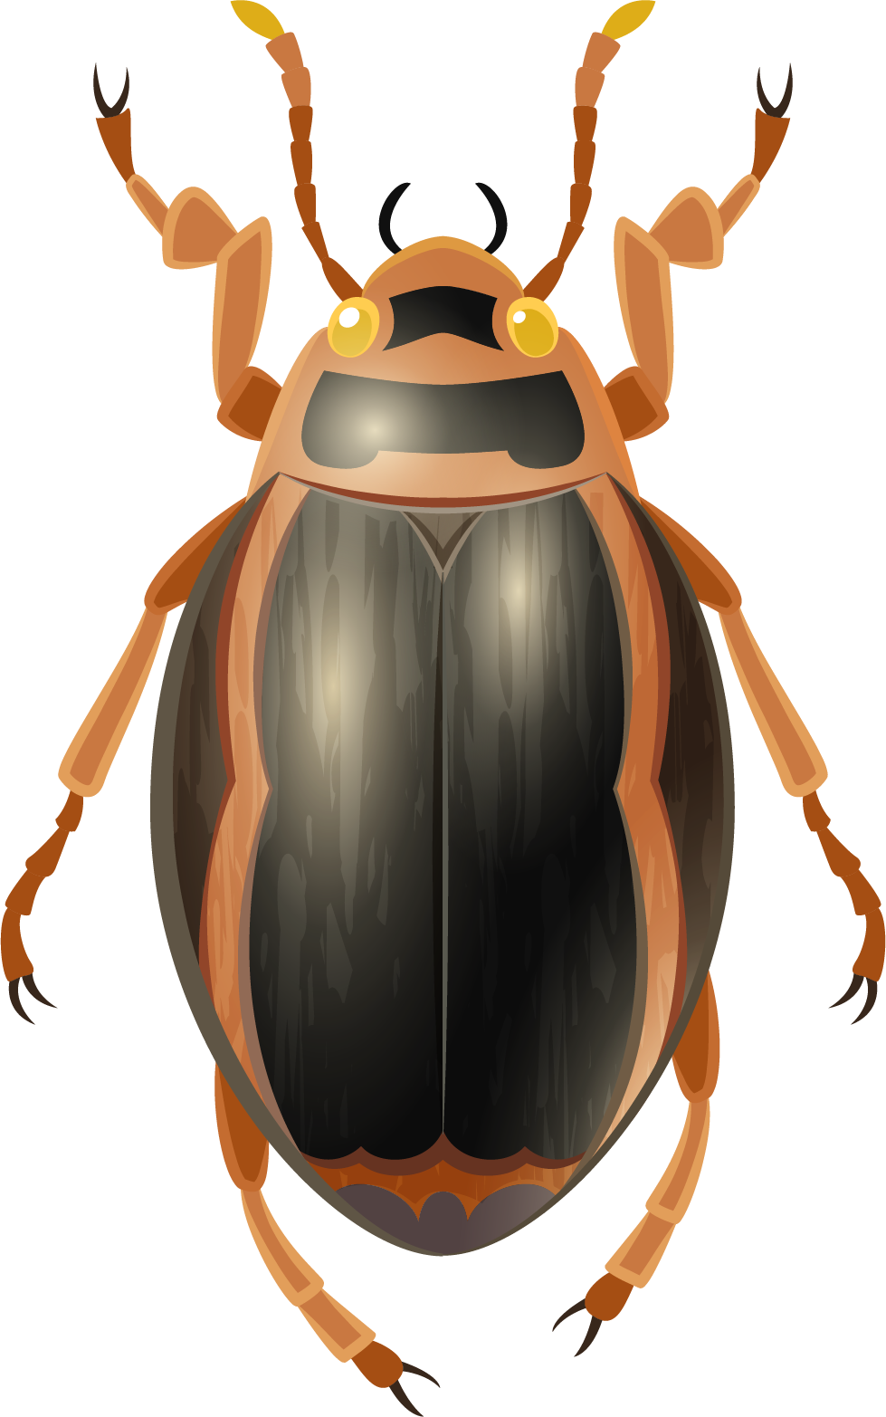
Thanks!
Do you have any questions?
Please keep this slide for attribution

