Slide 1
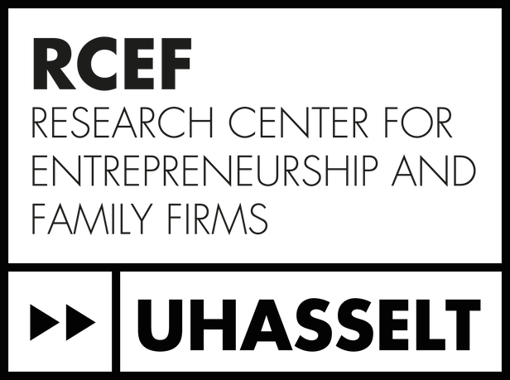


Strategic changes in family firms: The role of socioemotional wealth,
long-term orientation and TMT size
dr. Laura Hoekx (Hasselt University)
prof. dr. Rüveyda Kelleci (Open University Heerlen)
prof. dr. Wim Voordeckers (Hasselt University)
prof. dr. Pieter Vandekerkhof (Hasselt University)

Slide 2
Introduction
Strategic changes are indispensable for sustaining long-term organizational performance and long-term organizational survival
For family firms, socioemotional wealth (SEW) is a primary driver of strategic behavior
Findings on SEW and strategic change in family firms remain inconclusive
SEW is a multidimensional construct and family firms are heterogeneous in terms of the importance attached to different SEW dimensions
→ Thus, it is critical to use a multidimensional construct for SEW

Slide 3
Introduction: strategic change?
Definition: “Discrete changes in the extent and scope of a firm’s existing strategies in response to environmental changes” (Hermann & Nadkarni, 2014, p. 1320)
Examples of SC (based on measure Hermann & Nadkarni, 2014):
                (1) entries/exits in international markets
                (2) additions and eliminations of product lines or segments
                (3) new mergers and acquisitions completed
                (4) buying and selling of properties, plants, and equipment
                (5) increases or decreases in R&D expenditures

Slide 4
Introduction: SEW
Debicki et al.’s (2016) multidimensional SEW construct:
            Three SEW dimensions which family owners/managers attach importance to: (1) family prominence; (2) family continuity; and (3) family enrichment
            Specifically, dimension of interest “family prominence”:
                “Family prominence refers to the family's desire for public recognition and visibility through their ownership and control of the business. It reflects the importance placed on the family's reputation and prestige associated with the business (Debicki et al., 2016)”
→ “When and how does family prominence affect strategic change in family firms?”
Notes:
Family continuity and enrichment are “restrictive” forms of SEW (Miller & Le-Breton Miller, 2014)
→ “family-centric”: extracting funds from the business and using business resources to resolve family disputes leaving little room for strategic investments
Family prominence is an “extended” form of SEW (Miller & Le-Breton Miller, 2014)
→ satisfying stakeholders changing needs is important, strategic renewal is important for maintaining standing in the competitive market, social capital facilitates ability to change and innovate

Slide 5
Research model
+ H1
Long-term orientation
Initiation of strategic change
SEW (“family prominence”)
+ H2
+ H3
+ H4
TMT Size

Slide 6
Data collection
Part of a larger research project on “Strategic change in family firms” (collaboration between Hasselt University and University of Antwerp)
Data collected through questionnaire distributed among family firm CEOs in 2020-2021
Final sample = 348 Belgian family firms

Slide 7
Measures
SEW family prominence | Initiation of strategic change | Long-term orientation | TMT Size | Control variables
3 items of SEW scale of Debicki et al. (2016) | Measurement of Herrmann & Nadkarni (2014): indicate to which extent particular changes occurred in 2018 & 2019 | Measurement of Zellweger et al. (2012) | Number of TMT members | Firm size Firm age Industry Other 2 SEW dimensions (family continuity & family enrichment)

Slide 8
Preliminary findings
Results indicate:
No significant relationship (β = -0.056, p = 0.634) between family prominence and the initiation of strategic change (Hypothesis 1 X)
Significant positive relationship (β = 0.270, p < 0.01) between family prominence and long-term orientation (Hypothesis 2 ✔)
Significant positive relationship (β = 0.337, p < 0.01) between long-term orientation and the initiation of strategic change (Hypothesis 3 ✔)
Significant positive moderating effect of TMT size (β = 0.093, p < 0.10) (Hypothesis 4 ✔)

Slide 9
Post-hoc analysis
→ Distinction between “upscaling” (e.g., start exporting to new countries, adding new production lines, investing in additional assets) and “downscaling” (e.g., stop exporting to certain countries, closing production lines, selling assets) strategic changes.
→ Initial results can be mainly confirmed for “upscaling” part of strategic initiations and to a less extent for the “downscaling” part

Slide 10
Discussion
Positive indirect relationship between importance attached to SEW prominence and strategic change initiations, mediated by long-term orientation
→ unraveling the mechanisms explaining the relationship between SEW and strategic change
TMT size positively moderates this relationship
→ family firm’s capability to effectively translate long-term orientation into initiation of strategic changes depends on internal capabilities of their TMT

Slide 11
Thank you!
dr. Laura Hoekx (Hasselt University) (laura.hoekx@uhasselt.be)
prof. dr. Rüveyda Kelleci (Open University Heerlen)
prof. dr. Wim Voordeckers (Hasselt University)
prof. dr. Pieter Vandekerkhof (Hasselt University)

