Slide 1
Improving the Electrochemical Stability of Lithium‐Rich Cobalt‐Free Layered Oxides for Lithium‐Ion Batteries By Phase Engineering
Dries De Sloovere
October 9 2024 – Honolulu, HI, USA

Slide 2
Introduction
Why Co-free?
LIB technology for consumer EVs is dominated by cobalt-containing LiNi_{x}Mn_{y}Co_{z}O₂ chemistry.
Large reliance on Co:
High cost
Scarcity
Vulnerable global supply chain
Toxicity
Growing consensus to eliminate cobalt in high-energy-density cathode materials.
De Sloovere et al. Small, 2024.

Slide 3
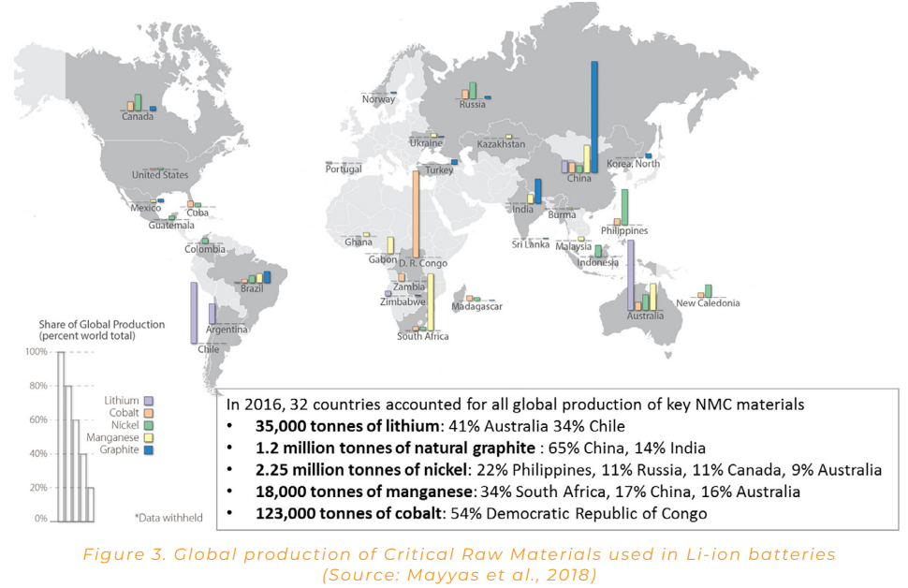

Slide 4
Introduction
Which material class?
Xiang et al. Adv Mater, 2022.

Slide 5
Introduction
Which material class?
NMC
Xiang et al. Adv Mater, 2022.

Slide 6
Introduction
Which material class?
NMC
LiFePO₄
Xiang et al. Adv Mater, 2022.

Slide 7
Introduction
Which material class?
NMC
LiFePO₄
Lithium-rich layered oxides
Xiang et al. Adv Mater, 2022.

Slide 8
Li-rich layered oxides
Combination of:
LiMO₂, rhombohedral
Lower capacity
TM redox
Li₂MnO₃, monoclinic
Higher capacity
TM redox
Oxygen redox
Li et al., Chem Sov Rev, 2019.

Slide 9
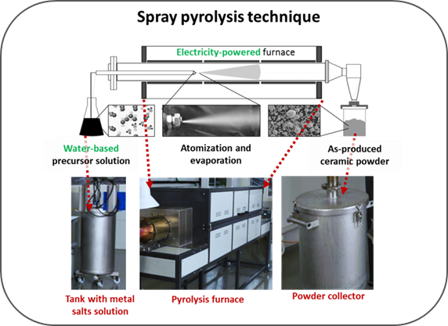
Synthesis

Slide 10
Synthesis
Sample | Nominal composition
LNMA0 | Li_{1.26}Ni_{0.15}Mn_{0.61}O₂
LNMA1 | Li_{1.26}Ni_{0.15}Mn_{0.60}Al_{0.01}O₂
LNMA5 | Li_{1.26}Ni_{0.15}Mn_{0.56}Al_{0.05}O₂
LNMA10 | Li_{1.26}Ni_{0.15}Mn_{0.51}Al_{0.1}O₂
Cobalt-free
Large Li excess
Increasing amount of Al

Slide 11
Electrochemical performance
Decrease in initial discharge capacity
Increase in capacity retention
Decrease in voltage fade
Can we figure out why Al doping improves the electrochemical stability?

Slide 12
POWDER CHARACTERISATION
AN INCOMPLETE IMAGE

Slide 13
X-ray diffraction
(001)_{M}
(003)_{R}
(104)_{R}
(131)_{M}
Si
(111)_{M}
(101)_{R}
Si
Rhombohedral and/or monoclinic?
Si
(020)_{M}
Materials are phase-pure
Data can be modeled as either a combination of rhombohedral and monoclinic phases, or as a monoclinic phase.

Slide 14
Raman spectroscopy
Rhombohedral and/or monoclinic?
Decrease in A_{1g} peak corroborates Al incorporation
~560 cm⁻¹: Al promotes formation of R phase
Incorporating more Al increases the rhombohedral character of the samples.

Slide 15
NMR spectroscopy
⁷Li and ⁶Li NMR
Increasing the extent of Al doping increases the amount of the rhombohedral phase in the samples.

Slide 16
Why is the stability improved?

Slide 17
POST MORTEM CHARACTERISATION
SHEDDING LIGHT ON DEGRADATION

Slide 18
Raman spectroscopy
Formation of a disordered spinel as degradation phase
Low capacity
Doesn’t allow to quantitatively study the effect of doping
Undoped
Doped

Slide 19
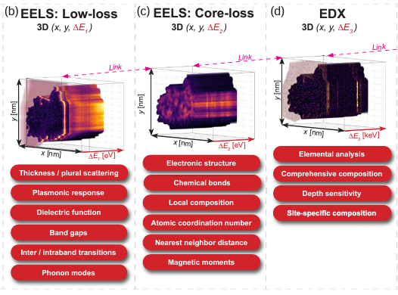
Hypermodel data fusion
An advanced TEM technique
Statistical technique (principle component analysis) allows to identify phases within the sample based on spectroscopy information
This allows to make abundance maps: location of the phases
Quantitative: fractional phase abundance
Thersleff & Tai, 2023.

Slide 20
Hypermodel data fusion
“
“
Three phases were identified:
Monoclinic phase
Rhombohedral phase
Disordered spinel

Slide 21
Hypermodel data fusion
“
“
“
“
Monoclinic phase
Rhombohedral phase
Disordered spinel

Slide 22
Hypermodel data fusion
“
“
“
“
“
Monoclinic phase
Rhombohedral phase
Disordered spinel

Slide 23
CONCLUSION

Slide 25
Acknowledgements
Satish Kumar Mylavarapu, Jan D’haen, Thomas Thersleff , Aleksander Jaworski, Jekabs Grins, Gunnar Svensson, Radostina Stoyanova, Leif Olav Jøsang, Kunkanadu Rajappa Prakasha, Maximiliano Merlo, Elías Martínez, Marc Nel‐lo Pascual, Jordi Jacas Biendicho, Marlies K. Van Bael, An Hardy,
This project has received funding from the European Union’s Horizon 2020 research and innovation programme under grant agreement No 875568

Slide 26
Improving the Electrochemical Stability of Lithium‐Rich Cobalt‐Free Layered Oxides for Lithium‐Ion Batteries By Phase Engineering
Dries De Sloovere
October 9 2024 – Honolulu, HI, USA

