Slide 1
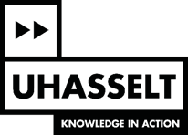
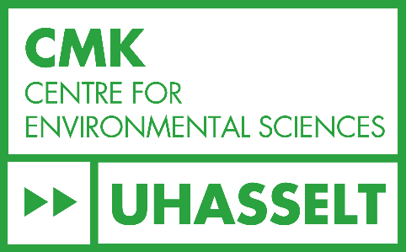
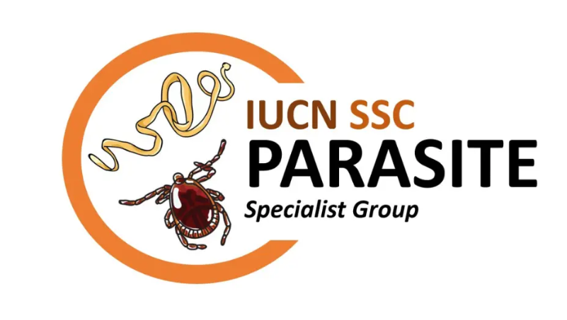
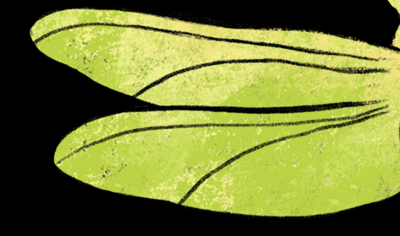
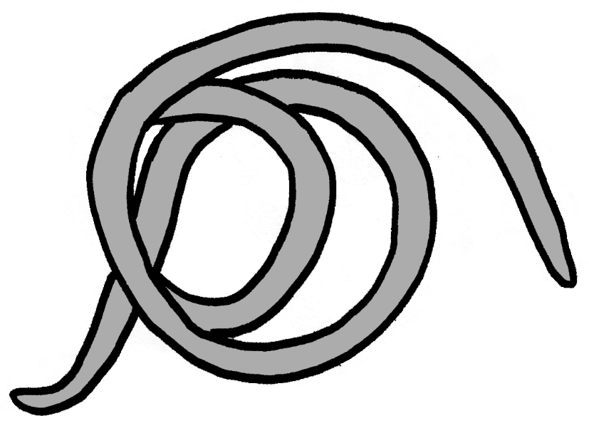
Ecosystem services of parasites and why should we care
Nikol Kmentová
Thanks to input from: Maarten Vanhove & Tiziana Gobbin
#RCF24ENCA
Notes:
Proud member of the PSG

Slide 2
MISSION
Assess extinction risks for metazoan parasites that use vertebrate hosts, a trophic group that is currently extremely underrepresented on the IUCN Red List. Additionally, our group aims to develop the first best practice guidelines and species recovery plans for threatened metazoan parasites that use vertebrate hosts and to broadly communicate the importance of parasite conservation.
#RCF24ENCA

Slide 3
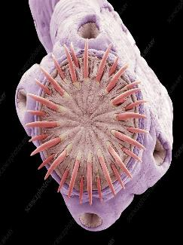
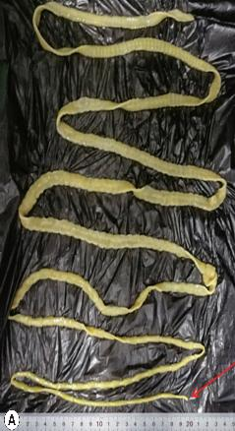
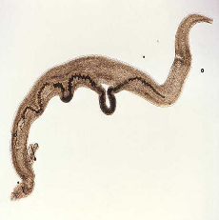
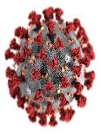
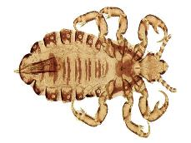
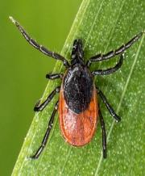
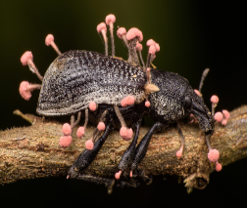
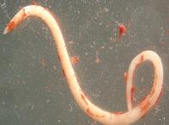
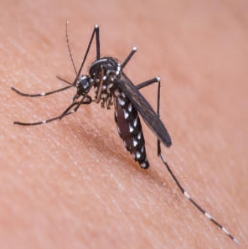
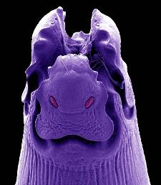
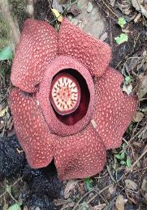
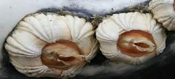
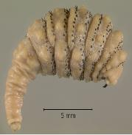
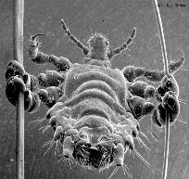
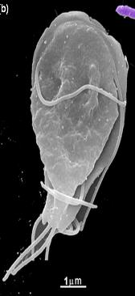
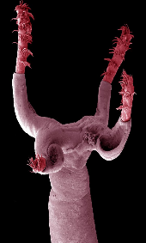
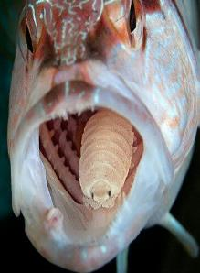
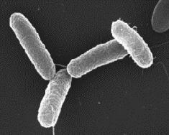
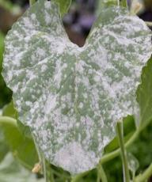
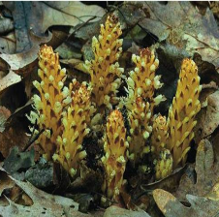
Parasite diversity
SCOPE
parasitic worms (Cestoda; Trematoda; Acanthocephala; Nematoda; Hirudinea), parasitic insects (Phthiraptera; Siphonaptera; Hippoboscoidea; Oestridae; Polyctenidae; Cimicidae), and parasitic arachnids (Ixodida; Acariformes)
Parasites make more than 50% of worldwide biodiversity
#RCF24ENCA

Slide 4
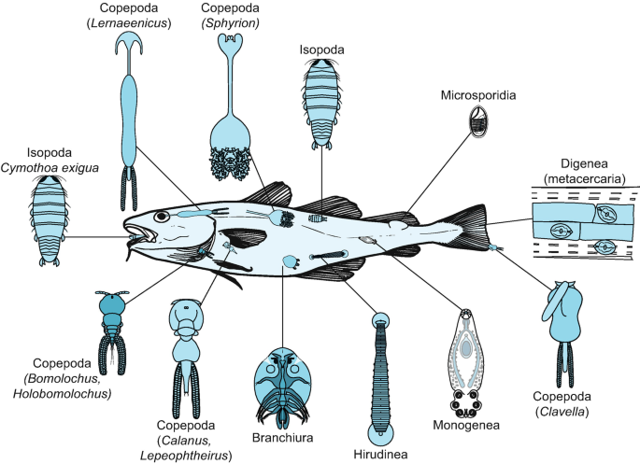
Parasite diversity
SCOPE
parasitic worms (Cestoda; Trematoda; Acanthocephala; Nematoda; Hirudinea), parasitic insects (Phthiraptera; Siphonaptera; Hippoboscoidea; Oestridae; Polyctenidae; Cimicidae), and parasitic arachnids (Ixodida; Acariformes)
#RCF24ENCA

Slide 5
Parasite diversity
SCOPE
parasitic worms (Cestoda; Trematoda; Acanthocephala; Nematoda; Hirudinea), parasitic insects (Phthiraptera; Siphonaptera; Hippoboscoidea; Oestridae; Polyctenidae; Cimicidae), and parasitic arachnids (Ixodida; Acariformes)
Parasites make more than 50% of worldwide biodiversity
#RCF24ENCA

Slide 6
Parasite diversity
parasites of medical or veterinary importance are excluded
Parasites make more than 50% of worldwide biodiversity
#RCF24ENCA

Slide 7
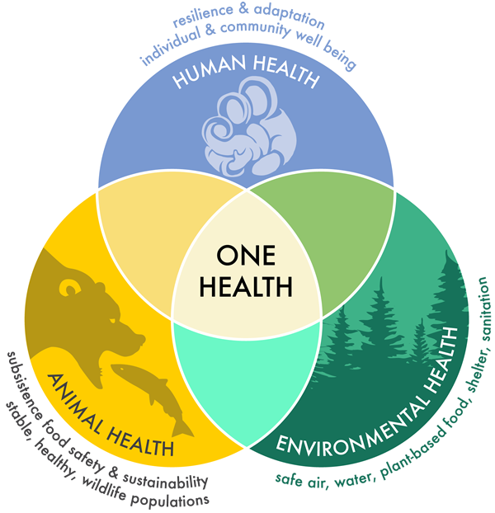
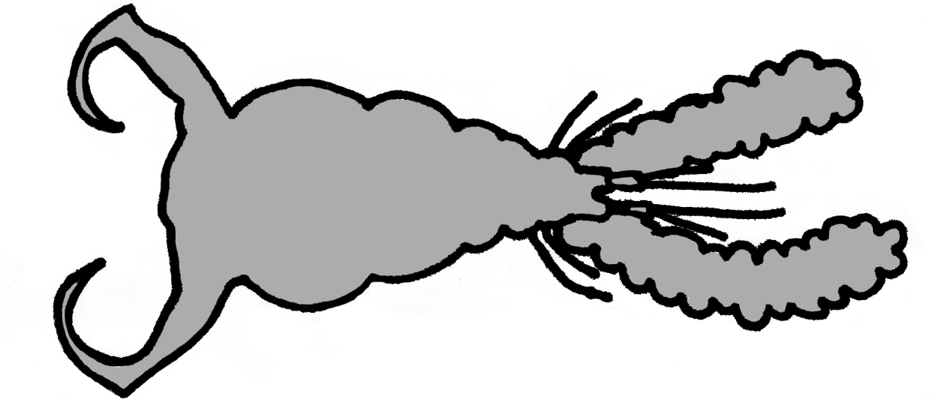
Parasitology & One Health
#RCF24ENCA
Notes:
They keep the balance!

Slide 8
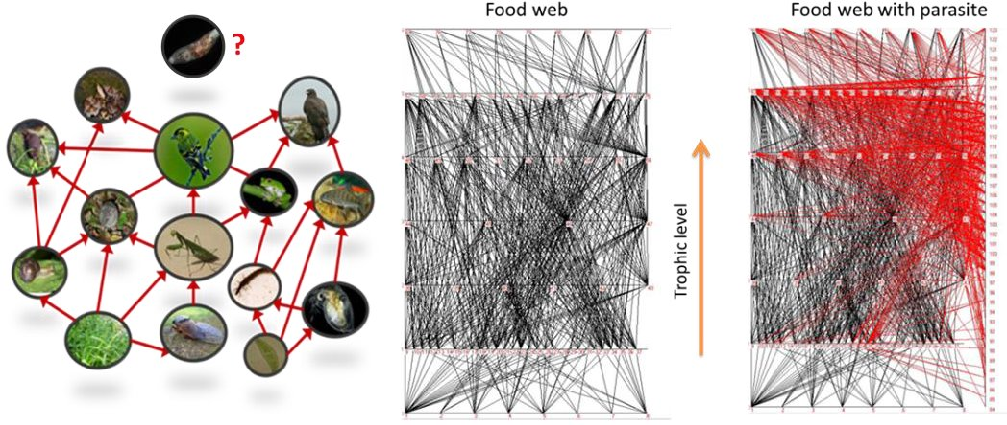
Parasitology & One Health
Hudson et al 2006, Trends in Ecology and Evolution
75% of the links in food webs involve a parasitic species
#RCF24ENCA

Slide 9
Parasitology & One Health
Hudson et al 2006, Trends in Ecology and Evolution
75% of the links in food webs involve a parasitic species
#RCF24ENCA
Notes:
A food web diagram of the Carpinteria Salt Marsh. Lines connect a consumer with a consumed species. Free-living species are arranged horizontally, with trophic level increasing along the left-hand y-axis. Predators are connected to their prey at different trophic levels (blue arrows). Parasites, arranged on the right-hand y-axis, are linked to their hosts (red arrows). This illustrates the complexity that is added to traditional food webs by the addition of parasites.

Slide 10
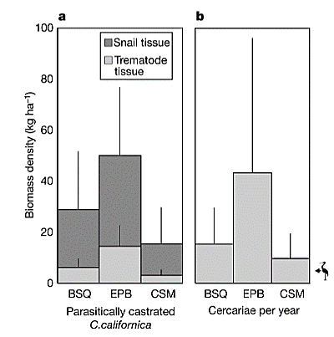
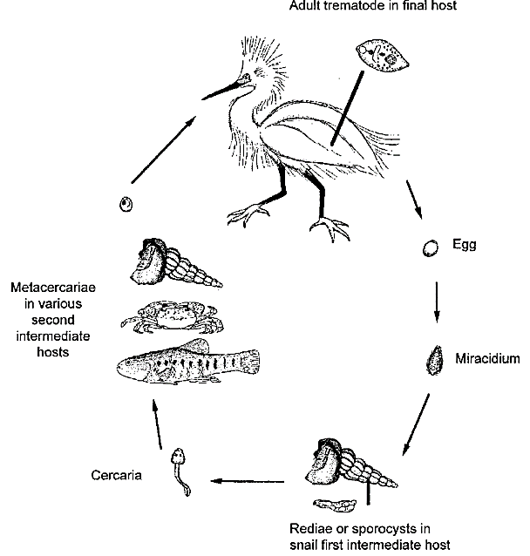
Parasitology & One Health
Parasite importance in biomass and trophic links
144kg/ha
Cerithidea californica
Kuris et al 2008, Nature Letters
Parasites comprise a substantial fraction of the biomass and production in the ecosystems
#RCF24ENCA

Slide 11
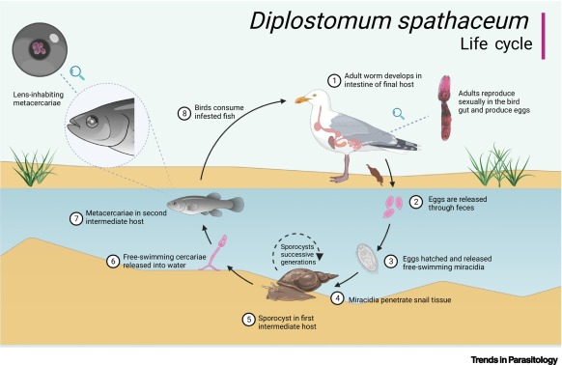
Parasites as tags for ecosystem health
Life-cycle complexity as a tool for biodiversity monitoring
#RCF24ENCA
Notes:
By nature of dependencies on their hosts, parasites can reveal unseen/rarely detectable hosts as part of the ecosystem health monitoring and biodiversity status

Slide 12
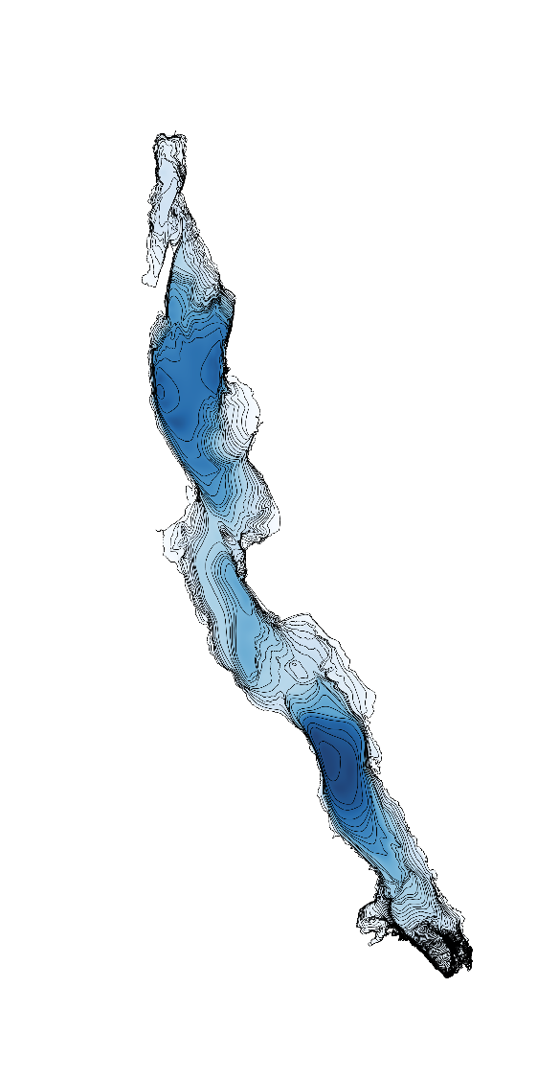
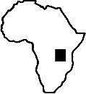
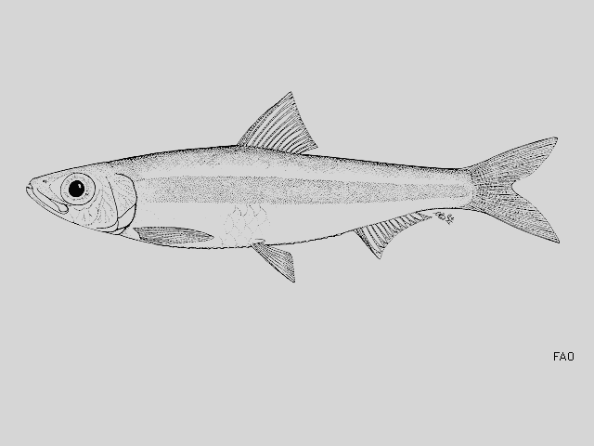
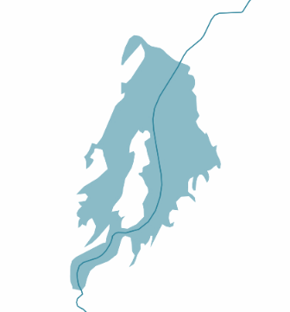
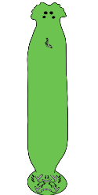
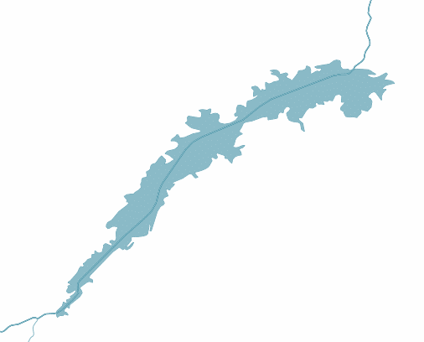
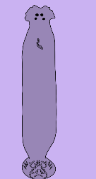
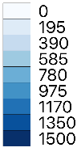
Parasites as tags for introduction pathways
Kmentova et al 2019, Biol. Invasions
Kmentova et al 2024, Oikos
Population dynamics of parasites reveal introduction pathways of their hosts
#RCF24ENCA
Notes:
By nature of dependencies on their hosts, parasites can reveal unseen/rarely detectable hosts as part of the ecosystem health monitoring and biodiversity status

Slide 13
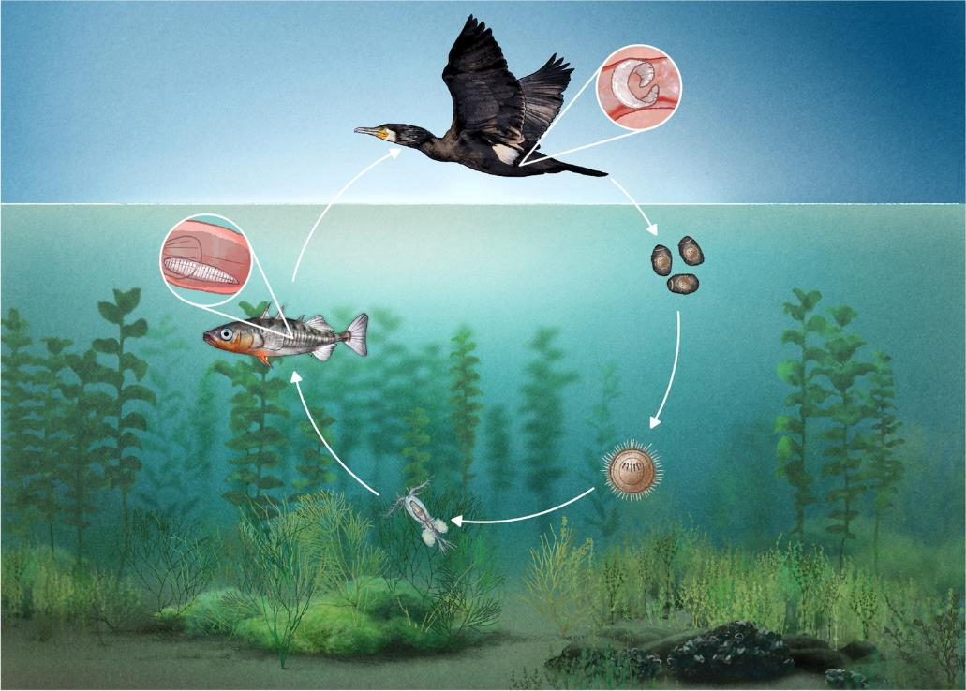
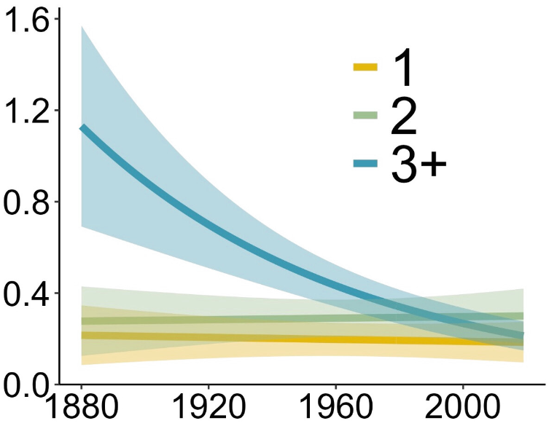
Parasites more threatened than their hosts
count
Baer et al 2022, Parasitol. Res.
Wood et al 2023, PNAS
#RCF24ENCA

Slide 14
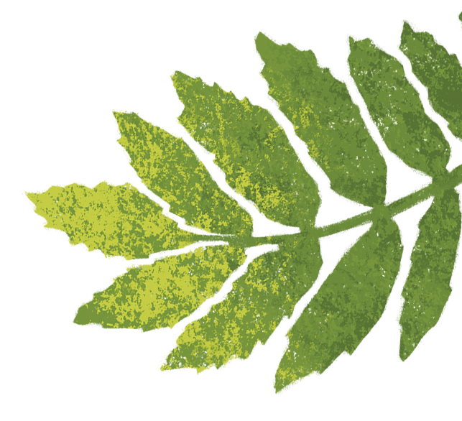
Thank you
@BiTE_UHasselt
@KmentovaNikol
nikol.kmentova@uhasselt.be
#RCF24ENCA

