Slide 1


Driver Preferences for Investment in Flexible Electric Vehicle Charging
2 July 2025
Brian Fowler, Steven Van Passel, Pieter Valkering, Sebastien Lizin

Slide 2
Highlights
Flexibility discount rate gap – the average driver applies a higher discount rate (28.5%) to a flexibility investment compared to financial assets
Adopting solar charging, dynamic load management, and vehicle to home and grid increases utility
The majority of drivers (~80%) open to upgrading their charger and derive utility from aforementioned charging features – applies lower discount rate (23%) compared to the sample average.

Slide 3
Literature
Consumers apply high discount rates to investment in energy efficient appliance – considering purchase price and long-term energy bill savings
  E.g. ~ 20% for energy efficient air conditioners according to seminal work by Hausman (1979)
  Between 11-13% for energy efficient heating per Schleich et al. (2022)
High implicit discount rates factor in risk perception or quality/convenience concerns
How do consumers discount energy bill savings from flexibility, rather than efficiency?
Why EVs?
Large demand – European ban on sale of petroleum-powered engines by 2035
Most drivers prefer to charge in the evening (Baek et al. 2024; Langbroek et al., 2017) – potentially exacerbating peak loads
Could also be used as a grid asset – with bidirectional charging potential

Slide 4
Survey sample
905 total with 769 quality survey-takers
  Filter out logically inconsistent responses, outlier (unrealistic) data, or signs of inattention
Survey-takers recruited and paid by a professional survey company
Must live in Belgium and have a driver’s license
Sample representative of Belgian population by age, gender, and region
Administered in Dutch, French, and English

Slide 5
EV charger adoption choice context
Assume that you own an electric car
If you had an EV, your total electric bill spending would be about X euros (calculated based on existing expenditure and daily average driving distance)
  Information given on how charging features save money based on billing structures (specific to survey-taker’s region)
You have a simple charger that works like your phone or laptop charger – charging immediately at full speed once it is plugged in
Upgrading to an advanced charger would offer electricity bill savings.
Your new charger would last for ten years
There are four advanced charging features to consider

Slide 6
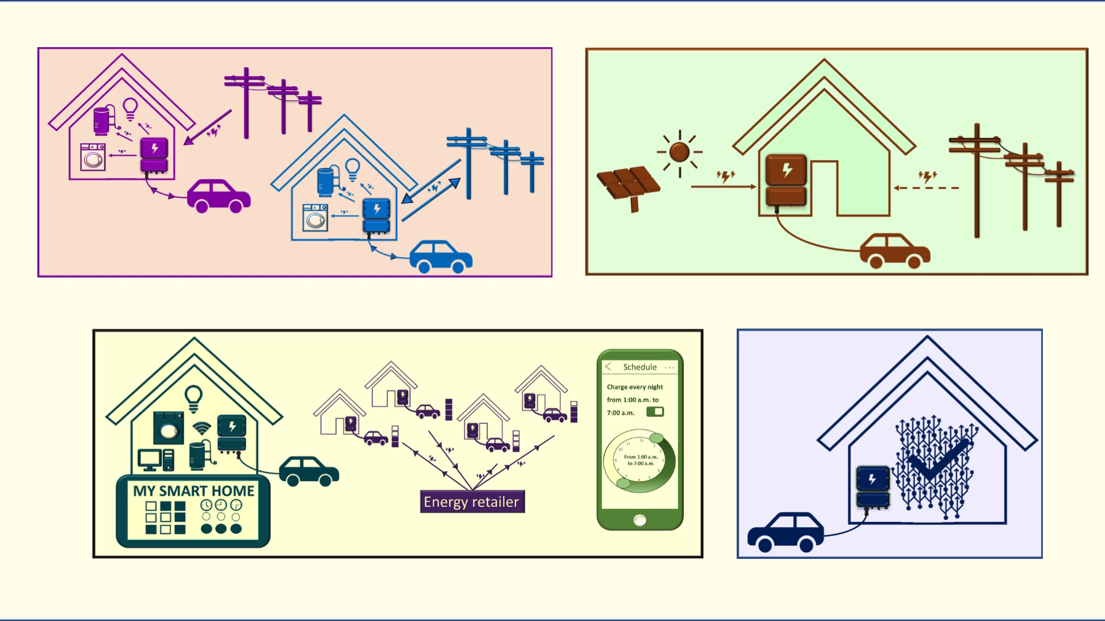

Slide 7
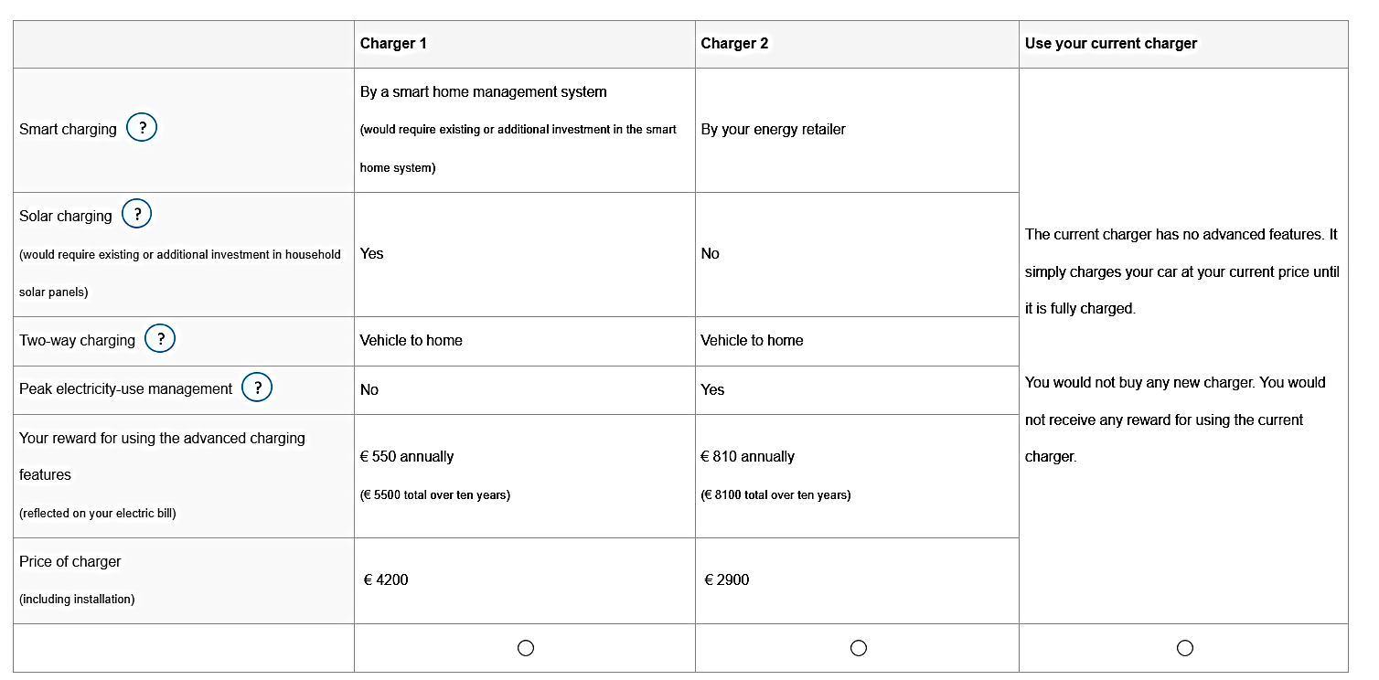
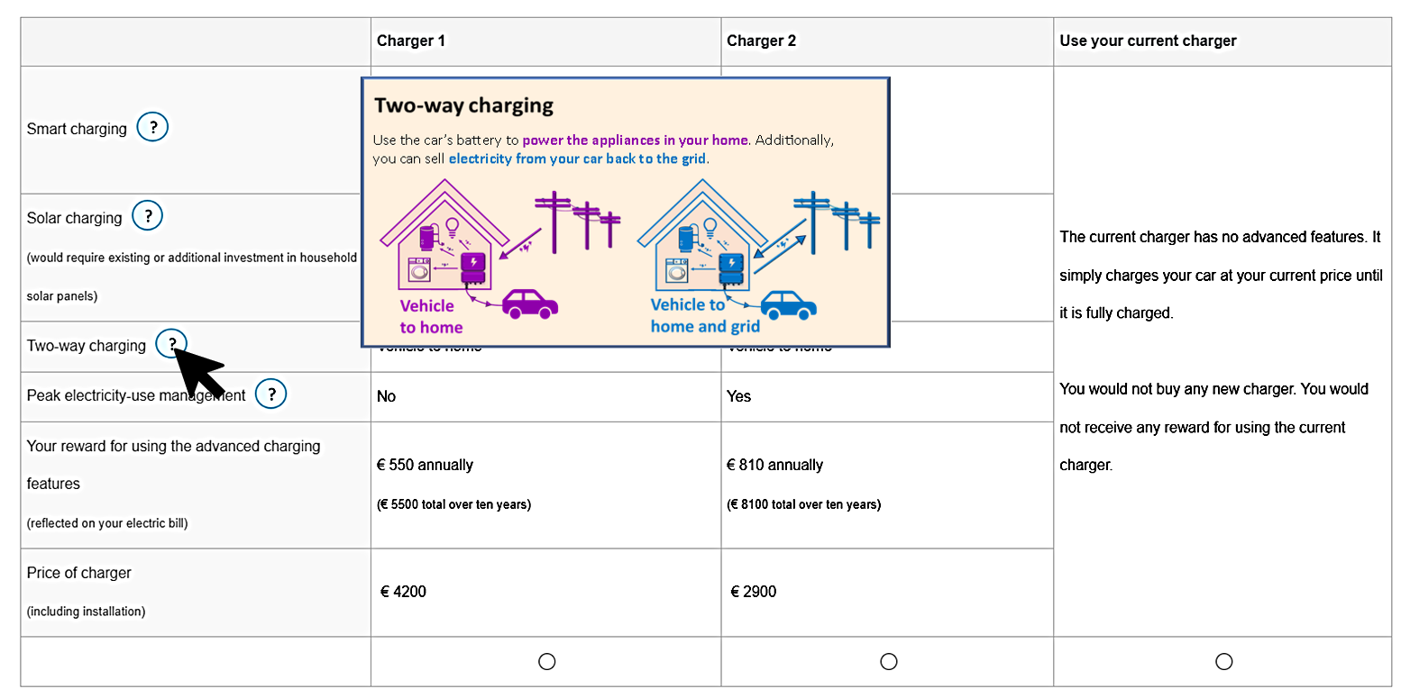
Sample choice card
If you drove an EV, would you buy a charger that has advanced charging features?

Slide 8
Sample choice card
If you drove an EV, would you buy a charger that has advanced charging features?

Slide 9
Attribute table
Annual reward for using charging features
Base attribute-level
(represents the reference point or default option for comparison)

Slide 10
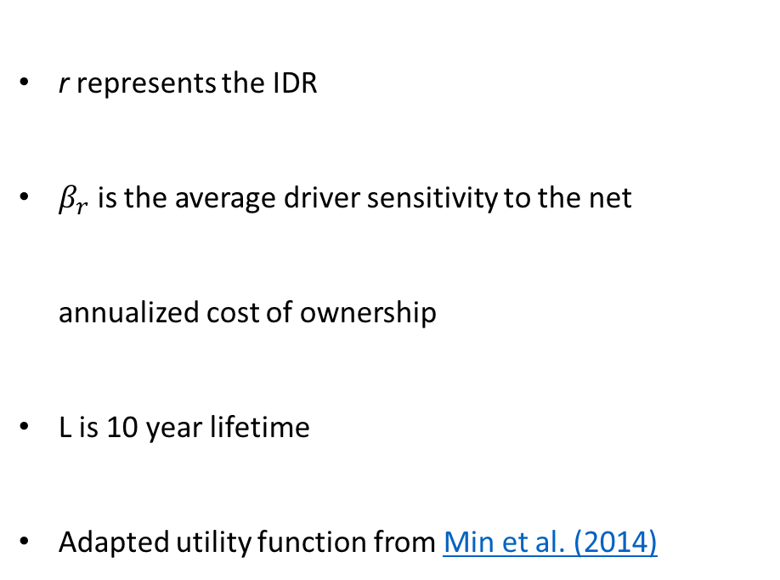
Model specification
$$V_{ij}=\sum_{k∈F}{}\left(β_{k}+σ_{k}v_{ik}\right)X_{ijk}+β_{r}\left(\frac{{r\left(1+r\right)}^{L}}{{r\left(1+r\right)}^{L}−1}∗\frac{{Price}_{ij}}{1000} − \frac{Annual {reward}_{ij}}{1000}\right)$$
V_{ij} is 1 if individual i chooses alternative j, 0 otherwise
X_{ijk}​​​ denotes the level of feature k
β_{k}​​​ reflects the population mean utility
σ_{k}​v_{ik} ​captures individual-level deviations
  Feature preferences vary across individuals - using simulated maximum likelihood estimation
r represents the IDR
$β_{r}$ is the average driver sensitivity to the net annualized cost of ownership
L is 10 year lifetime
Adapted utility function from Min et al. (2014)
Notes:
I make some assumptions about the distribution of preferences a mu and a sigma.
I draw from that distribution a bunch of times for each individual.
For each individual for each draw, I calculate the probability of matching the actual choice.
I take the average across each individual and then sum the probabilities per individual.
I take the log of that sum.
I do that many times for different parameters (mu and sigma) and then use the distributional assumptions that maximize the log-likelihood of matching the observations. Is that right?

Slide 11
Utilities and IDR estimation
28.5% discount rate
Utility gained from adopting three charging features
Significant heterogeneity from charging features

Slide 12
Utilities and IDR estimation
28.5% discount rate
Utility gained from adopting three charging features
Significant heterogeneity from charging features

Slide 13
Utilities and IDR estimation
28.5% discount rate
Utility gained from adopting three charging features
Significant heterogeneity from charging features

Slide 14

Utilities and IDR estimation
$P=\frac{exp⁡(β_solar)}{1+\exp\left(β_solar\right)}$ ≈ 0.605
P = The average probability of a survey-taker choosing a charger with solar charging over a baseline charger with no features

Slide 15
Utilities and IDR estimation
28.5% discount rate
Utility gained from adopting three charging features
Significant heterogeneity from charging features

Slide 16
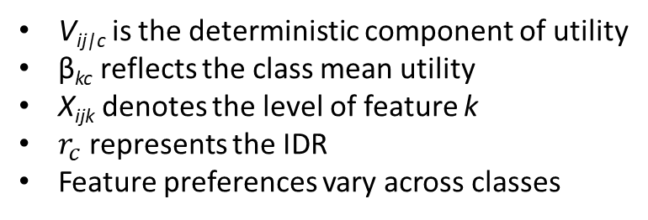
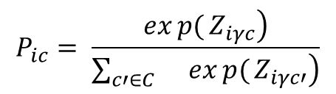
Model specification – Latent class analysis
$V_{ij|c}=\sum_{k∈F}{}\left(β_{kc} X_{ijk}\right)$ + $β_{r_{c}}\left(\frac{{r_{c}\left(1+r_{c}\right)}^{L}}{{r_{c}\left(1+r_{c}\right)}^{L}−1}∗\frac{{Price}_{ij}}{1000} − \frac{Annual {reward}_{ij}}{1000}\right)$
V_{ij|c} is the deterministic component of utility
β_{kc}​​​ reflects the class mean utility
X_{ijk}​​​ denotes the level of feature k
$r_{c}$ represents the IDR
Feature preferences vary across classes
$$P_{ic}= \frac{\left.exp{(}Z_{iγc}\right)}{\left.\sum_{c′∈C}{}exp{(}Z_{iγc′}\right)}$$
P_{ic} is the probability that individual i belongs to class c, Z_{i}​ ​ is a vector of observed covariates
Notes:
In the latent class model, I assume that the sample is made up of a distinct preference types. For each individual, I estimate how likely they are to belong to each type based on how well each class explains their observed choices

Slide 17
Latent Class Utilities and IDR estimation
79.86% of people in the majority class
23% discount rate amongst the majority latent class
Positive constant terms and feature coefficients for majority class

Slide 18
Latent Class Utilities and IDR estimation
79.86% of people in the majority class
23% discount rate amongst the majority latent class
Positive constant terms and feature coefficients for majority class

Slide 19
Latent Class Utilities and IDR estimation
79.86% of people in the majority class
23% discount rate amongst the majority latent class
Positive constant terms and feature coefficients for majority class

Slide 20
Latent Class Utilities and IDR estimation
79.86% of people in the majority class
23% discount rate amongst the majority latent class
Positive constant terms and feature coefficients for majority class

Slide 23
Notes:
Used the results of the first experiment to make a D-efficient experimental design, which means that we can improve the amount of information we get from the DCE.
Could use the last points here to speculate a bit on whether expectations can change adoption behavior.
For example, if expectations of high price variability correlates with a preference for smart charging, then it might be a good idea to publicize plans for dynamic tariffs.

Slide 24
Implications
Households discount energy bill savings highly – similar for flexibility as for efficiency
  Indicates risk or inconvenience associated with flexible charging
Gillingham and Palmer (2013) argue that subsidies and financing programs can be justified in such scenarios for energy efficient appliances
  Results point to less expensive interventions to lower risk/inconvenience
    Improving customer service with retailers to build trust – billing transparency, accuracy, communication
    Credible expectations of time-of-use pricing or higher prices/kWh
    Mitigate range anxiety (e.g. public charging infrastructure or minimum battery level)
Targeted intervention toward younger and better educated households amongst the majority of drivers

Slide 25
References
Baek, K., Lee, E. and Kim, J., 2024. A dataset for multi-faceted analysis of electric vehicle charging transactions. Scientific Data, 11(1), p.262.
Gillingham, K. and Palmer, K., 2013. Bridging the energy efficiency gap. Resources for the Future discussion paper, pp.13-02. Available at: https://www.rff.org/publications/working-papers/bridging-the-energy-efficiency-gap/.
Langbroek, J.H., Franklin, J.P. and Susilo, Y.O., 2017. When do you charge your electric vehicle? A stated adaptation approach. Energy Policy, 108, pp.565-573.
Hausman, J.A., 1979. Individual discount rates and the purchase and utilization of energy-using durables. The bell journal of economics, pp.33-54. https://www.jstor.org/stable/3003318.
Min, J., Azevedo, I.L., Michalek, J. and de Bruin, W.B., 2014. Labeling energy cost on light bulbs lowers implicit discount rates. Ecological Economics, 97, pp.42-50. https://doi.org/10.1016/j.ecolecon.2013.10.015.
Schleich, J., Guetlein, M.C., Tu, G. and Faure, C., 2022. Household preferences for private versus public subsidies for new heating systems: insights from a multi-country discrete choice experiment. Applied Economics, 54(37), pp.4292-4309. https://doi.org/10.1080/00036846.2022.2030043.

Slide 26
Thank you!
Straatnaam nr
postcode gemeente
info@alexander.be
www.alexander.be

