Slide 1
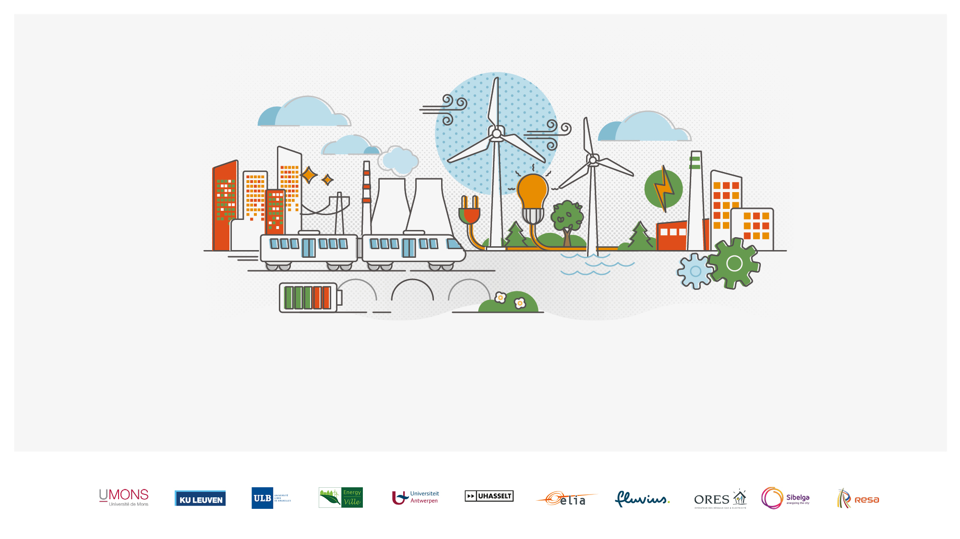

What Drives Energy Sharing and Flexible Demand? Survey Evidence from Belgium
Brian Fowler
Dr. Maíra Finizola e Silva
September 2025
Notes:
(BRIAN)
Introduce ourselves

Slide 2
Purpose
Survey results on what motivates households to join energy communities, what holds others back, and how participation shapes reported energy use.
Co-create recommendations from audience experience
Notes:
(BRIAN)

Slide 3
INTRODUCTION
Notes:
/

Slide 4
Energy sharing benefits per Gjorgievskia et al. (2021)
💶 Economic gains: lower costs, faster payback
🌍 Greener energy: more renewable production & lower emissions
👥 Community value: stronger ties, shared responsibility, empowerment
🏛️ Democratic governance: citizen participation & transparency
⚡ Flexibility & infrastructure: local use, storage, grid support
Notes:
(BRIAN)
Main Idea is to build off of this research to find the most important motivations and perhaps to expand the list of benefits of energy sharing.

Slide 5
Energy sharing benefits per Gjorgievskia et al. (2021)
💶 Economic gains: lower costs, faster payback
🌍 Greener energy: more renewable production & lower emissions
👥 Community value: stronger ties, shared responsibility, empowerment
🏛️ Democratic governance: citizen participation & transparency
⚡ Flexibility & infrastructure: local use, storage, grid support
Which motivations are most important for households?
Notes:
Policy design & incentives
Policymakers need to know whether people are motivated mainly by cost savings, environmental goals, or community belonging. This helps target subsidies, regulations, or awareness campaigns to what actually drives adoption.
Tailored communication strategies
If financial motives dominate, communication should stress savings and returns.
If environmental or social motives matter more, messages should highlight carbon reduction and community benefits.
Community recruitment & retention
Energy communities and local initiatives can design recruitment strategies based on the top motivators.
Understanding drivers helps them keep members engaged and reduce dropout

Slide 6
Energy sharing benefits per Gjorgievskia et al. (2021)
💶 Economic gains: lower costs, faster payback
🌍 Greener energy: more renewable production & lower emissions
👥 Community value: stronger ties, shared responsibility, empowerment
🏛️ Democratic governance: citizen participation & transparency
⚡ Flexibility & infrastructure: local use, storage, grid support
Which motivations are most important for households?
What are the barriers?
Notes:
(BRIAN)
These are some of the (expected) benefits of energy sharing projects, but we were particularly interested in:
which of these benefits drives people to join EC?
And does being an EC member make you change your energy consumption behaviour? (link to second research question)

Slide 7
Energy sharing benefits per Gjorgievskia et al. (2021)
💶 Economic gains: lower costs, faster payback
🌍 Greener energy: more renewable production & lower emissions
👥 Community value: stronger ties, shared responsibility, empowerment
🏛️ Democratic governance: citizen participation & transparency
⚡ Flexibility & infrastructure: local use, storage, grid support
Which motivations are most important for households?
What are the barriers?
Can we add flexible energy use? (off-peak use and self-consumption)
Notes:
(BRIAN)
These are some of the (expected) benefits of energy sharing projects, but we were particularly interested in:
which of these benefits drives people to join EC?
And does being an EC member make you change your energy consumption behaviour? (link to second research question)

Slide 8
Theoretical reasons: energy sharing → flexible energy use
Social norms & community identity
Possibility of monitoring effects
Solar PV access and electric bill savings
Environmental identity & pro-social motives
Notes:
(BRIAN)
These are some of the (expected) benefits of energy sharing projects, but we were particularly interested in:
which of these benefits drives people to join EC?
And does being an EC member make you change your energy consumption behaviour? (link to second research question)

Slide 9
Theoretical reasons: energy sharing → flexible energy use
Social norms & community identity
Possibility of monitoring effects
Solar PV access and electric bill savings
Environmental identity & pro-social motives
Main Idea: economic and non-economic incentives for flexible demand may increase
Notes:
(BRIAN)
These are some of the (expected) benefits of energy sharing projects, but we were particularly interested in:
which of these benefits drives people to join EC?
And does being an EC member make you change your energy consumption behaviour? (link to second research question)

Slide 10
METHODS
Notes:
/

Slide 11
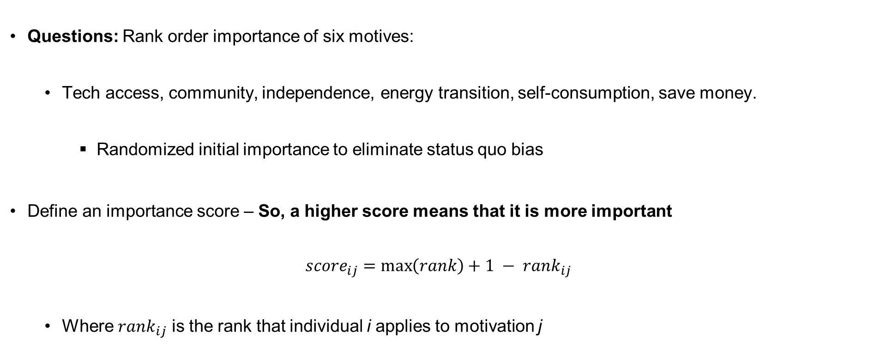
Rank most important motivations for energy sharing
Questions: Rank order importance of six motives:
  Tech access, community, independence, energy transition, self-consumption, save money.
    Randomized initial importance to eliminate status quo bias
Define an importance score – So, a higher score means that it is more important
$${score}_{ij}=\max\left(rank\right)+1 − {rank}_{ij}$$
  Where ${rank}_{ij}$ is the rank that individual i applies to motivation j
Notes:
(BRIAN)

Slide 12
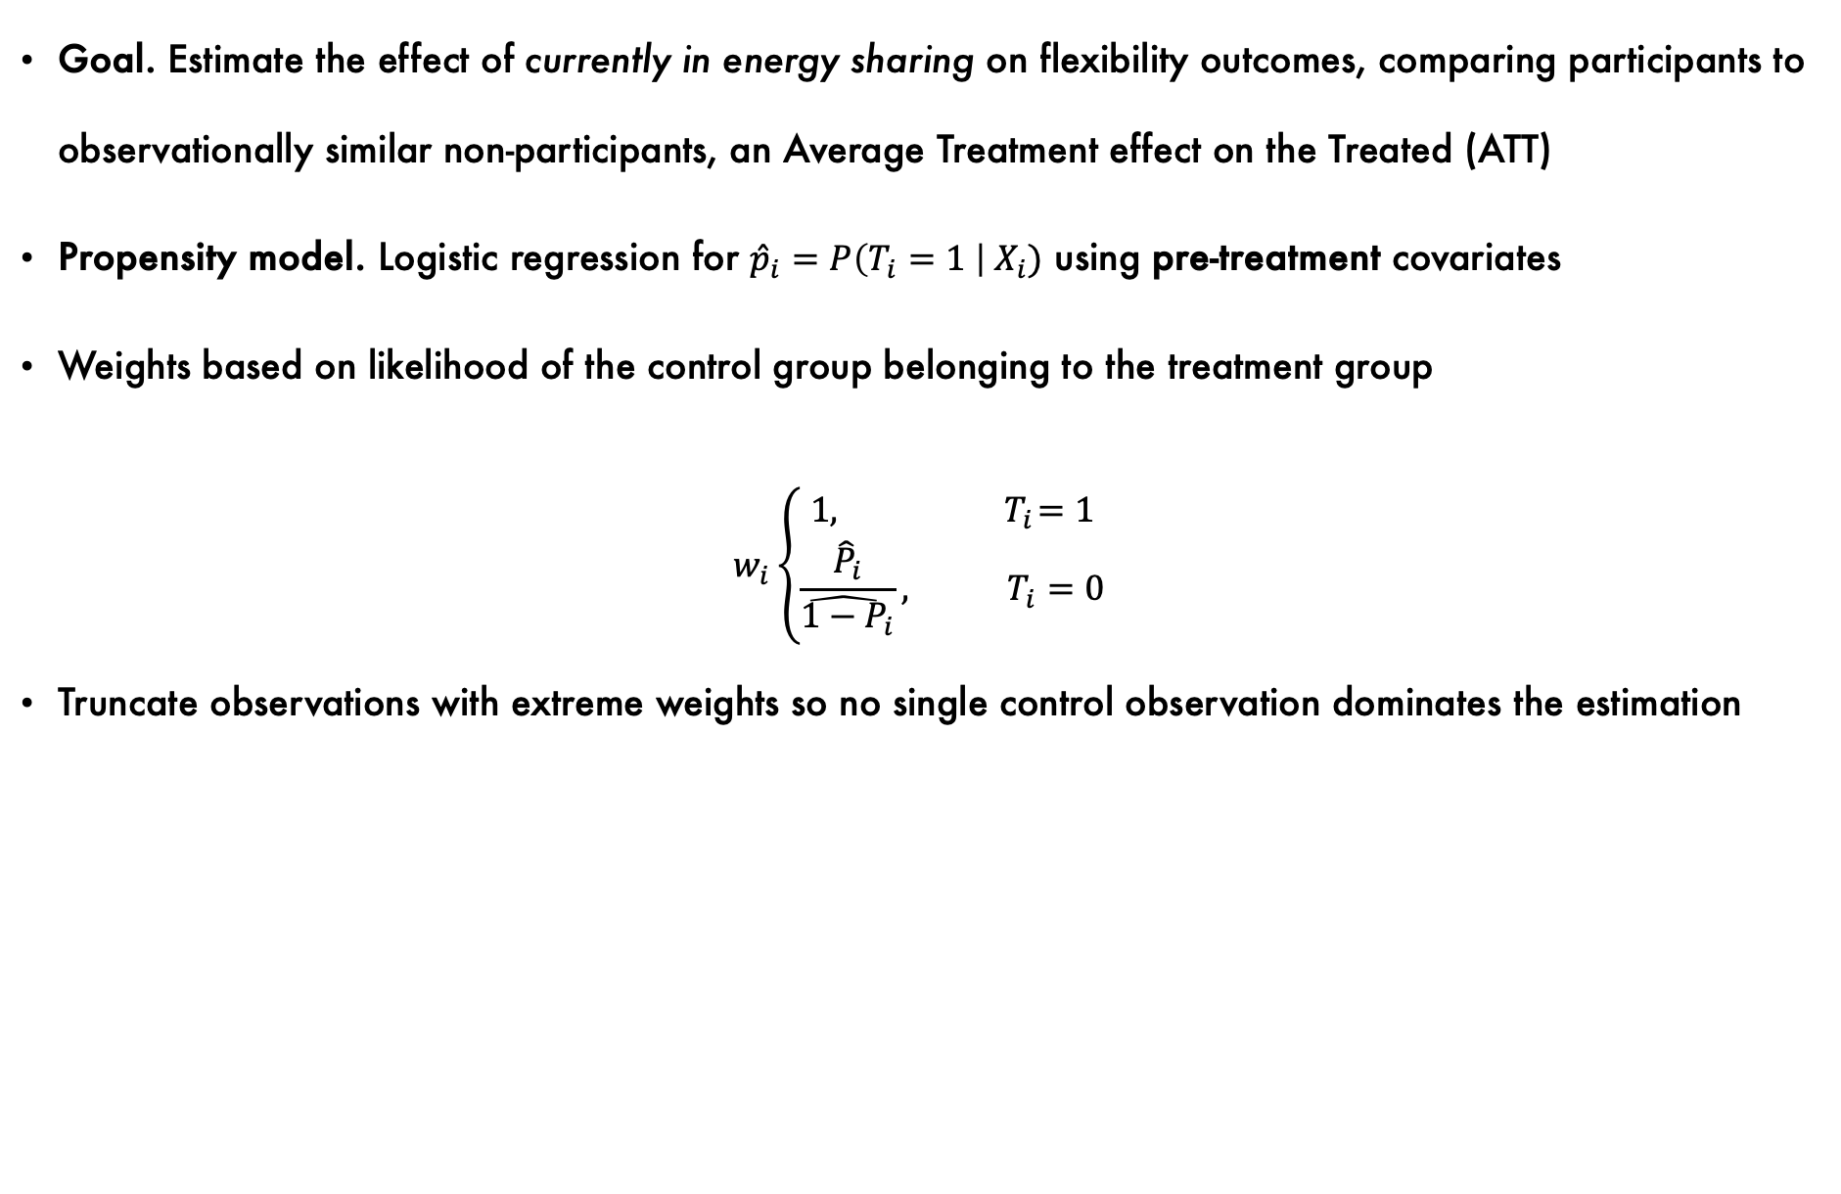
Inverse probability weighting for effect of energy sharing on reported energy use
Goal. Estimate the effect of currently in energy sharing on flexibility outcomes, comparing participants to observationally similar non-participants, an Average Treatment effect on the Treated (ATT)
Propensity model. Logistic regression for ${\hat{p}}_{i}=P\left(T_{i}=1 \right| X_{i})$ using pre-treatment covariates
Weights based on likelihood of the control group belonging to the treatment group
$$w_{i}\left\{\begin{aligned}1, { T}_{i}=1 \\ \frac{{\hat{P}}_{i}}{{\hat{1−P}}_{i}}, T_{i}=0\end{aligned}\right.$$
Truncate observations with extreme weights so no single control observation dominates the estimation
Notes:
(BRIAN)

Slide 13
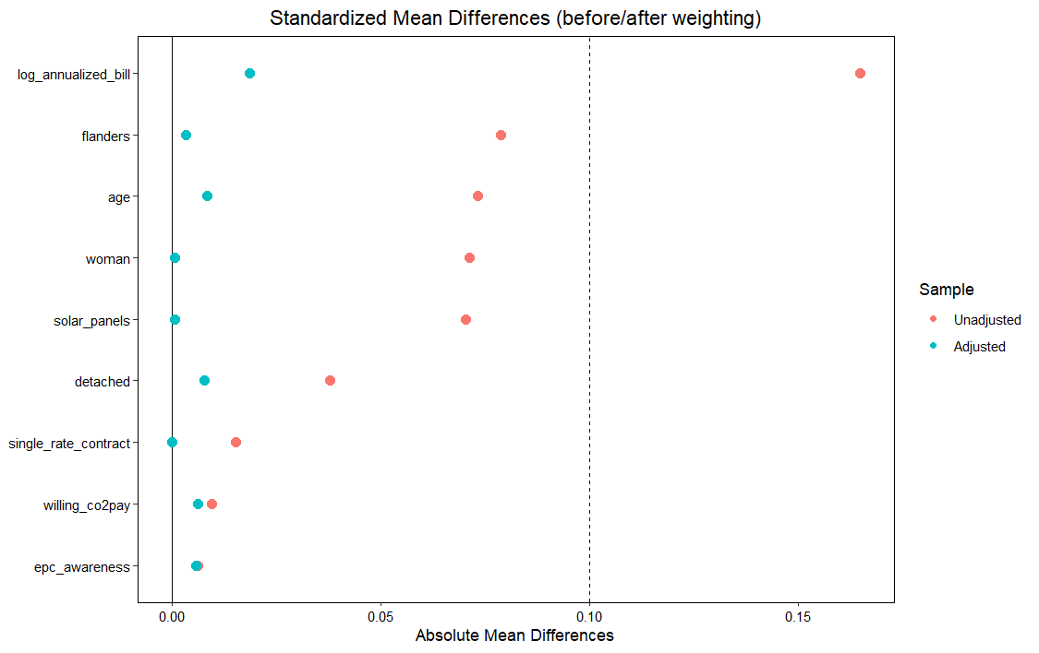
Notes:
(BRIAN)
This plot compares standardised mean differences (SMDs) of covariates before and after ATT weighting (Average Treatment effect on the Treated weighting). ATT weighting allows for re-weighting the control group (people who are not (yet) involved in an energy sharing arrangement) so it resembles the treatment group (energy community members) in observed/socio-demographic characteristics.
The red dots are before weighting, and the blue dots are after weighting. The dashed vertical line at 0.10 is a common benchmark: standardised mean differences below 0.1 are typically considered negligible (good balance between groups).
So what does this plot show?
Before weighting: treatment and control groups were not directly comparable due to systematic differences (especially in energy bill size, solar panel ownership, and region). However, after weighting all covariates shift very close to 0, well below the 0.10 threshold. Indicates that weighting has been highly effective in balancing the groups. The differences between treated and control are now negligible across all observed characteristics. In other words, results are less likely to be biased by these observed differences.
This ensures good comparability between treated and control groups.

Slide 14
Propensity score weighting in estimation
Attention to timing (binary) — “Do you pay attention to when you use the most electricity?”
  Binary outcomes → weighted logit
Appliance-specific off-peak use — for each owned appliance, indicator = 1 if “mostly/only off-peak.”
  Binary outcomes → weighted logit
Solar optimization among PV owners — Likert 1–5 (“never”→“always” shift to match PV)
  Likert (1–5) → weighted OLS
Notes:
(BRIAN)

Slide 15
RESULTS
Notes:
This brings us to the results section…

Slide 16

397 valid respondents
Descriptive statistics
Survey: July – September 2025
Notes:
(MAIRA)
Let’s first dive into the characteristics of our sample. → +/- 400 respondents

Slide 17
397 valid respondents
Descriptive statistics
Flanders: 72% respondents
Brussels: 19% respondents
Wallonia: 9% respondents
Survey: July – September 2025
Notes:
(MAIRA)

Slide 18


397 valid respondents
Descriptive statistics
Flanders: 72% respondents
Brussels: 19% respondents
Wallonia: 9% respondents
~31% ~69% 0.3%
Survey: July – September 2025
Notes:
(MAIRA)

Slide 19

397 valid respondents
Descriptive statistics
Flanders: 72% respondents
Brussels: 19% respondents
Wallonia: 9% respondents
~31% ~69% 0.3%
12% Lower education (up to secondary school)
88% Higher education (Bachelor’s, Master’s, PhD)
Survey: July – September 2025
Notes:
(MAIRA)
Our respondents are relatively highly educated: 88% hold at least a Bachelor’s degree, compared to the Belgian average of 50%*.
*The percentage of 25-34-year-olds with a higher education diploma in Belgium is estimated at 50.7% in 2024, which is a slight increase compared to the previous year. (source: https://statbel.fgov.be/en/themes/work-training/training-and-education/level-education )

Slide 20

397 valid respondents
Descriptive statistics
Flanders: 72% respondents
Brussels: 19% respondents
Wallonia: 9% respondents
26% Energy community members
58% Non-member but interested in joining an energy community
16% Non-member and not interested in joining an energy community
~31% ~69% 0.3%
12% Lower education (up to secondary school)
88% Higher education (Bachelor’s, Master’s, PhD)
Survey: July – September 2025
Notes:
(MAIRA)

Slide 21



397 valid respondents
Descriptive statistics
Flanders: 72% respondents
Brussels: 19% respondents
Wallonia: 9% respondents
87% 12% 1%
26% Energy community members
58% Non-member but interested in joining an energy community
16% Non-member and not interested in joining an energy community
~31% ~69% 0.3%
12% Lower education (up to secondary school)
88% Higher education (Bachelor’s, Master’s, PhD)
Survey: July – September 2025
Notes:
(MAIRA)
From the 26% of people in an energy sharing arrangement, almost 90% are satisfied with the arrangement, and only 1 is not satisfied.

Slide 22

397 valid respondents
Descriptive statistics
Flanders: 72% respondents
Brussels: 19% respondents
Wallonia: 9% respondents
87% 12% 1%
26% Energy community members
58% Non-member but interested in joining an energy community
16% Non-member and not interested in joining an energy community
~31% ~69% 0.3%
12% Lower education (up to secondary school)
88% Higher education (Bachelor’s, Master’s, PhD)
59% have solar panels
Survey: July – September 2025
Notes:
(MAIRA)
The strength of our sample is that the EC members and non-members are easier to compare because they are similar. We also have a lot of people who are in an EC or who are interested, so we can get a good idea of the motivations.
The drawback of the sample is that it is harder to understand barriers (only 12% do not want to join an EC) or the reasons why people are dissatisfied (1% of EC members), because those percentages are so low

Slide 23
Results
Key research questions are:
👥💰🌱 What motivations (e.g., social, financial, environmental) encourage or discourage individuals from joining energy communities?
  What motivates individuals to join and remain in energy-sharing communities?
  What motivates individuals who are considering participation in an energy-sharing community?
  Why do some individuals choose not to join, or decide to leave, an energy-sharing community?
  Which measures could encourage energy-sharing, according to members and non-members of ECs?
  Which measures could support energy-sharing for non-members who have expressed interest in joining ECs?
Notes:
(MAIRA)
Remember the research questions introduced by Brian? A first goal was to better understand the motives (barriers and drivers) to joining an EC.
The questions was devided in a couple of sub-questions which I will go over one by one.

Slide 24
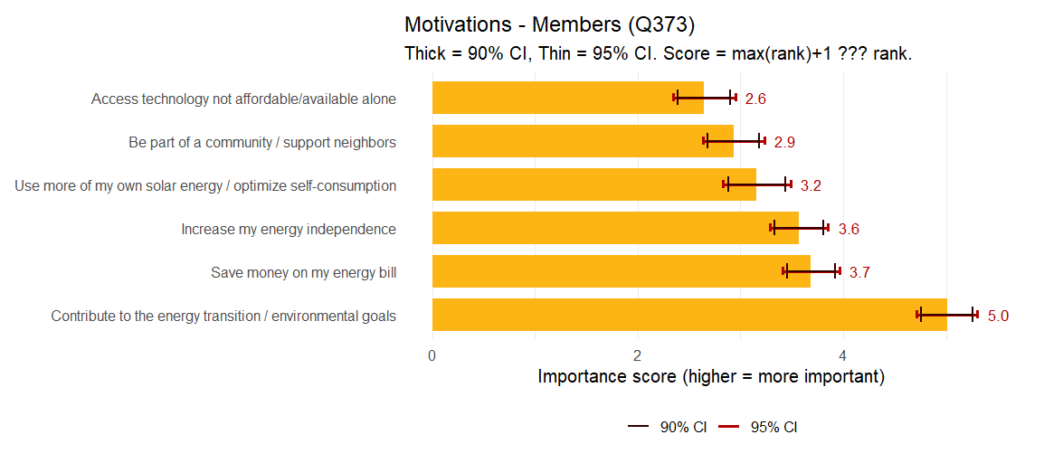
Results
  1.a. What motivates individuals to join energy-sharing communities?
Notes:
(MAIRA)
The first bar chart shows the average importance scores (with 90% and 95% confidence intervals) that members of energy communities assign to different motivations for participating. Higher scores mean higher importance. So what do we find?
The most important motivation in ‘contributing to the energy transition / environmental goals’. Energy community members are most motivated by the idea of helping the environment and supporting the broader energy transition.
Other strong motivations are:
‘Increase my energy independence’
‘Save money on my energy bill’
These suggests that practical personal benefits (lower costs, autonomy) are strong incentives alongside the environmental idealism.
The least important motivation is ‘Access technology that is not affordable/available alone’
In sum: For members of Belgian energy communities, the primary justification for joining is environmental concern and contributing to the energy transition. This ‘collective good’ motivation outweighs purely individual or economic ones. Still, energy independence and saving money are very important secondary drivers, showing that members balance idealism with practical benefits. Meanwhile, the idea of simply ‘belonging to a community’ or ‘having access to certain technologies’ plays a relatively smaller role in actual participation decisions.
You can also see the Confidence Interval, meaning that → we are 90% confident that our interval contains the true population parameter.

Slide 25
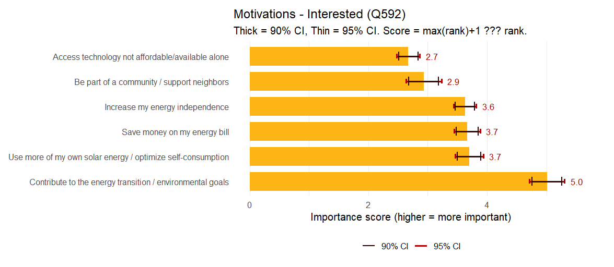
Results
  1.b. What motivates individuals who are interested in participating in an energy-sharing community?
Notes:
(MAIRA)
The second bar chart shows the average importance scores (with 90% and 95% confidence intervals) of people who are not (yet) members of an energy community but are interested in joining an energy sharing arrangement, assigned to different motivations for participating. Higher scores mean higher importance. So what do we find?
The most important motivation is also ‘contributing to the energy transition / environmental goals’. People who are not yet involved in an energy community but are interested in participating are most motivated by the idea of helping the environment and supporting the broader energy transition.
Other strong motivations are:
‘Save money on my energy bill’
‘Increase my energy independence’
‘Use more of my own solar energy / optimise self consumption’
These suggest that practical personal benefits (lower costs, autonomy) are strong incentives alongside the environmental idealism.
The least important motivation is again ‘Access technology that is not affordable/available alone’
In sum: Similar to the motivations of Belgian energy community members, people who are interested in joining an energy sharing arrangement are primarily motivated by environmental concern and contributing to the energy transition. This ‘collective good’ motivation outweighs purely individual or economic ones. Still, saving money, energy independence, and optimising self consumtion/using own solar energy, are very important secondary drivers. Meanwhile, the idea of simply ‘belonging to a community’ or ‘having access to certain technologies’ plays a relatively smaller role in actual participation decisions.

Slide 26
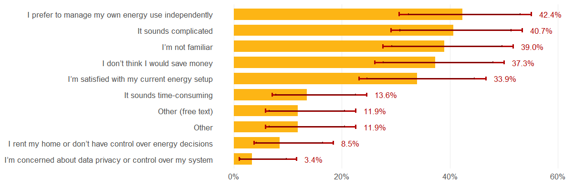
Results
  1.c. Why are individuals not interested in energy communities?
Notes:
(MAIRA)
In our sample, 42.4% of respondents indicated that a preference for managing their own energy use independently was a key reason for not joining an energy community. Followed by concerns with how complicated it would be, and simply because they are not familiar with energy sharing.
We see that the confidence intervals are larger here; this has to do with the small sample size (very few people were not interested in joining an EC).

Slide 27
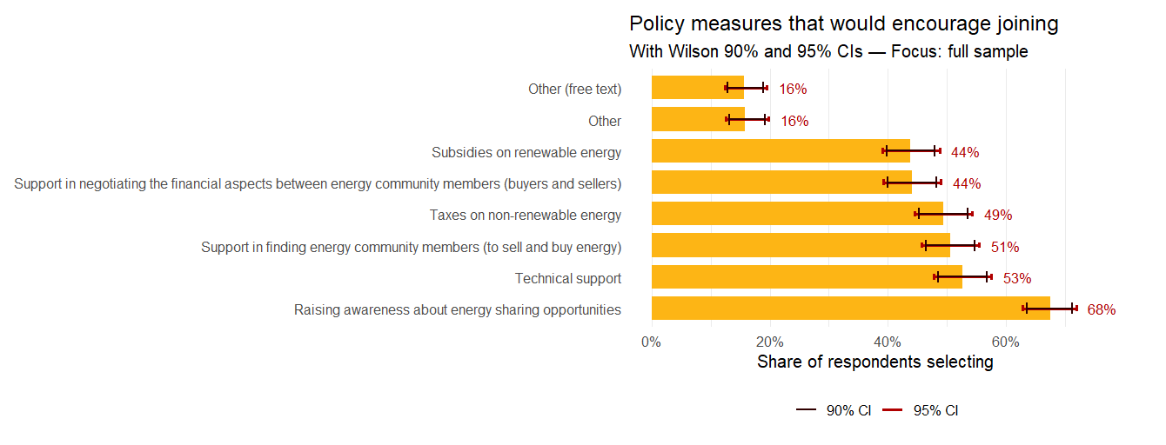
Results
  1.e. Which measures could support energy-sharing for the full sample?
Notes:
(MAIRA)
The barriers of unfamiliarity and perceived complexity (shown in the previous slide) reappear in responses to this question. Raising awareness about energy sharing emerges as the most frequently mentioned measure to support its adoption, followed by the need for technical assistance and support in finding potential community members. These top three measures all point to the importance of addressing perceived complexity and improving familiarity with energy sharing.

Slide 28
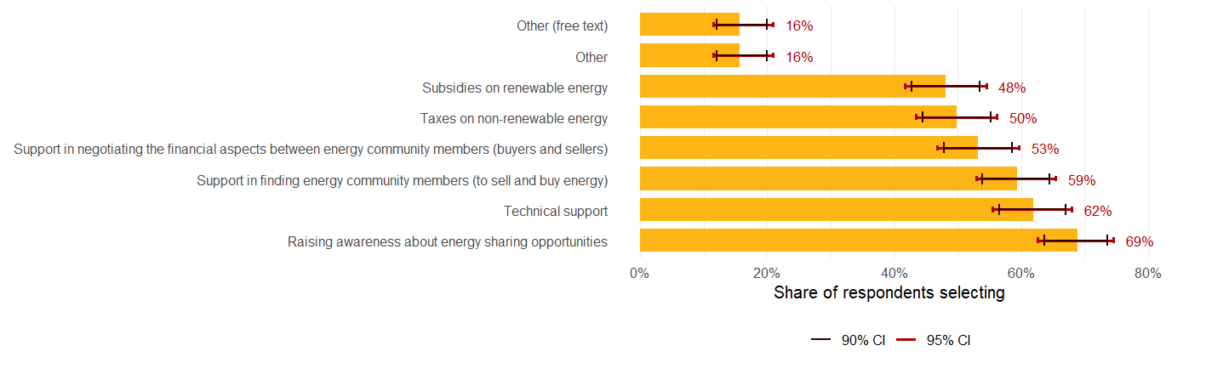
Results
  1.e. Which measures could support energy-sharing for non-members who have expressed interest in joining ECs?
Notes:
(MAIRA)
When we specifically look at the non-members who would consider joining an EC, we still see the same trend

Slide 29
Results
Key research questions are:
⚡🔄🏠 How does participation in energy-sharing networks influence individuals’ strategies for optimising self-consumption compared to those managing energy use independently?
  To what extent do individuals adjust their electricity consumption to align with their own solar generation?
  Do energy community members differ from non-members in how much attention they pay to the timing of their electricity use (e.g., doing certain activities at specific times of day)?
  Does this adjustment differ depending on the type of appliance being used?
Notes:
(MAIRA)
This brings us to our second research question and related sub-questions. We were also very interested in self-consumption and flexibility in energy use.
Let’s have a look at each sub-question

Slide 30
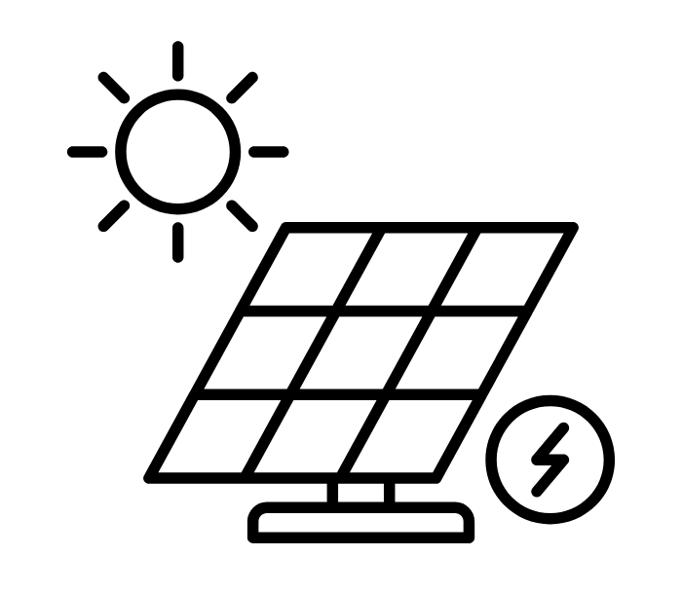





Results
2.a. To what extent do individuals adjust their electricity consumption to align with their own solar generation?
EC members
Non-members
Weighted Cohen's d (participants - all non-members): 0.335 (p<0.05)
Notes:
(MAIRA)
Self-consumption behavior (how often people change electricity consumption to match their own solar output) → People in energy sharing arrangements are more likely to adjust their electricity use to match their solar production (statistically significant at p < 0.05) in comparison with non-members. The effect size (Cohen’s d = 0.3) is small to moderate, so while the effect is not huge, it is meaningful.
= het verschil tussen de twee groepsgemiddelden bedraagt 0.3 standaarddeviaties.

Slide 31


Results
2.b. Do energy community members differ from non-members in how much attention they pay to the timing of their electricity use (e.g., doing certain activities at specific times of day)?
EC members
Non-members
Notes:
(MAIRA)
→ we don't have good evidence (=no significant effect) that energy sharing has an effect on paying attention to the timing of electricity use

Slide 32

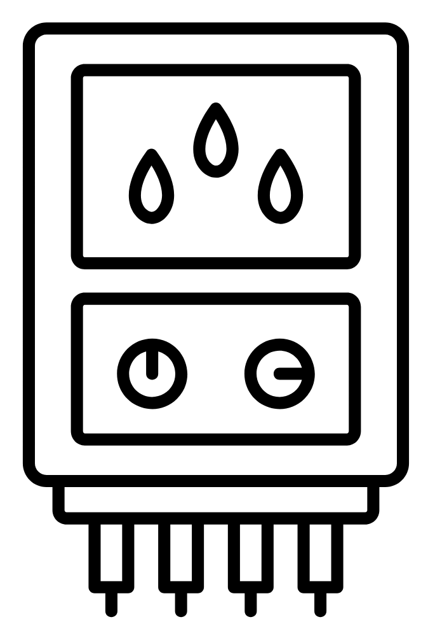



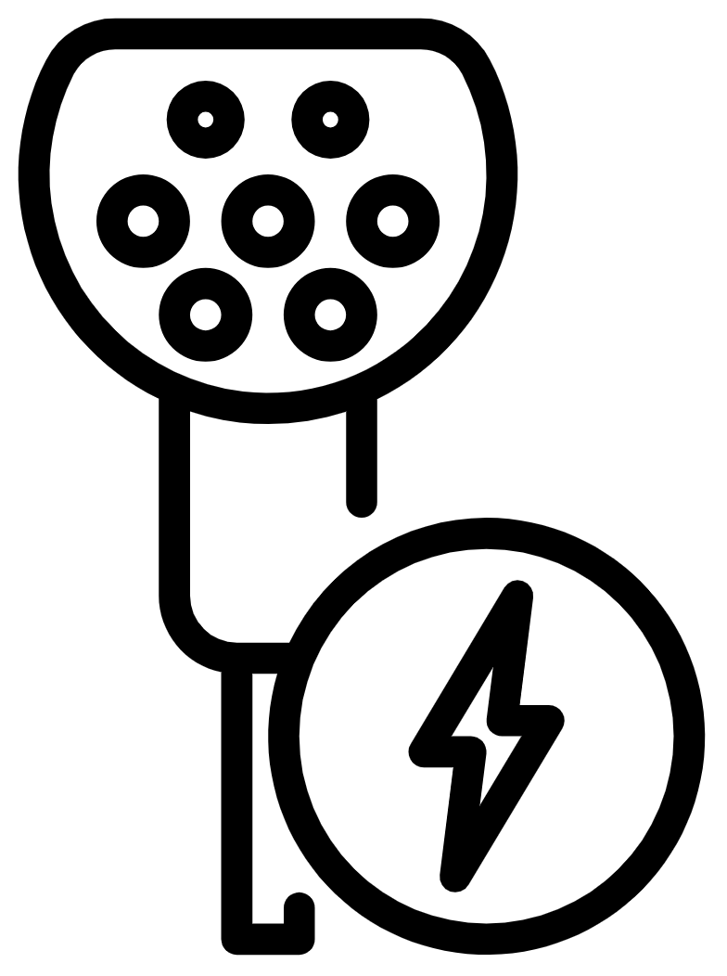
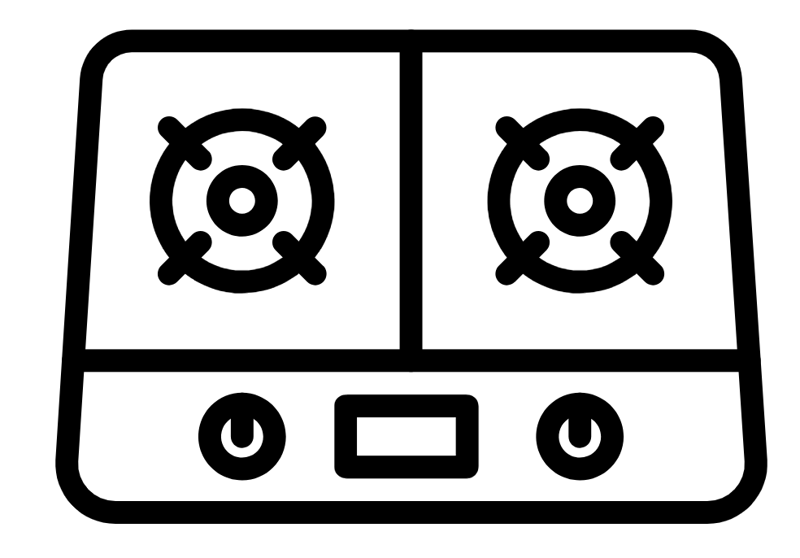
Results
2.c. Does this adjustment differ depending on the type of appliance being used?
Washing machine
Electric water
boiler
Dishwasher
AC
Electric cooking
stove
Electric heating
system
EV charger
Icons from the Noun Project
Notes:
(MAIRA)
Appliance-specific flexibility → We also explored whether there is a difference in the use of specific appliances.
We found that EC members have a higher propensity for off-peak usage for all except for cooking, though only two are significant at the 10% level (=90% chance that this is a real effect seen in the wider population)

Slide 33
Results
2.c. Does this adjustment differ depending on the type of appliance being used?
Non-members: 55% use it off-peak
EC members: 67% use it off-peak
(p=0.052)
Non-members: 21% use it off-peak
EC members: 44% use it off-peak
(p=0.055)
Washing machine
AC
Icons from the Noun Project
Notes:
(MAIRA)
We found significant differences: EC members are more likely than non-members to shift washing machine (55.4% of non-members vs 67.3% of members use it off-peak) and air conditioner (20.8% of non-members vs 45% of members use it off-peak) usage to off-peak times.

Slide 34
Results
2.c. Does this adjustment differ depending on the type of appliance being used?
Non-members: 55% use it off-peak
EC members: 67% use it off-peak
(p=0.052)
Non-members: 21% use it off-peak
EC members: 44% use it off-peak
(p=0.055)
Washing machine
AC
Non-members: 75% use it off-peak
EC members: 83% use it off-peak
(p=0.419) – may need more data
EV charger
Icons from the Noun Project
Notes:
(MAIRA)
There was no significant difference for other appliances, though trends suggest members may also shift EV charging usage more often, but the evidence isn’t strong enough to be conclusive (likely limited by sample size).

Slide 35
CONCLUSION
Notes:
/

Slide 36
Conclusion
👥💰🌱What motivations (e.g., social, financial, environmental) for joining energy communities are most important?
Top tier: environmental goals most important
Mid tier: energy independence, financial gains, and optimizing solar-energy use
Bottom tier: Technology access and community values
👥💰🌱What barriers (e.g., social, financial, environmental) discourage individuals from joining energy communities?
Managing energy use independently
Complexity
Familiarity
Scepticism of financial benefits
Satisfaction with energy setup
Notes:
(MAIRA)
Remember: It is difficult to say more about the barriers the size of the sample

Slide 37
Conclusion
⚡🔄🏠 How does participation in energy-sharing networks influence individuals’ strategies for optimizing reported self-consumption compared to those managing energy use independently?
Effect on self-consumption (solar PV) and off-peak usage of select appliances
⚡🔄🏠 Policy suggestions for increasing membership
Raising awareness and a high interest in energy sharing suggest latent demand
Notes:
(MAIRA)
We learned that EC members are more likely to align their energy use with their solar power than non-members (moderate effect)
EC members use their AC and washing machine more often during off-peak hours than non-members
Respondents are very interested in energy sharing and membership wan increase if there is more AWARENESS

Slide 38
WORKSHOP / DISCUSSION
Notes:
/

Slide 39
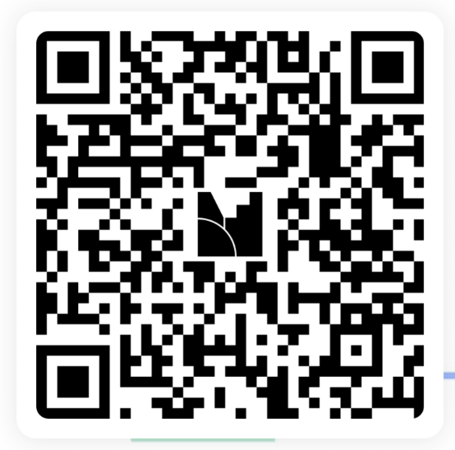
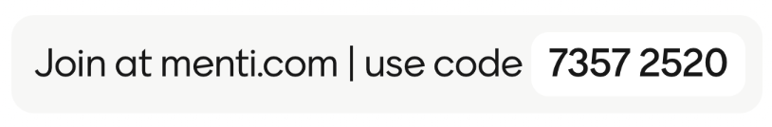
Task instructions
Mentimeter questions about:
🔍 Survey reflections (motivations & barriers)
⚡ Flexibility & energy use
🚀 Future outlook of ECs
Remember: answers are anonymous!
Notes:
(MAIRA)

Slide 40
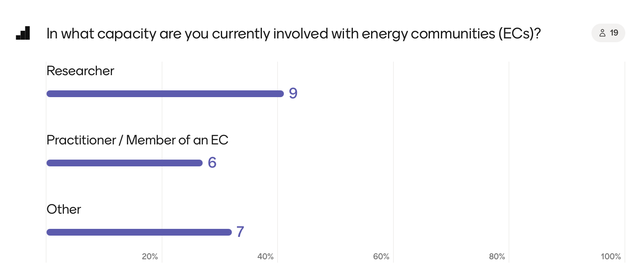
Mentimeter results

Slide 41
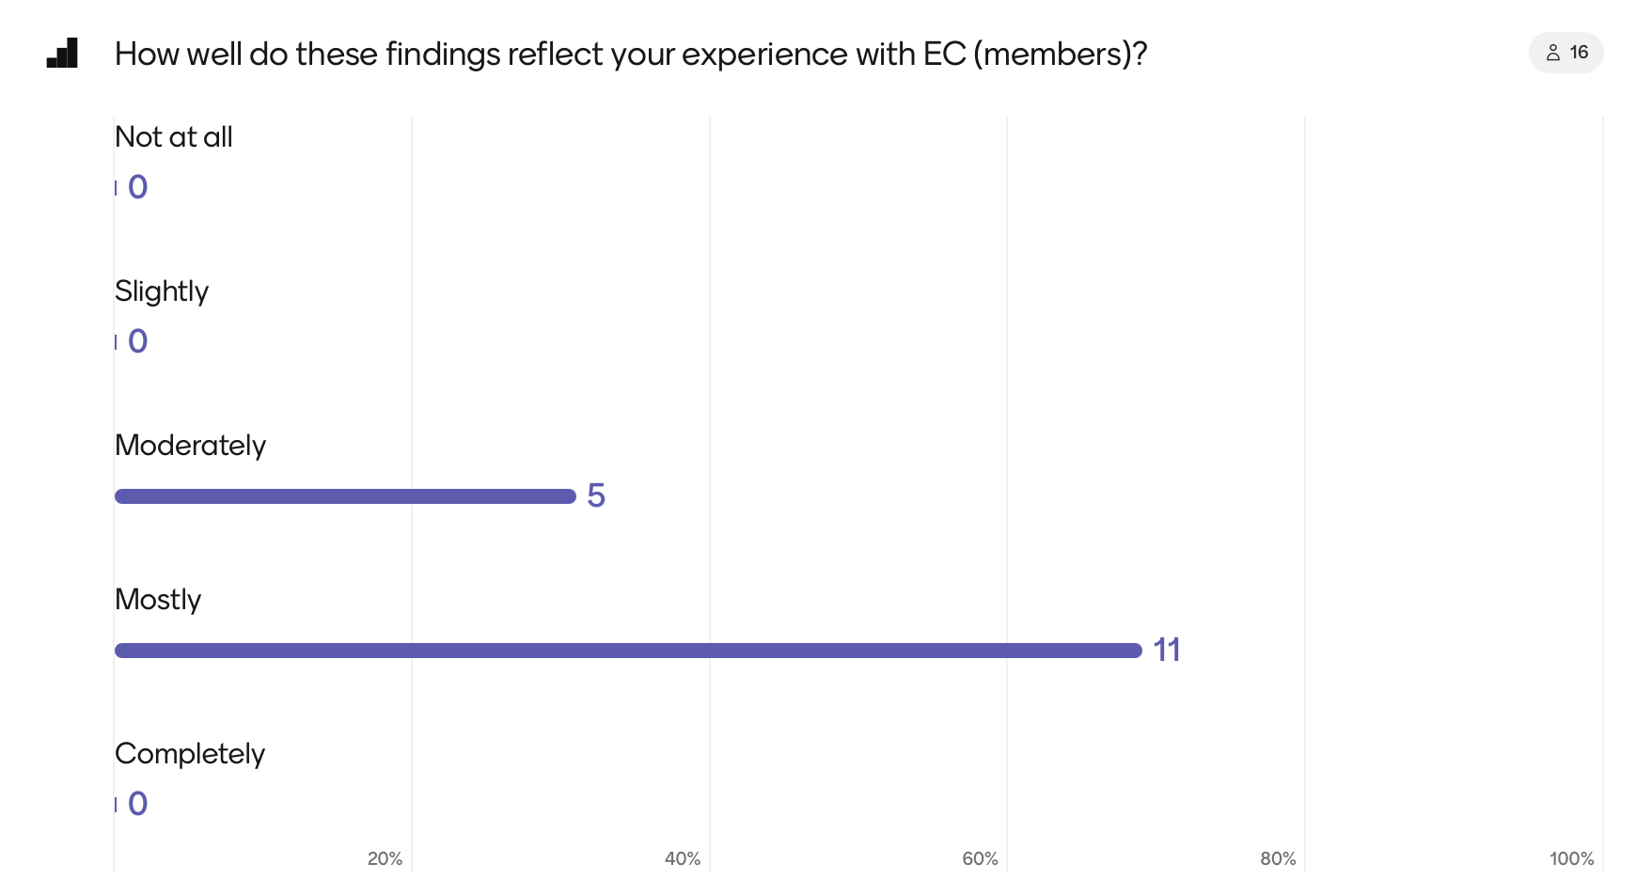
Mentimeter results

Slide 42
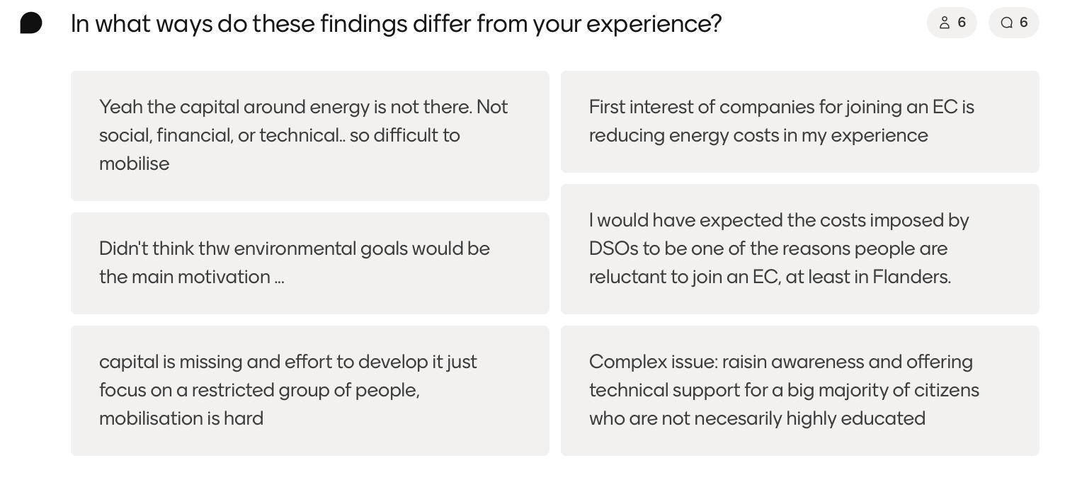
Mentimeter results

Slide 43
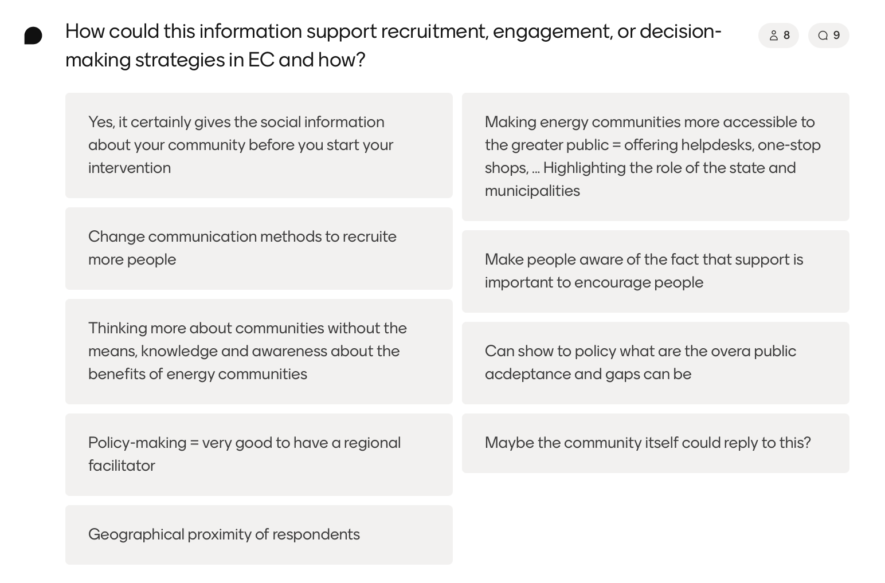
Mentimeter results

Slide 44
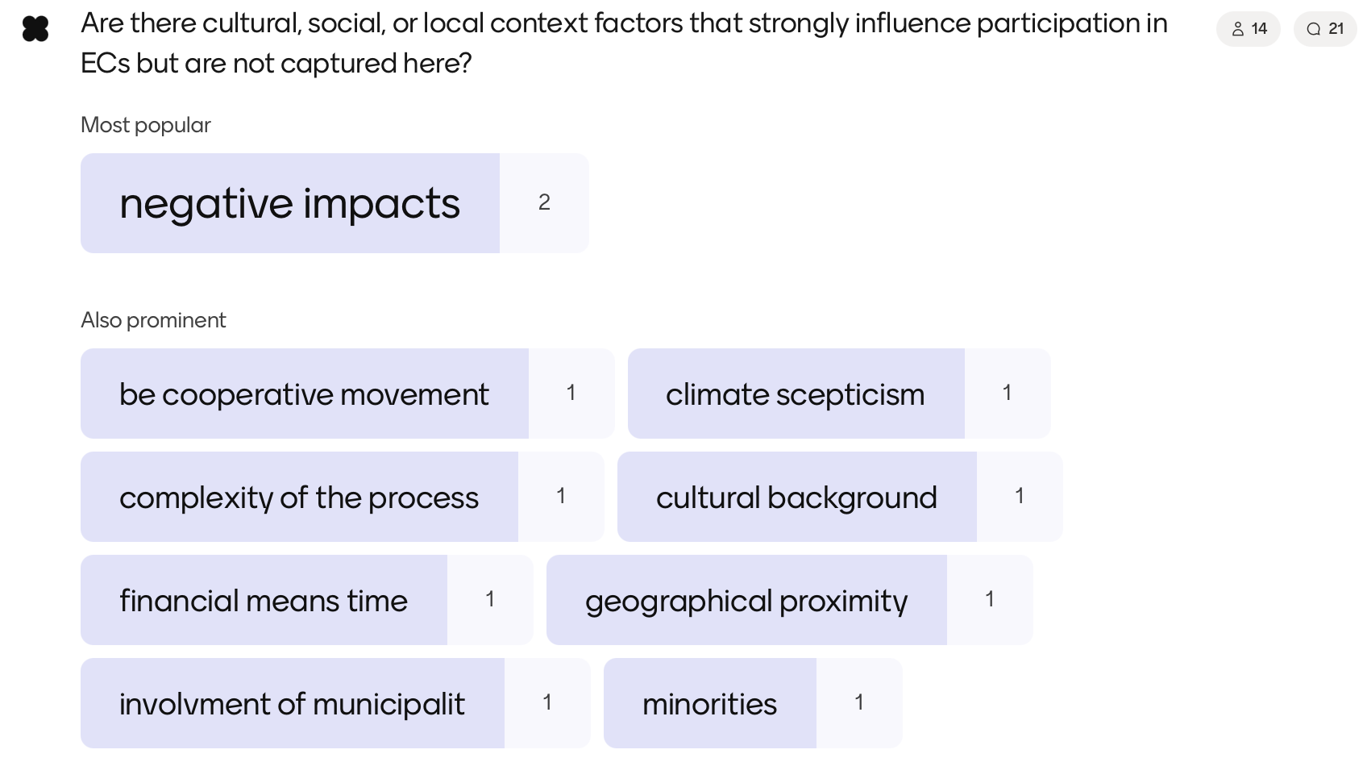
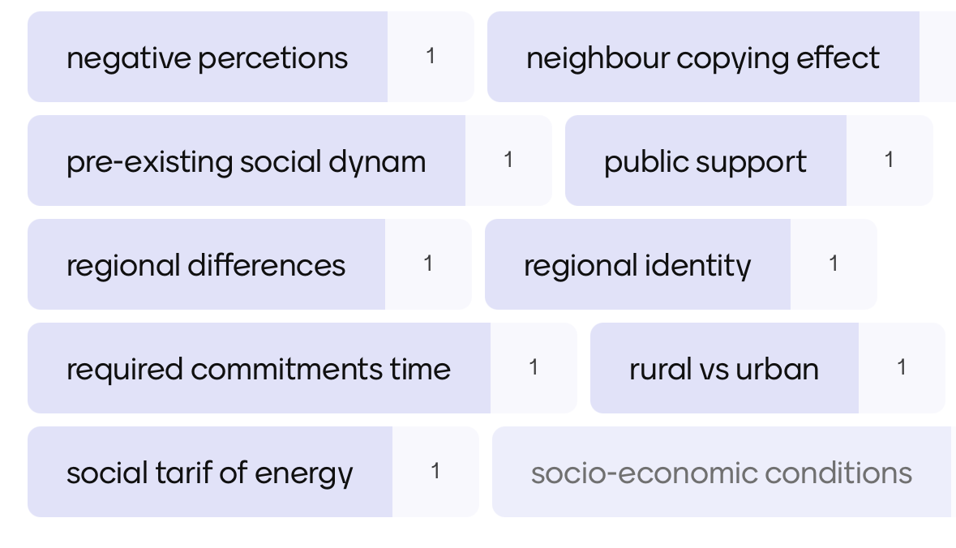
Mentimeter results

Slide 45
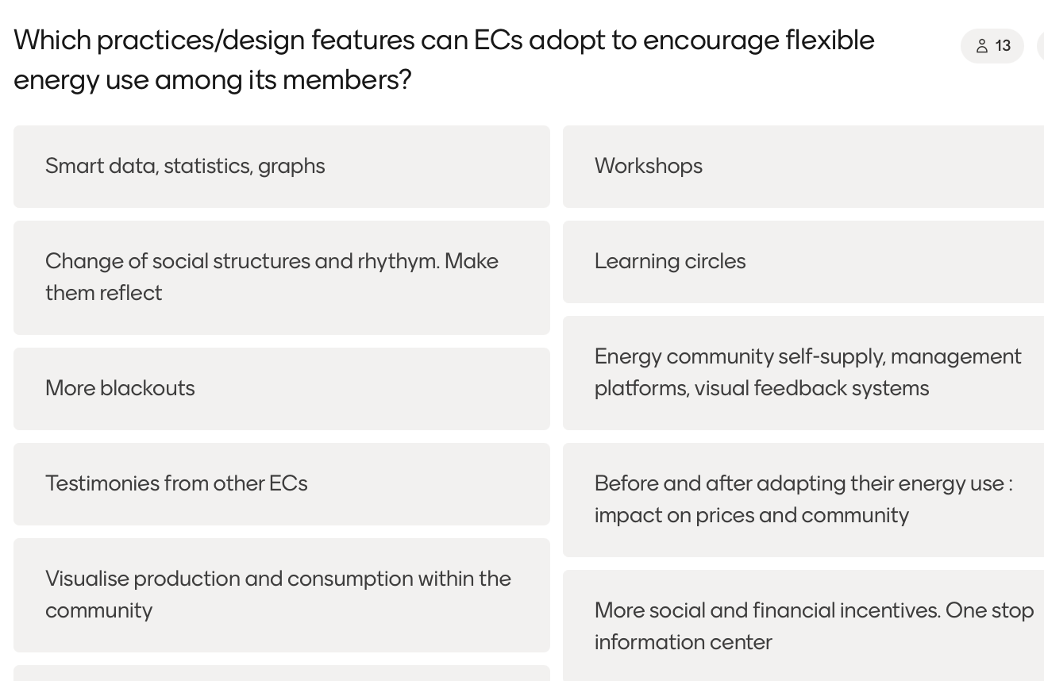
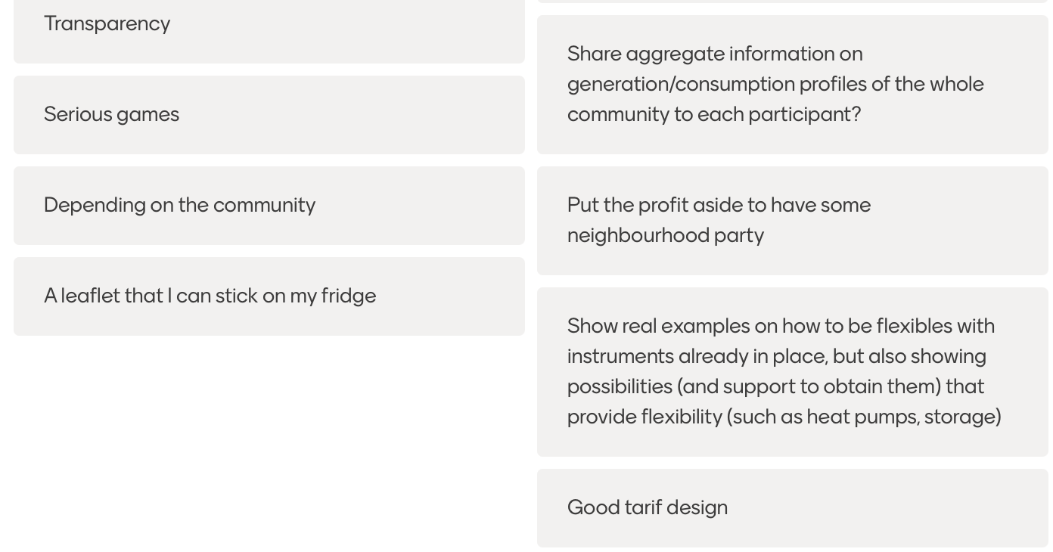
Mentimeter results

Slide 46
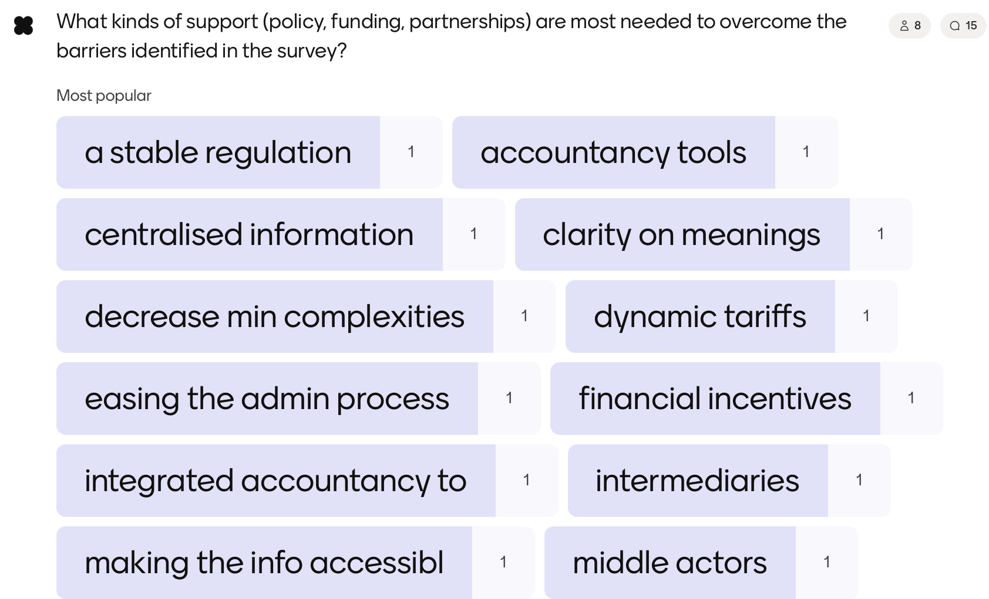
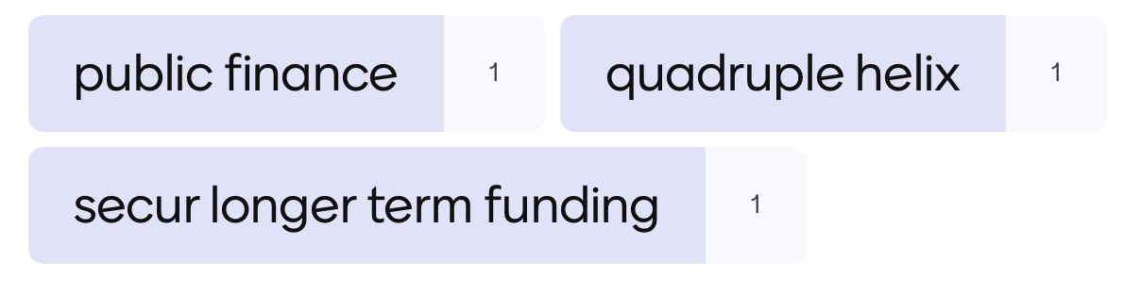
Mentimeter results

Slide 47
Straatnaam nr
postcode gemeente
info@alexander.be
0000 00 00 00
www.alexander.be

