Slide 1

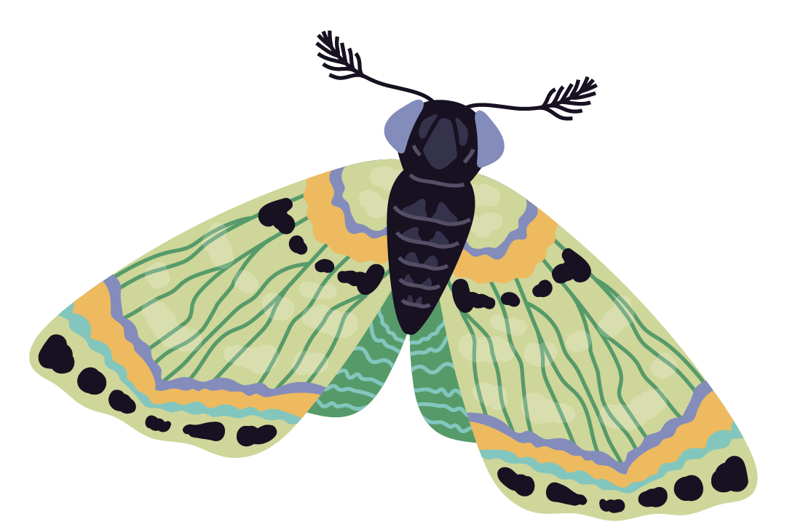
The Restoration of Grassland Butterflies in Belgium
Siemen Kalders
Rome Conference, 6-7 November 2025
Carole Billiet, BOF23OWB10

Slide 2

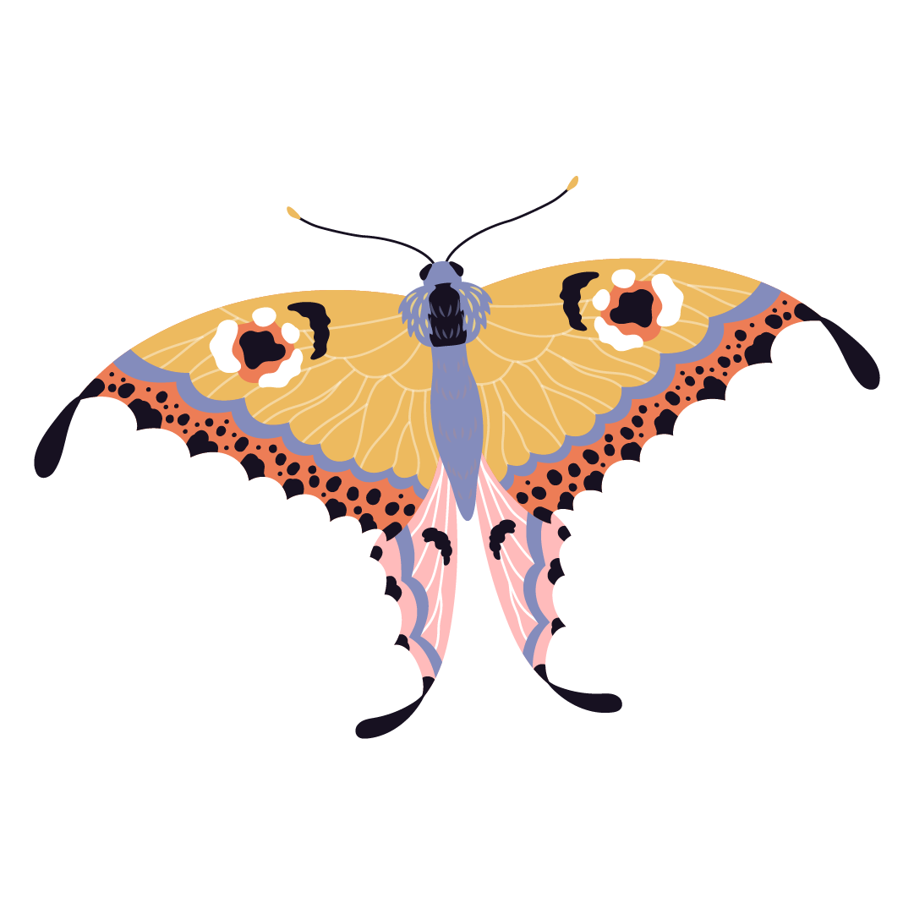
Table of contents
01
02
03
04
Grassland Butterflies
Grassland Butterfly
Index
Conclusion
Implications for Flanders

Slide 3

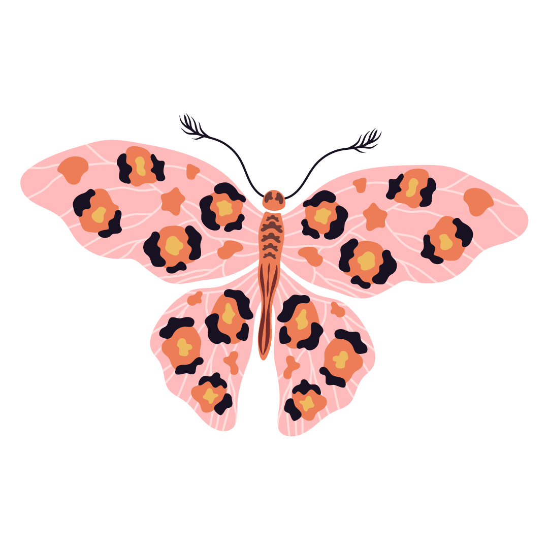
01
Grassland Butterflies

Slide 4
European Butterfly Monitoring
EBMS
European Butterfly Monitoring Scheme
Data
Around 30 countries with trends calculated from 1991
Outcome
European Red List on Butterflies (2025) and the Grassland Butterfly Index (GBI)

Slide 5
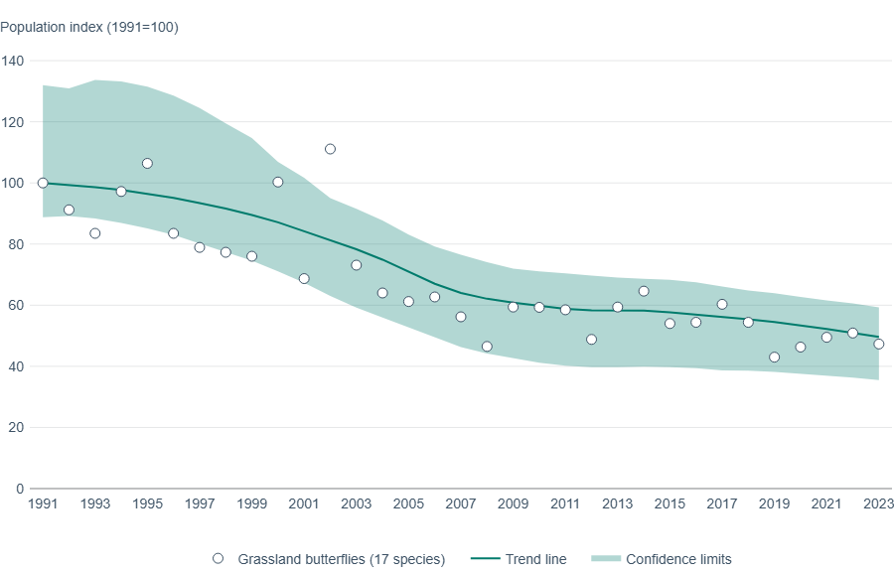
The Grassland Butterfly Index 1991-2023
(C): EEA

Slide 6

Flanders: Europe’s worst case scenario
Maes et al. 2001
Maes et al. 2022
Study found that 19 out of 64
butterflies went extinct, while half of remaining were threatened
Specialist butterflies in grasslands continued to decline, while generalists did not change

Slide 7
02
Grassland Butterfly Index

Slide 8
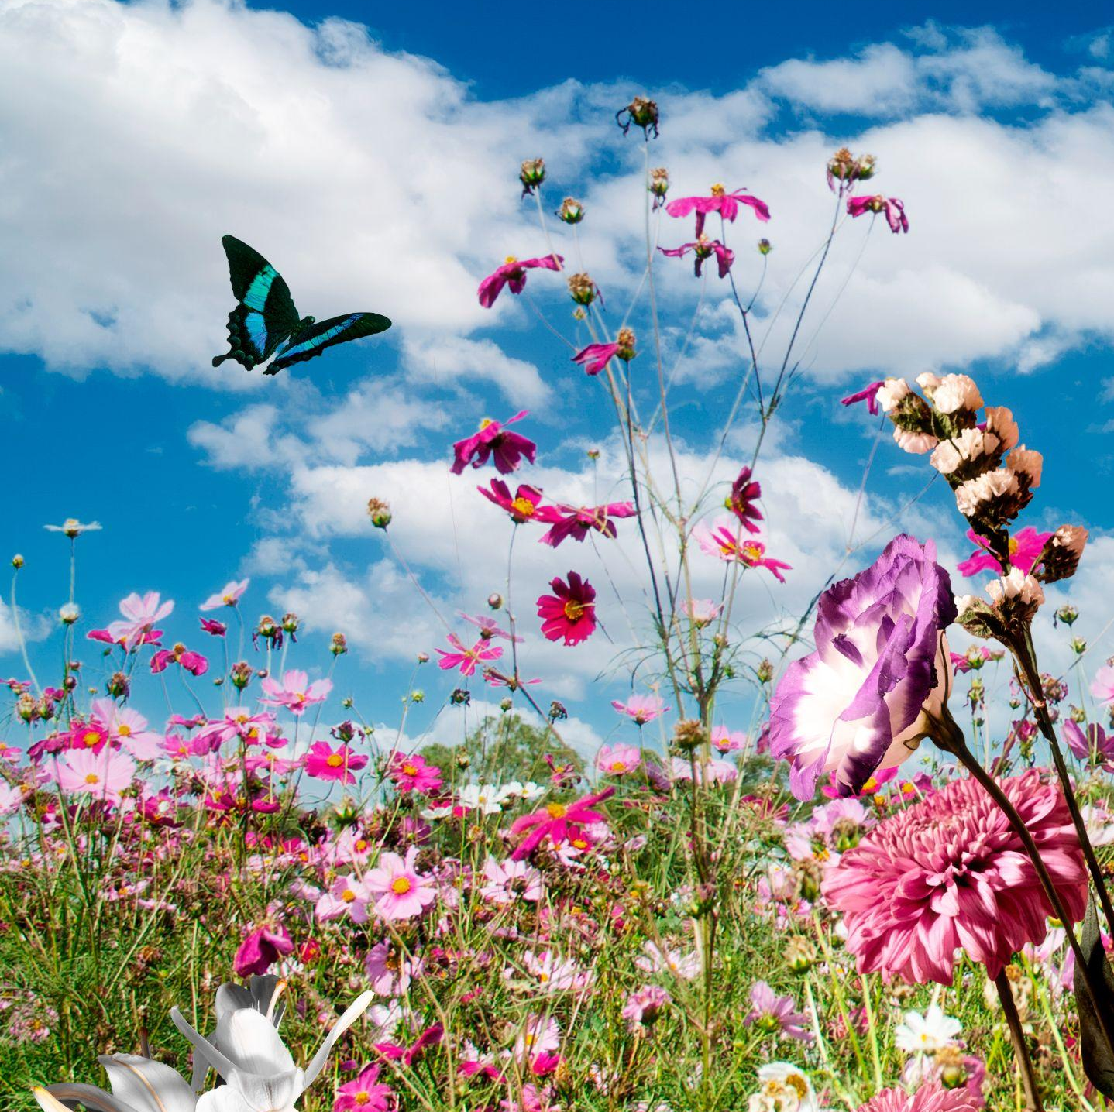
Restoration of Agricultural Ecosystems
Article 11
General obligation (§1)
Indicators for Agricultural Ecosystems (§2):
Grassland Butterfly Index
Stock of organic carbon in cropland mineral soils
Share of land with high-diversity landscape features
2 out of 3 (<-> proposal all 3!)

Slide 9
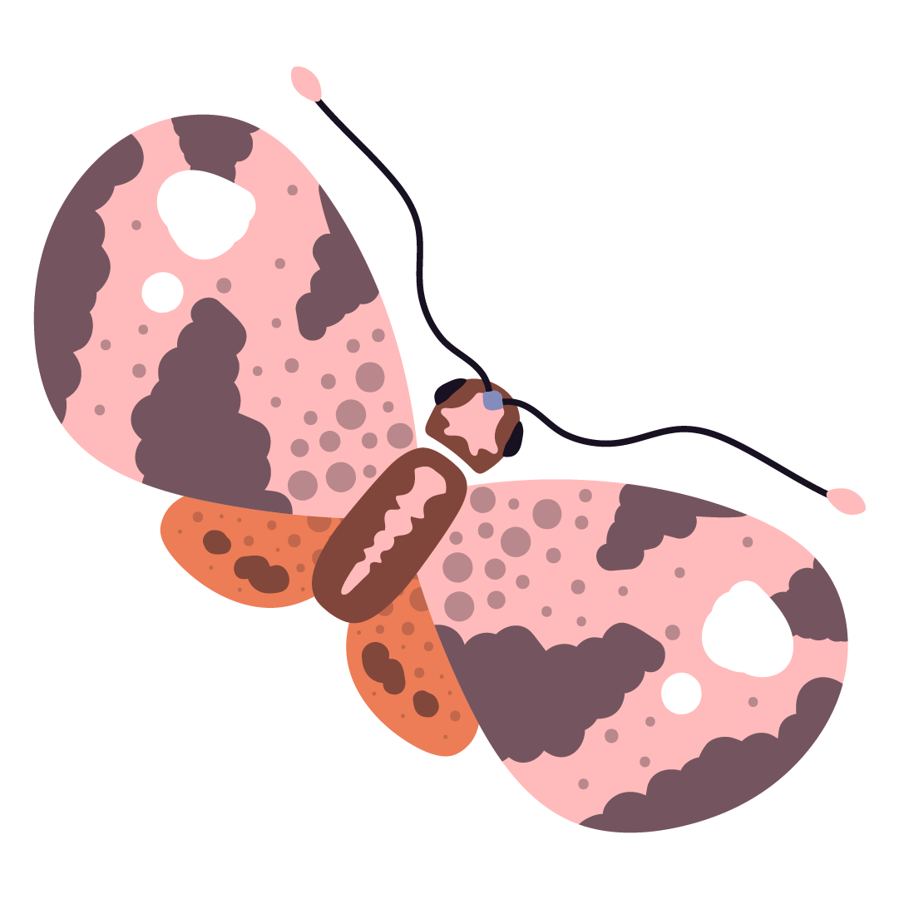
The Grassland Butterfly Index
Member States shall put in place measures which shall aim to achieve an increasing trend at the national level of the Grassland Butterfly Index until satisfactory levels are reached
17 grassland butterflies
7 widespread and 10 specialist butterflies
3 are protected under Habitats Directive
National level
Methodology and monitoring:
Annex IV
Report of Butterfly Conservation Europe
Measuring:
18/08/2024-31/12/2030
Every 6 years

Slide 10
The Grassland Butterfly Index (cont.)
Member States’ discretion for measures
Tackling agricultural intensification
Reduce nitrogen deposition
Reducing the use of pesticides
Improving ecological connectivity
Climate change adaptation
Measures interact and are complementary
For example, marsh fritillary in Sweden
Synergy with other obligations and indicators
Symbiosis with pollinator restoration (Art. 10)
Benefit from increased share of high-diversity landscape features (Art. 11, §2)
Study in Wallonia on sown wildflower strips

Slide 11
03
Implications for Flanders

Slide 12

Legislative rationale and spillover effects
Why has the GBI been included in the ecosystem-based framework of the NRR, and what are the broader implications for butterfly restoration in Flanders?
Biodiversity in agricultural ecosystems to be enhanced (Art. 11, §1)
Progress assessed with biological indicators (Art. 11, §2, see recital 55)
Criteria:
Direct information about state of biodiversity or ecological quality
Data is readily or shortly available, and are reliable and updated
Rationale for (grassland) butterflies
Proxy of grassland and ecosystem health
Well-documented, measurable, sensitive to environmental and climate changes
Also, represents many other insects and species (e.g. farmland birds)
Not only local info, but also regional and EU level

Slide 13

Legislative rationale and spillover effects (cont.)
Thus, butterflies are key indicator species
Provide complementary information on presence of biodiversity
Positive trends provide evidence of broader positive trends
GBI reflects, in synergy with other provisions, broader biodiversity in agriculture
Even though focus is on 17 butterflies
Opportunities for ecosystem and habitat management
Suggesting also trends of other butterflies and insects
Caveat: integrated, holistic implementation is needed

Slide 14

Satisfactory levels
The ultimate target to be achieved
No deadline
Measured every 6 years
The concept is undefined in NRR
Member States set them (Art. 11, §2 and 14, §5)
Allows for national and local considerations
For example, if the MS is the worst-case scenario
Procedural guarantees (Art. 14, §5):
Open and effective process
Latest scientific evidence
Guiding framework by Commission
Substantive guarantees: none

Slide 15

Shifting baselines (cont.)
The lack of substantive guarantees may challenge effective butterfly restoration
Butterfly monitoring started in the 1990s
1991 is the reference year for GBI
In some countries, there is only more recent data
Technical report of GBI
Recognised that substantial decreases probably already happened before the start
Van Strien et al. (2019)
Range of butterflies fell by 84% (1890-2017)
Decline is strongest between 1890-1939
Required to consider the lack of historical information?
Satisfactory levels based on latest scientific evidence (Art. 14, §5)
Annex IV refers to the technical report as the methodology (Annex IV)
Precautionary principle (Art. 191, §2 TFEU)
European Commission guidance?

Slide 16
Marsh fritillary: back from the dead
Flemish Red List (2021)
Regionally extinct (1959)
Unlawfully reintroduced (2016)
Currently, populations stable and limited dispersal
However, questions remain about its long-term survivability
Is Flanders required to restore this marsh fritillary population?
None of the provisions of NRR limit scope to permanent populations
In the technical report, some filters apply if data is unrepresentative-limited
So, Flanders seems required to restore, which raises questions and concerns
Restoration of extinct or cryptic species may be ineffective and costly
Does the unlawfulness of the reintroduction alter the obligations?
What about grassland butterflies that colonise Flanders due to cc?
Example, chalkhill blue in Flanders

Slide 17

Conclusions

Slide 18

Thanks!

