Slide 1



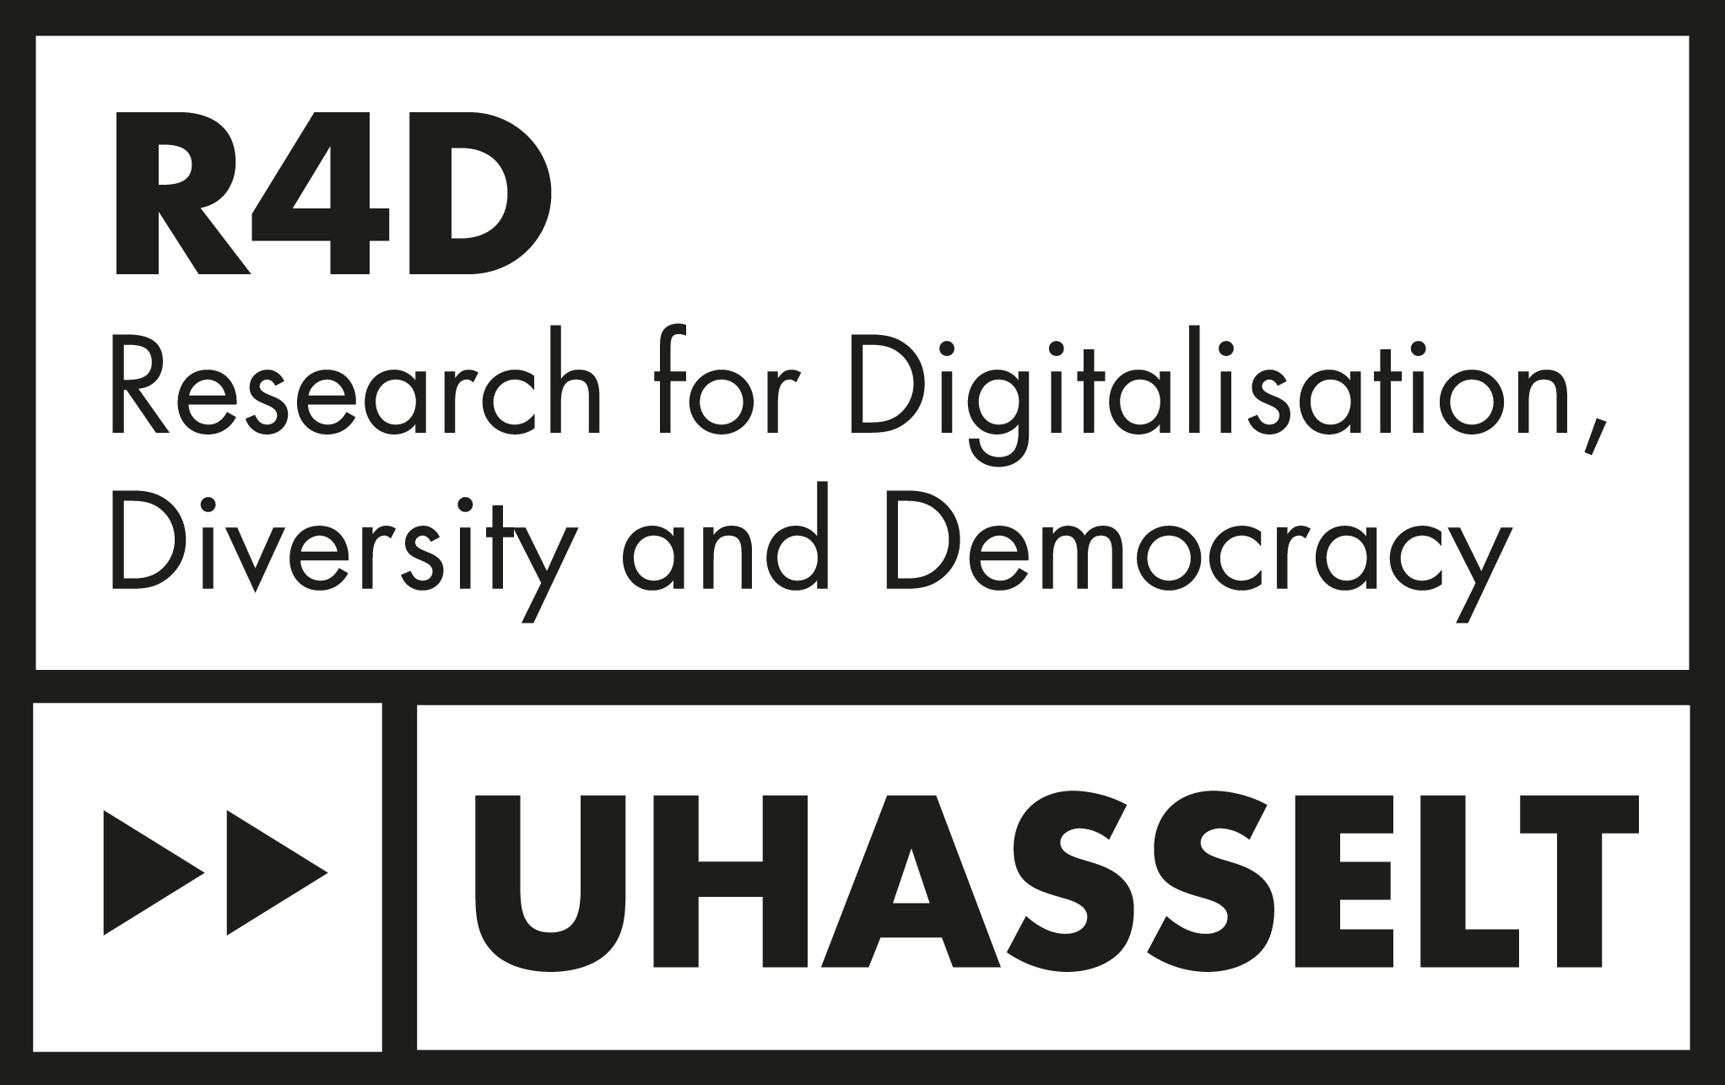


Doing intersectionality in equality policies of Higher Education and Research organizations: A critical scoping review Joanna Yasmina Marie Beeckmans (she/her), Prof. Patrizia Zanoni & Prof. Koen Van Laer Session: Inclusivity and Intersectionality in Academic Realms European Conference on Politics and Gender 09/07/2024

Slide 2
Table of content
The promises and pitfalls of doing intersectional equality policies
Methodology
Findings
Study characteristics
Themes
Discussion
Conclusion

Slide 3
Promises and pitfalls of doing intersectional equality policies

Slide 4
Promises
Visibilizing & delegitimizing intersecting inequalities in HE&R
Institutionalizing intersectionality through tranformative policies
Pitfalls
Lack of shared understanding
Risk of undoing intersectionality
Self-representation in policymaking
Divisive rhetoric of Oppression Olympics
“Doing intersectionality refers to the way in which scholars engage with a social justice agenda that unveils structures of inequality and aims to transform individuals, institutions, and society.”
“Intersectional equality policies outline specific strategies to address inequalities and discrimination that occur along multiple, intersecting inequality axes including gender, race, ethnicity, disability, age and sexual orientation.”
Notes:
Doing intersectionality is defined as a way to engage with intersectionality’s social justice agenda to unveil intersecting inequality structures and work transformatively. Intersectional equality policies differ from current equality policies such as gender equality plans, EDI policies, etc. as they are not interchangeable. Only intersectional equality policies address the discrimination that occurs along multiple interesting inequality axes. These policies promise firstly, based on Joan Acker’s concept of inequality regimes, to visibilize and delegitimize these intersecting inequalities in institutions such as HE&R. Secondly, (pushed by supranational institutions such as the EU) by institutionalizing intersectionality, equality policies would become transformative and integrative towards structural change and thirdly, they would enhance the self-representation of intersectional minoritized groups which are currently invisibilized in the policymaking. However, one of the primary pitfalls is that there is a lack of shared understanding how intersectionality can be translated and inform policies (among scholars and between scholars and policymakers as Christoffersen has shown in her study on UK NGO’s). Secondly, many scholars have pointed out the risk of undoing intersectionality by utilizing the concept as a buzzword or co-opting it but uprooting it from its critical and social justice agenda and thirdly, the complexified self-representation could lead to a divisive rhetoric of Oppression Olympics in which identity groups compete between each other in a neoliberal and highly competitive field.
Bilge, S. (2013). INTERSECTIONALITY UNDONE: Saving Intersectionality from Feminist Intersectionality Studies. Du Bois Review: Social Science Research on Race, 10(2), 405–424. https://doi.org/10.1017/S1742058X13000283

Slide 5
Research questions
RQ1: What are the prevalence and main study characteristics on the literature on intersectional equality policies in HE&R?
RQ2: How are intersectional equality policies in HE&R approached in the literature?
RQ3: What are the main knowledge gaps on intersectional equality policies in HE&R identified in this literature?
Notes:
In order to better understand how intersectional equality policies are used in HE&R, we have conducted a critical scoping review based on three research questions:

Slide 6
Methodology

Slide 7
STEP 1: Selecting relevant studies based on RQ’s and inclusion/exclusion criteria
STEP 2: Scoping review of existing literature through inductive themes
STEP 3: Critical assessment and identification of knowledge gaps
STEP 4: Discussing intersectional political gap
STEP 5: Summarizing and reporting recommendations for future research and policy work
Notes:
This critical scoping literature review employs a twofold method. First, a scoping review was conducted to rapidly map the key available literature available on this topic which is still rather new and therefore complex by identifying three inductive themes. Secondly, a critical review of the final sample has assessed and identified the knowledge gaps and are discussed as an intersectional political gap. Finally, we report on recommendations for future research and policy work.
(The final sample of 61 scientific articles was stored in Excel and coded in MaxQDA by the characteristics of the studies (title, author(s), year of publication, journal, method, study location, sample and included social identities).
Secondly, these articles were critically assessed to identify a knowledge gap that was guided by the foundational work of Crenshaw on structural and political intersectionality. We argue that a political intersectional gap currently hinders the design and effective implementation of equality policies focused on dismantling the interlocking systems of oppression and privilege in HE&R. Based on this gap, we conclude with reflexive recommendations for academics and policymakers to bridge these gaps into further research and their policy work.)

Slide 8
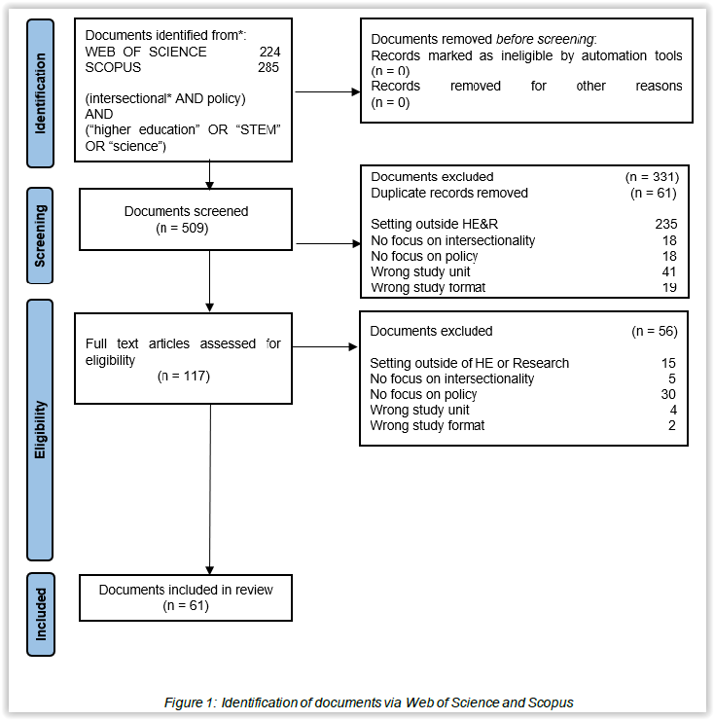





Time scope: 1989 and 2022 Systematic search between Nov. ’22 & Jan. ’23
Keywords: “Intersectional*” AND “policy” “science” OR “STEM” OR “higher education”
Inclusion criteria: Intersectionality and policy focus Higher Education & Research context Scientific literature
Results: 61 publications
Notes:
The systematic searches were conducted between November 2022 and January 2023 and have as starting date, the year in which Kimberlé Crenshaw published her seminal work Demarginalizing the Intersection of Race and Sex: A Black Feminist Critique of Antidiscrimination Doctrine, Feminist Theory and Antiracist Politics

Slide 9
Findings

Slide 10
Study characteristics
The literature on intersectional equality policies has emerged in the last decade, strong increase in the last few years (2/3 of the sample since 2020).
Strong predominance of studies in the Anglosphere: USA (33), UK (11), South Africa (5), Australia (4) and Canada (4).
Predominance of qualitative studies of minoritized students’ and staff’s lived experiences of intersecting inequalities in HE&R (37 out of 61, 61%).
Focus on “traditional diversity strands” such as gender (included in all studies), mostly intersected with race (N=52). Class or SES (N=23), sexual orientation (N=19) and, to a lesser extent, disability (N=15), age (N=10), religion or faith (N=9), mother- or parenthood (N=7) and gender identity (N=5) are included.
Aligns with previous studies that intersectional equality policies focus on gender and additive approaches to inequality.
Notes:
The findings are divided into two parts. The prevalence and main characteristics of the studies showed that the study field is recent, predominantly situated in the Anglosphere and focuses mostly on qualitative studies and the traditional diversity strands. This aligns with previous studies.
Tatli, A., & Özbilgin, M. F. (2012). An Emic Approach to Intersectional Study of Diversity at Work: A Bourdieuan Framing. International Journal of Management Reviews, 14(2), 180–200. https://doi.org/10.1111/j.1468-2370.2011.00326.x
Christoffersen, A., & Emejulu, A. (2022). “Diversity Within”: The Problems with “Intersectional” White Feminism in Practice. Social Politics: International Studies in Gender, State & Society, jxac044. https://doi.org/10.1093/sp/jxac044
Bourabain, D., & Verhaeghe, P.-P. (2022). Shiny on the Outside, Rotten on the Inside? Perceptions of Female Early Career Researchers on Diversity Policies in Higher Education Institutions. Higher Education Policy, 35(2), 542–560. https://doi.org/10.1057/s41307-021-00226-0

Slide 11
Themes
Policy approach |  | Theme | Subtheme
Experiences (N=40) | Intersectional equality policies are understood as a way to centre the narratives and include the experiences of individuals and groups with intersecting identities. They are predominantly linked to sense of belonging and how a person’s intersecting identity co-shapes its self-concept in Higher Education and Research. Derived from Crenshaw’s structural intersectional approach, policies should ensure its students and staff to feel recognized and encouraged to overcome barriers. | Recognition | 1. Representational recognition 2. Academic recognition 3. Experiential recognition
Theoretical arguments (N=9) | Intersectional equality policies connect knowledge on intersecting inequalities from academia, (public) policy and social justice. They transform existing equality policies that assume group uniformity logics based on identity categories and critiques in-group essentialism. Rooted in intersectionality as a critical inquiry, policies should acknowledge it’s social justice approach to tackle silenced intersecting forms of discrimination and oppression in structures within Higher Education and Research and move towards transformative and integrative policymaking. | Critical inquiry | 1. Social justice approach 2. Coalition-building
Policies’ content (N=12) | Intersectional equality policies are a policy tool to address the power relations that cause discrimination and inequality on multiple intersecting axes in Higher Education and Research. Rooted in intersectionality as a sensibility, policies should apply a critical assessment informed by evidence-based knowledge and through accountability measures. | Intersectional sensibility | 1. Evidence-based knowledge 2. Accountability measures
Notes:
Three inductive themes arose from the thematic analysis: 40 studies focus on the experiences of minoritized students and staff with the equality policies. They foreground the importance of representational recognition through mentoring programs and leadership programs, however limiting to visibility without accountability measures, support mechanisms and community-building leads to ineffectiveness. In terms of academic recognition, the hiring and promotion of diverse staff and role models, diversifying curriculum and tackling aggressions to go beyond tokenization and meritocratic ideal are foregrounded. The experiential recognition focuses on how policies should provide the availability of diversified services and make intersectional equality policies as a shared responsibility by increased the knowledge on the topic. The second stream of studies examines the content of policies such as GEP, EDI, AAP, sex. viol. And highlight how current equality policies prioritize gender, don’t mention or enact intersectionality and should strive for more knowledge based on data, although it is often used as excuse for inaction. Therefore accountability measures are crucial to tackle the intersecting inequalities in policies. The last stream does not use empirical date but through theoretical arguments, critiques the essentialist notion of identity and the whiteness of HE&R and foreground the necessity of coalitions both bottom-up and top-down and to use intersectionality’s mode as a critical inquiry rooted in social justice.

Slide 12
Discussion

Slide 13
Political intersectionality gap
“Structural intersectionality highlights that individuals and groups can have differentiated experiences to discrimination and inequality based on the specific intersection of their identities.” (Crenshaw, 1991; 2013)
“Political intersectionality focuses on the modalities of the simultaneous mobilization of multiple identities to move forward an equality agenda.” (ibid)
Critiques the compartmentalization of policies
Critiques the hierarchisation of inequality axis in policies
Three types of political intersectionality gap:
Complement a structural intersectional approach, hence, highlighting the need for recognition of minoritized groups by investigating which issues are currently visibilized and whose voices are jeopardized in equality policies.
Evaluate the effectiveness of policies as part of a broader organizational setting, from beyond discursive uses of intersectionality towards organizational strategies that are currently used to advance an intersectional approach.
Broaden the focus on empowerment of individuals with different backgrounds and in dissimilar positions to examine how to overcome the depoliticization of intersectionality on the organizational level.
Notes:
Based on the critical review of the 61 articles, a political intersectionality gap was identified based on Crenshaw’s dual conceptualization of structural and political intersectionality. Structural intersectionality highlights that individuals and groups can have differentiated experiences to discrimination and inequality based on the specific intersection of their identities. Political intersectionality focuses on the modalities of the simultaneous mobilization of multiple identities to move forward an equality agenda. We believe that this concept, which she utilizes for social movements, can be used to critique the compartmentalization of policies and the hierarchisation of inequality axis in policies. Therefore, we identify a knowledge gap in which the current structural approach of focusing on recognition should be complemented by an analysis of which issues are visibilized and why. We also argue that the effectiveness of policies should be part of a broader organizational setting in which the current strategies to foreground an intersectional equality agenda should be examined and to broaden the focus on empowerment on the individual level to how to overcome the depolitization of intersectionality when translating this onto the organizational level.
Political intersectionality is an applied form of structural intersectionality
Cho, S., Crenshaw, K. W., & McCall, L. (2013). Toward a Field of Intersectionality Studies: Theory, Applications, and Praxis. Signs, 38(4), 785–810. https://doi.org/10.1086/669608
Crenshaw, K. (1991). Mapping the Margins: Intersectionality, Identity Politics, and Violence against Women of Color. Stanford Law Review, 43, 1241.

Slide 14
Conclusion

Slide 15
Further research needs to build on current literature on intersectional equality policies that address the need to…
increase the representational, academic and experiential recognition of students and staff.
adopt an intersectional sensibility in their equality policies.
utilize intersectionality’s mode as critical inquiry by building evidence-based knowledge and coalitions.
…by examining the entire policymaking process of equality policies and unpacking the current strategies utilized to mobilize multiple identities and stakeholders to advance an intersectional equality agenda in HE&R.
Notes:
We then conclude that further research and policy work should build on the current literature that primarily critique the lack of intersectional equality policies through structural, discursive and empowering uses of intersectionality, and fill the knowledge gap by examining the entire policymaking process and unpack the current strategies utilized to advance an intersectional equality agenda in HE&R.

Slide 16
THANK YOU FOR LISTENING! Questions, suggestions, feedback,…?

