Slide 1
The impact of “affective commitment separation” on the decision-making quality of family firm top management teams: the mediating role of collective psychological ownership
Prof. dr. Laura Hoekx
Prof. dr. Ine Umans

Slide 2
Introduction

Slide 3

Research question
Affective organizational commitment = “the affective or emotional attachment to the organization, such that the strongly committed individual identifies with, is involved in, and enjoys membership in the organization”
Positive outcomes (e.g., better job performance, lower absenteeism)
→ Important for top managers (dominant decision-making entity)

Slide 4

Research question
BUT: not every manager within the same team will experience the same levels of affective commitment!
Introduction of new concept: affective commitment separation

Slide 5

Research question
How does affective commitment separation impact the decision-making quality of a family firm TMT

Slide 6
Hypotheses

Slide 7
Affective commitment separation
Diversity framework of Harison & Klein (2007)
Separation = a (horizontal) distribution of where members stand on a value, belief, attitude, or orientation
Affective commitment separation = intra-team differences regarding the attitude of feeling emotionally connected to the firm and “really wanting to stay within the firm”
→ High degree = (very) high levels of affective commitment vs. (very) low levels of commitment

Slide 8
Impact on decision-making quality
Decision-making quality = an indiciation of whether the decisions made were based on accurate argumentation and the best accessible information possible, and fit the organization’s goals
→ important TMT outcome, critical for (family) firm’s success

Slide 9
Impact on decision-making quality
High separation within TMT = some members willing to go “the extra mile”, while others are barely committed
→ less cohesiveness, more interpersonal conflicts and distrust between team members, lower overall team performance
Opposing views within the TMT → impacts how its members analyze, view, and act upon decision situations

Slide 10

Hypothesis 1: A negative relationship exists between affective commitment separation and decision-making quality in family firm TMTs

Slide 11

Collective psychological ownership
= “the collectively held feeling that a target of ownership (or a piece of that target) is collectively ‘ours’”
A shared idea of an “us” and a specific target of ownership being “ours”
Research is scarce, especially in family firm contexts

Slide 12
Collective psychological ownership
Separation → polarization, impedes shared identity
Requirement for CPO = equitable situation in which all team members contribute equal effort, energy, and time
<-> affective commitment separation

Slide 13
Hypothesis 2: A negative relationship exists between affective commitment separation and collective psychological ownership in family firm TMTs

Slide 14
Collective psychological ownership
Psychological ownership → more job satisfaction, lower turnover intentions, organizational citizenship behavior…
Team-level → higher team creativity, higher team effectiveness evaluations…
Shared sense of identity ≈ shared sense of responsibility → take care of what is “ours” (= job of decision-making) → care about performing well and willing to put in effort

Slide 15
Hypothesis 3: A positive relationship exists between collective psychological ownership and decision-making quality in family firm TMTs

Slide 16
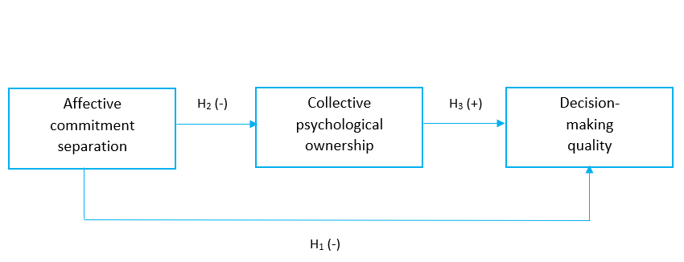
Research model

Slide 17
Methodology

Slide 18

Sample
Hand-collected dataset
212 individual managers of 45 Belgian family firms
Multiple-respondent → entire TMT had to fill out survey in order for firm to be included in sample
Team-level data of 45 teams

Slide 19
Measures
Affective commitment separation: Organizational Commitment Scale of Meyer & Allen (1991) → calculate within-team standard deviation
Decision-making quality: combination of decision quality and decision commitment, scale of Olson et al. (2007)
Collective psychological ownership: scale of Pierce et al. (2018)
Control variables: TMT size, firm size

Slide 20
Results

Slide 21

Results
Significant negative relationship between affective commitment separation and decision-making quality (β = -0,610, p = 0,051) → Hypothesis 1
Significant negative relationship between affective commitment separation and collective psychological ownership (β = -0,747, p = 0,024) → Hypothesis 2
Significant positive relationship between collective psychological ownership and decision-making quality (β = 0,678, p = 0,000) → Hypothesis 3

Slide 22
Contributions

Slide 23

Contributions
Introduction of “affective commitment separation” → new manifestation of TMT diversity
Collective psychological ownership as mediator → black-box between TMT diversity and outcomes → underexposed in family firm context
Family firm context: focus on family or non-family members → this study: shared responsibility of family and non-family members

Slide 24

Thank you!

