Slide 1
Post-succession predecessor involvement and strategic change in family firms: the role of intergenerational dissimilarities
Manu Moyens
Supervisors: Ine Umans – Tensie Steijvers – Wim Voordeckers

Slide 2


Notes:
So far, in the first two studies of my PhD, I have focused on the CEO as the main leader of the business and the family business in particular. This is a perspective that we also see often the literature. However, both empirical and anecdotal evidence show us that, in the particular the top of the business may sometimes actually look more like this.

Slide 3


“Generational shadow”
“Valuable resource”
Notes:
First, negative generational shadow, impeding successors’ managerial discretion and upholding the status quo
Recently, positive effects through mentorship and knowledge

Slide 4
Which boundary conditions determine whether post-succession predecessor involvement fosters or hinders strategic change in family firms?
post-succession predecessor involvement
+/- ?
strategic change
in family firms

Slide 5
Relational demography theory
Grounded in social identity theory and the similarity-attraction paradigm, relational demography theory asserts that dyadic relationships are shaped by the relative similarity or dissimilarity of individuals’ demographic characteristics (Tsui & O'Reilly, 1989)
Demographic similarities result in in-group classifications, so that demographically similar individuals tend to view and treat each other favorably
Demographic dissimilarities can lead to out-group classifications, generating negative perceptions, hindering interpersonal support, and reducing knowledge transfer
Indeed, dissimilarities in generational characteristics can unleash powerful tensions in predecessor-successor dyads (Magrelli, Rondi, et al., 2022)

Slide 6
The role of intergenerational dissimilarities
Intergenerational dissimilarities can have a locus in society and in the family
(Magrelli, Rovelli, et al., 2022)
Societal intergenerational dissimilarity
The concept of societal generations stresses intergenerational differences
predecessor-successor generational gap
(difference in birth years ≥ 20 years)
Family intergenerational dissimilarity
The concept of family generations
stresses genealogical linkages
predecessor-successor kinship dissimilarity
(non-kin to partial-kin to full-kin)

Slide 7
The role of intergenerational dissimilarities
H1: Predecessor-successor generational gap negatively moderates the relationship between post-succession predecessor involvement and strategic change in family firms, such that there will be a negative relationship between post-succession predecessor involvement and strategic change when a generational gap exists.
H2: Predecessor-successor kinship dissimilarity negatively moderates the relationship between post-succession predecessor involvement and strategic change in family firms, such that there will be a negative relationship between post-succession predecessor involvement and strategic change when kinship dissimilarity is high.

Slide 8

The role of goal congruence
Goal congruence is a crucial issue in succession processes, as it incentivizes predecessors and successors to work together and integrate perspectives in order to attain their common goal set
While intergenerational dissimilarities often result in diverging perspectives that erode mutual trust and disrupt knowledge exchange, goal congruence may incentivize predecessors and successors to bridge intergenerational dissimilarities

Slide 9
The role of goal congruence
H3a: The negative moderating effect of predecessor-successor generational gap on the relationship between post-succession predecessor involvement and strategic change in family firms is attenuated by predecessor-successor goal congruence, such that the negative moderating effect is weaker for high levels of goal congruence.
H3b: The negative moderating effect of predecessor-successor kinship dissimilarity on the relationship between post-succession predecessor involvement and strategic change in family firms is attenuated by predecessor-successor goal congruence, such that the negative moderating effect is weaker for high levels of goal congruence.

Slide 10
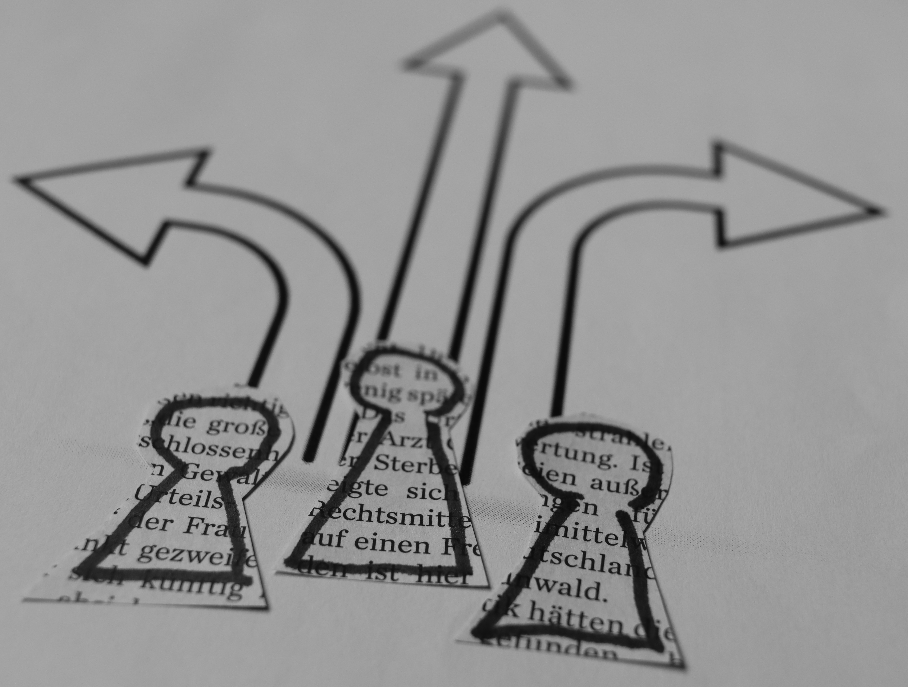
Methodology
Empirical strategy
Hierarchical regression analysis
Other option to explore:
  FsQCA
Data
Survey
Sample
Non-founding Belgian family SME CEOs
Their predecessor

Slide 11
Methodology
Measurements
Family firm strategic change
  Scale by Brunninge et al. (2007): asks whether the firm has introduced changes along 13 dimensions during the last two years
Post-succession predecessor involvement
    Degree of predecessor influence scale (Ahrens et al., 2018): weighted score of 8 potential post-succession predecessor roles (e.g., board member, consultant, etc.)
Predecessor-successor generational gap
    1 if birth-year difference is at least twenty years, 0 otherwise (Strauss & Howe, 1997)
Predecessor-successor kinship dissimilarity
    Classification into full-kin (i.e., parent-child), partial-kin (i.e., uncle/aunt-niece/nephew), and non-kin (cf. Madison et al., 2021)
Predecessor-successor goal congruence
    Scale by De Clercq et al. (2017): four-item Likert scale including statements like “my predecessor and I share a similar vision regarding the company's future”

Slide 12
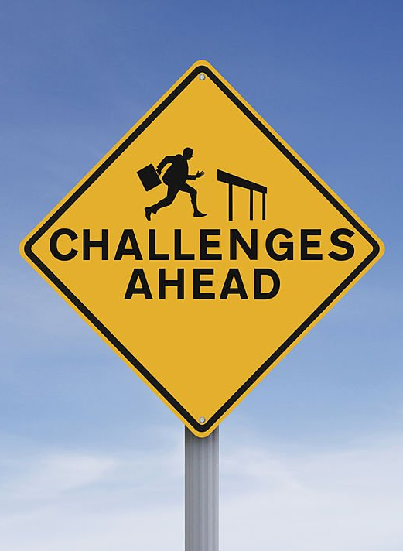
Main challenges ahead
Data collection
→ access to predecessors
Data analysis
→ multicollinearity between predecessor-successor generational gap and kinship dissimilarity?

Slide 13
Anticipated contributions
Relational demography theory
Extend application to the predecessor-successor dyad in family firms
Identify goal congruence as a boundary condition
Generations in family businesses
Examine the role of intergenerational dissimilarities with a locus in society and family
Debate on post-succession predecessor involvement
Highlight the role of predecessor-successor intergenerational dissimilarities in shaping its outcomes
Identify predecessor-successor goal congruence as a solution to bridge intergenerational dissimilarities

Slide 14


Post-succession predecessor involvement and strategic change in family firms: the role of intergenerational dissimilarities
Manu Moyens
Manu.Moyens@uhasselt.be

