Slide 1
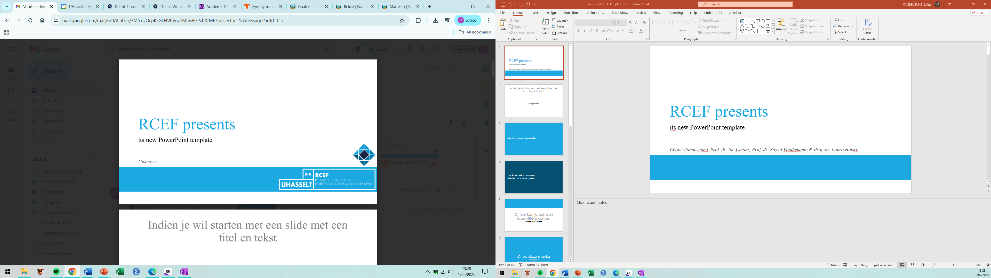
How do Family Business Goals shape the Financing Preferences of Family Firms’ Finance Teams?
Céline Vandevenne,
Prof. dr. Ine Umans,
Prof. dr. Sigrid Vandemaele,
Prof. dr. Laura Hoekx

Slide 2
Does this align with our family business goals?
What is the most optimal financing mix or strategy?
The Eternal Dilemma
Is it valuable to start looking at more innovative sources of financing?
Does this align with our individual goals?
Notes:
The eternal dilemma in family businesses remains:
What is the most optimal financing mix or strategy?
Is it valuable to start looking at more innovative sources of financing?
Does this align with our predefined goals that we are pursuing as a family business?
Does this align with our individual goals?
These questions are increasingly common when examining the financing landscape of family businesses.

Slide 3

Research Question
How do family business goals shape the optimal financing mix in the family firm’s finance team?

Slide 4
Family business goals represent the nature of the firm’s decision making and are driving forces (i.e., antecedents) of family firm behavior, performance, continuity, competitiveness, and sustainability.
(Basco, 2017, p.1)
Notes:
Family business goals represent the nature of the firm’s decision making and are driving forces (i.e., antecedents) of family firm behavior, performance, continuity, competitiveness, and sustainability.

Slide 5
Current Situation & Problem Statement
Current situation
1
2
3
Goal alignment
Family firms try to navigate into the labyrinth of various financing options. Still, they find it difficult to find the optimal financing mix while aligning with their family business goals.
Constraints
Financial constraints of traditional financing → need for alternatives
Economic versus non-economic
& Family versus business
Separation in goals
Individual versus family business team goals
Problems
Notes:
Current situation → family firms try to navigate into the labyrinth of various financing options but as a matter of fact they find it difficult to find the optimal financing mix while simultaneously align with their goals.
Financial constraints → need for more innovative forms of financing, as traditional finance has several constraints. Also if the firm strives accelerating growth it is better to choose for entrepreneurial finance.
Goal alignment → family firms pursue family business goals, where most of these goals are non-economic, it is possible that these non-economic goals conflict with economic goals or that family and business goals conflict.
Separation in goals → we know in the literature the concept of separation has been discussed on socio-emotional wealth, but has not been integrated in the field of all family business goals which is an important point because goals are set and pursued by the family firm, mostly its founders, but ultimately everyone in a specific firms has those goals and their individual goals which might conflict. Therefore, we integrate the separation concept to consider this diversity of opinions.

Slide 6
Hier kan een tussentitel

Slide 7
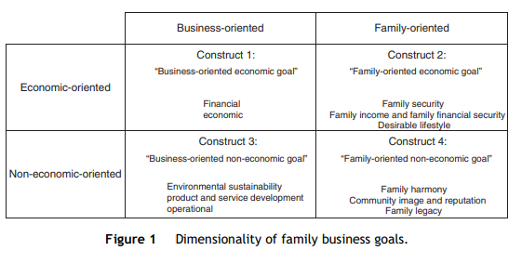
Theoretical Framework
Theoretical framework
 | The multidimensionality of family business goals | Our framework
 | The multidimensionality of family business goals | Team perspective into the multidimensionality of family business goals
 | Saturn is a gas giant and has rings. It’s composed mostly of hydrogen and helium
(Basco, 2017)

Slide 8
Hypotheses
Everything
begins
with
an
idea

Slide 9



Methodology
DATA
Survey
Bel-first database Bureau Van Dijk
SAMPLE
Estimation: 50 Belgian family firms’ finance teams
QUANTITATIVE RESEARCH METHOD

Slide 10
So What?
The multidimensionality of family business goals
Separation in family business goals
Practice: optimal financing mix
Financial perspective on the dimensionality of goals
Team influence on goals
Development of the most optimal financing mix
Notes:
Contributions → aanpassen!

Slide 11
Bibliographical References
Basco, R. (2017). “Where do you want to take your family firm?” A theoretical and empirical exploratory study of family business goals. BRQ Business Research Quarterly, 20(1), 28-44. https://doi.org/https://doi.org/10.1016/j.brq.2016.07.001

Slide 12
How do Family Business Goals shape the Financing Preferences of Family Firms’ Finance Teams?
Céline Vandevenne,
Prof. dr. Ine Umans,
Prof. dr. Sigrid Vandemaele,
Prof. dr. Laura Hoekx

