Slide 1
First-order cost analysis of increased hydrogen and decreased sulphur content in jet fuel
Alessandro Martulli
Robert Malina
European Aviation Fuel Stakeholder Forum
Brussels, February 3rd 2026

Slide 2
Background and goal of the analysis
Reducing the levels of sulphur and increasing the hydrogen content in aviation fuels can help to reduce contrail formation and decrease air-quality-related impacts
Hydroprocessing methods can increase hydrogen content and significantly reduce sulphur, resulting in jet fuels with lower aromatic and sulphur content, at the expense of additional operational and capital costs.
At the end of Phase I, a first-order estimate of these additional costs was needed.
First-order refinery cost analysis in the EU due to:
Sulphur content reduction to 10 ppm
Hydrogen content increase from 13.8% to 14.6%

Slide 3
First-order refinery cost analysis
Modeling approach

Slide 4
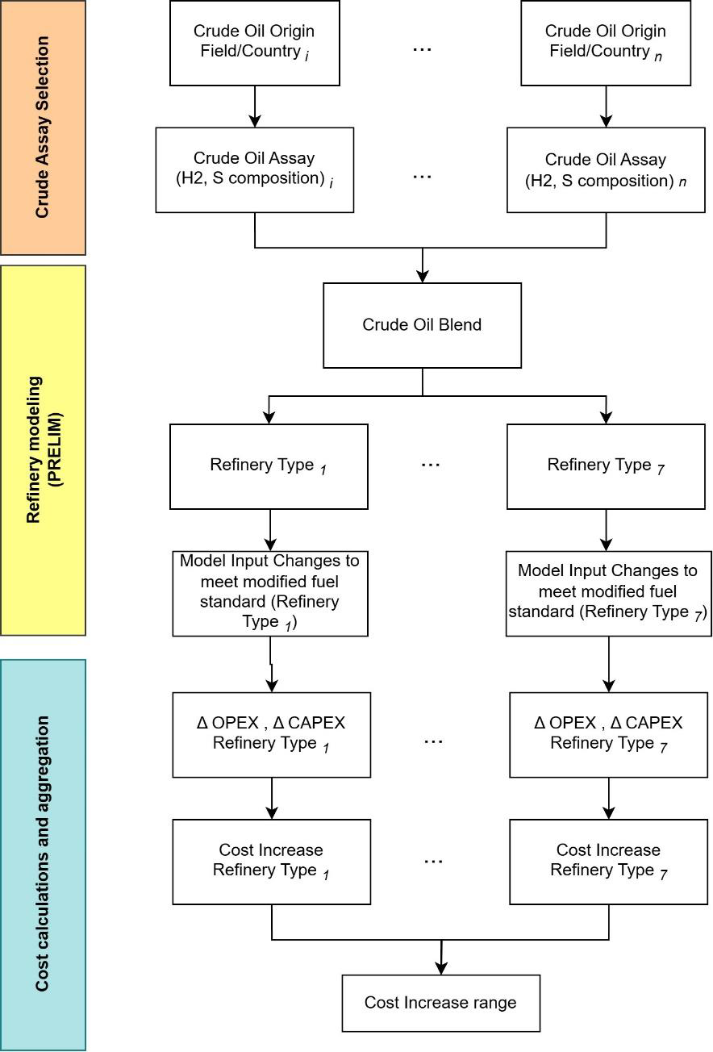
First-order cost estimation - modeling approach
Crude oil selection
Modeling processing inputs changes based on crude oil blend and refinery configuration
Quantification of additional costs (OPEX, CAPEX, jet fuel)

Slide 5
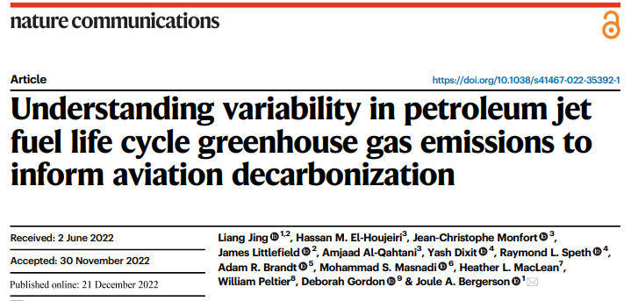
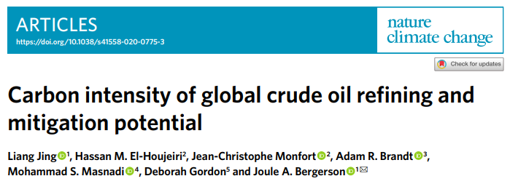
First-order cost analysis - modeling approach
Refinery Model
The Petroleum Refinery Life Cycle Inventory Model (PRELIM) is a mass and energy-based process unit-level tool for the estimation of energy use and greenhouse gas (GHG) emissions associated with processing a variety of crude oils within a range of configurations in a refinery.
Peer-reviewed, open source, detailed, and representative of refining operations.
Widely employed in high-impact academic publications on petroleum refining and jet fuel.
How PRELIM is used in this analysis
1 | Create an average EU crude oil blend for each refinery type available in PRELIM
2 | Change the hydrogen and sulfur content of jet fuel to match the defined requirements.
3 | Derive changes in processing inputs due to new requirements.
4 | Link changes in processing inputs to cost estimates

Slide 6
First-order cost analysis - modeling approach
Crude Oil Selection
In PRELIM, it is possible to build a crude blend with max 10 crude oils.
A list of crude oils by country/field of origin entering European refineries was considered (Eurostat, 2023)
The 10 largest crude oils were included in the blend in PRELIM with mass ratio adjusted using the available data on the amount of imports in the EU
The 10 oils considered represent >60% of European crude refineries intake.
Crude Oil Assay | Mass Ratio used
West Texas Intermediate (WTI) | 23.37%
Kazak (CPC) | 15.58%
Norway (Ekofisk) | 13.64%
Arab light | 9.02%
Libya (EsSider) | 7.50%
Azeri BTC | 7.35%
Brazil (Lula) | 6.25%
UK (Brent) | 5.86%
Nigeria (Escravos) | 5.75%
Iraq (Basrah) | 5.68%
Mass ratios based on EU import shares for the top 10 blends, scaled to 100%.

Slide 7
First-order cost analysis - modeling approach
Refinery configurations
Refinery types differ based on their complexity, the types of processing units, and the yields of transportation fuels.
Seven refinery configurations are available in PRELIM
1 | Hydroskimming
2 | Medium Conversion: FCC (Fluid Catalytic Cracking)
3 | Medium Conversion: GO-HC (Gas Oil Hydrocracker)
4 | Medium Conversion: FCC & GO-HC
5 | Deep Conversion: FCC
6 | Deep Conversion: GO-HC
7 | Deep Conversion: FCC & GO-HC
Include crude distillation, support services, catalytic reforming, hydrotreating, and blending to upgrade naphtha to gasoline and reduce sulfur in products.
Conversion refineries build on hydro-skimming units with catalytic cracking and/or hydrocracking to further process heavier fractions.
Deep conversion refineries go further by adding coking units, which break down residual oil into lighter streams for use in conversion and upgrading processes, maximizing fuel yield

Slide 8
Operational cost approach

Slide 9
First-order cost analysis - modeling approach
Operational costs (OPEX)
To meet the fuel requirements, modifications to the straight-run and hydrotreated kerosene fractions are needed. SR kerosene needs to undergo hydrotreatment to reduce its sulphur content. To increase the overall hydrogen content of the final jet fuel product, more hydrogen must be added during hydrotreatment (derived from PRELIM)
Additional processing inputs needed: natural gas, electricity, hydrogen, and steam consumption (derived from PRELIM)
The results are computed as additional operational cost per ton of jet fuel produced by each refinery type
The additional costs are assumed to be added to the baseline jet fuel price to obtain an estimate of the jet fuel price increase range
Parameter | Baseline Value | Min - Max | Unit | Source
Electricity price | 0.1685 | 0.0882 – 0.2580 | €/kWh | EUROSTAT (2024)
Natural gas price | 0.0432 | 0.0349 – 0.0772 | €/kWh | EUROSTAT (2024)
Jet Fuel Price | 734 | / | €/ton | Jet A1 Reference Price (EASA, 2024)

Slide 10
Capital cost approach

Slide 11
First-order cost analysis - modeling approach
Capital costs (CAPEX) considerations
Specific data on kerosene hydrotreatment processing and hydrogen production capacity is not available → uncertain whether installed capacity is sufficient to accommodate larger kerosene fraction in each refinery
All refinery configurations available in PRELIM include kerosene hydrotreatment and hydrogen production units.
Their capacities is typically greater for deep-conversion refineries than hydroskimming/medium-conversion refineries
Scenario 1 – No additional CAPEX needed for any refinery type → cost increase only due to OPEX increase
Scenario 2 – Additional CAPEX in hydroskimming and medium conversion refineries
 | Hydrogen production capacity | Hydrotreatment capacity
CAPEX consideration | 0.26 €/kg of hydrogen produced (European Hydrogen Observatory, 2023) | 50 million € (adjusted using CEPCI from Gary et al. 2007 and depreciated for 15 years)
Refinery type | Hydroskimming and medium conversion | Hydroskimming and medium conversion

Slide 12
First-order refinery cost analysis
Results

Slide 13
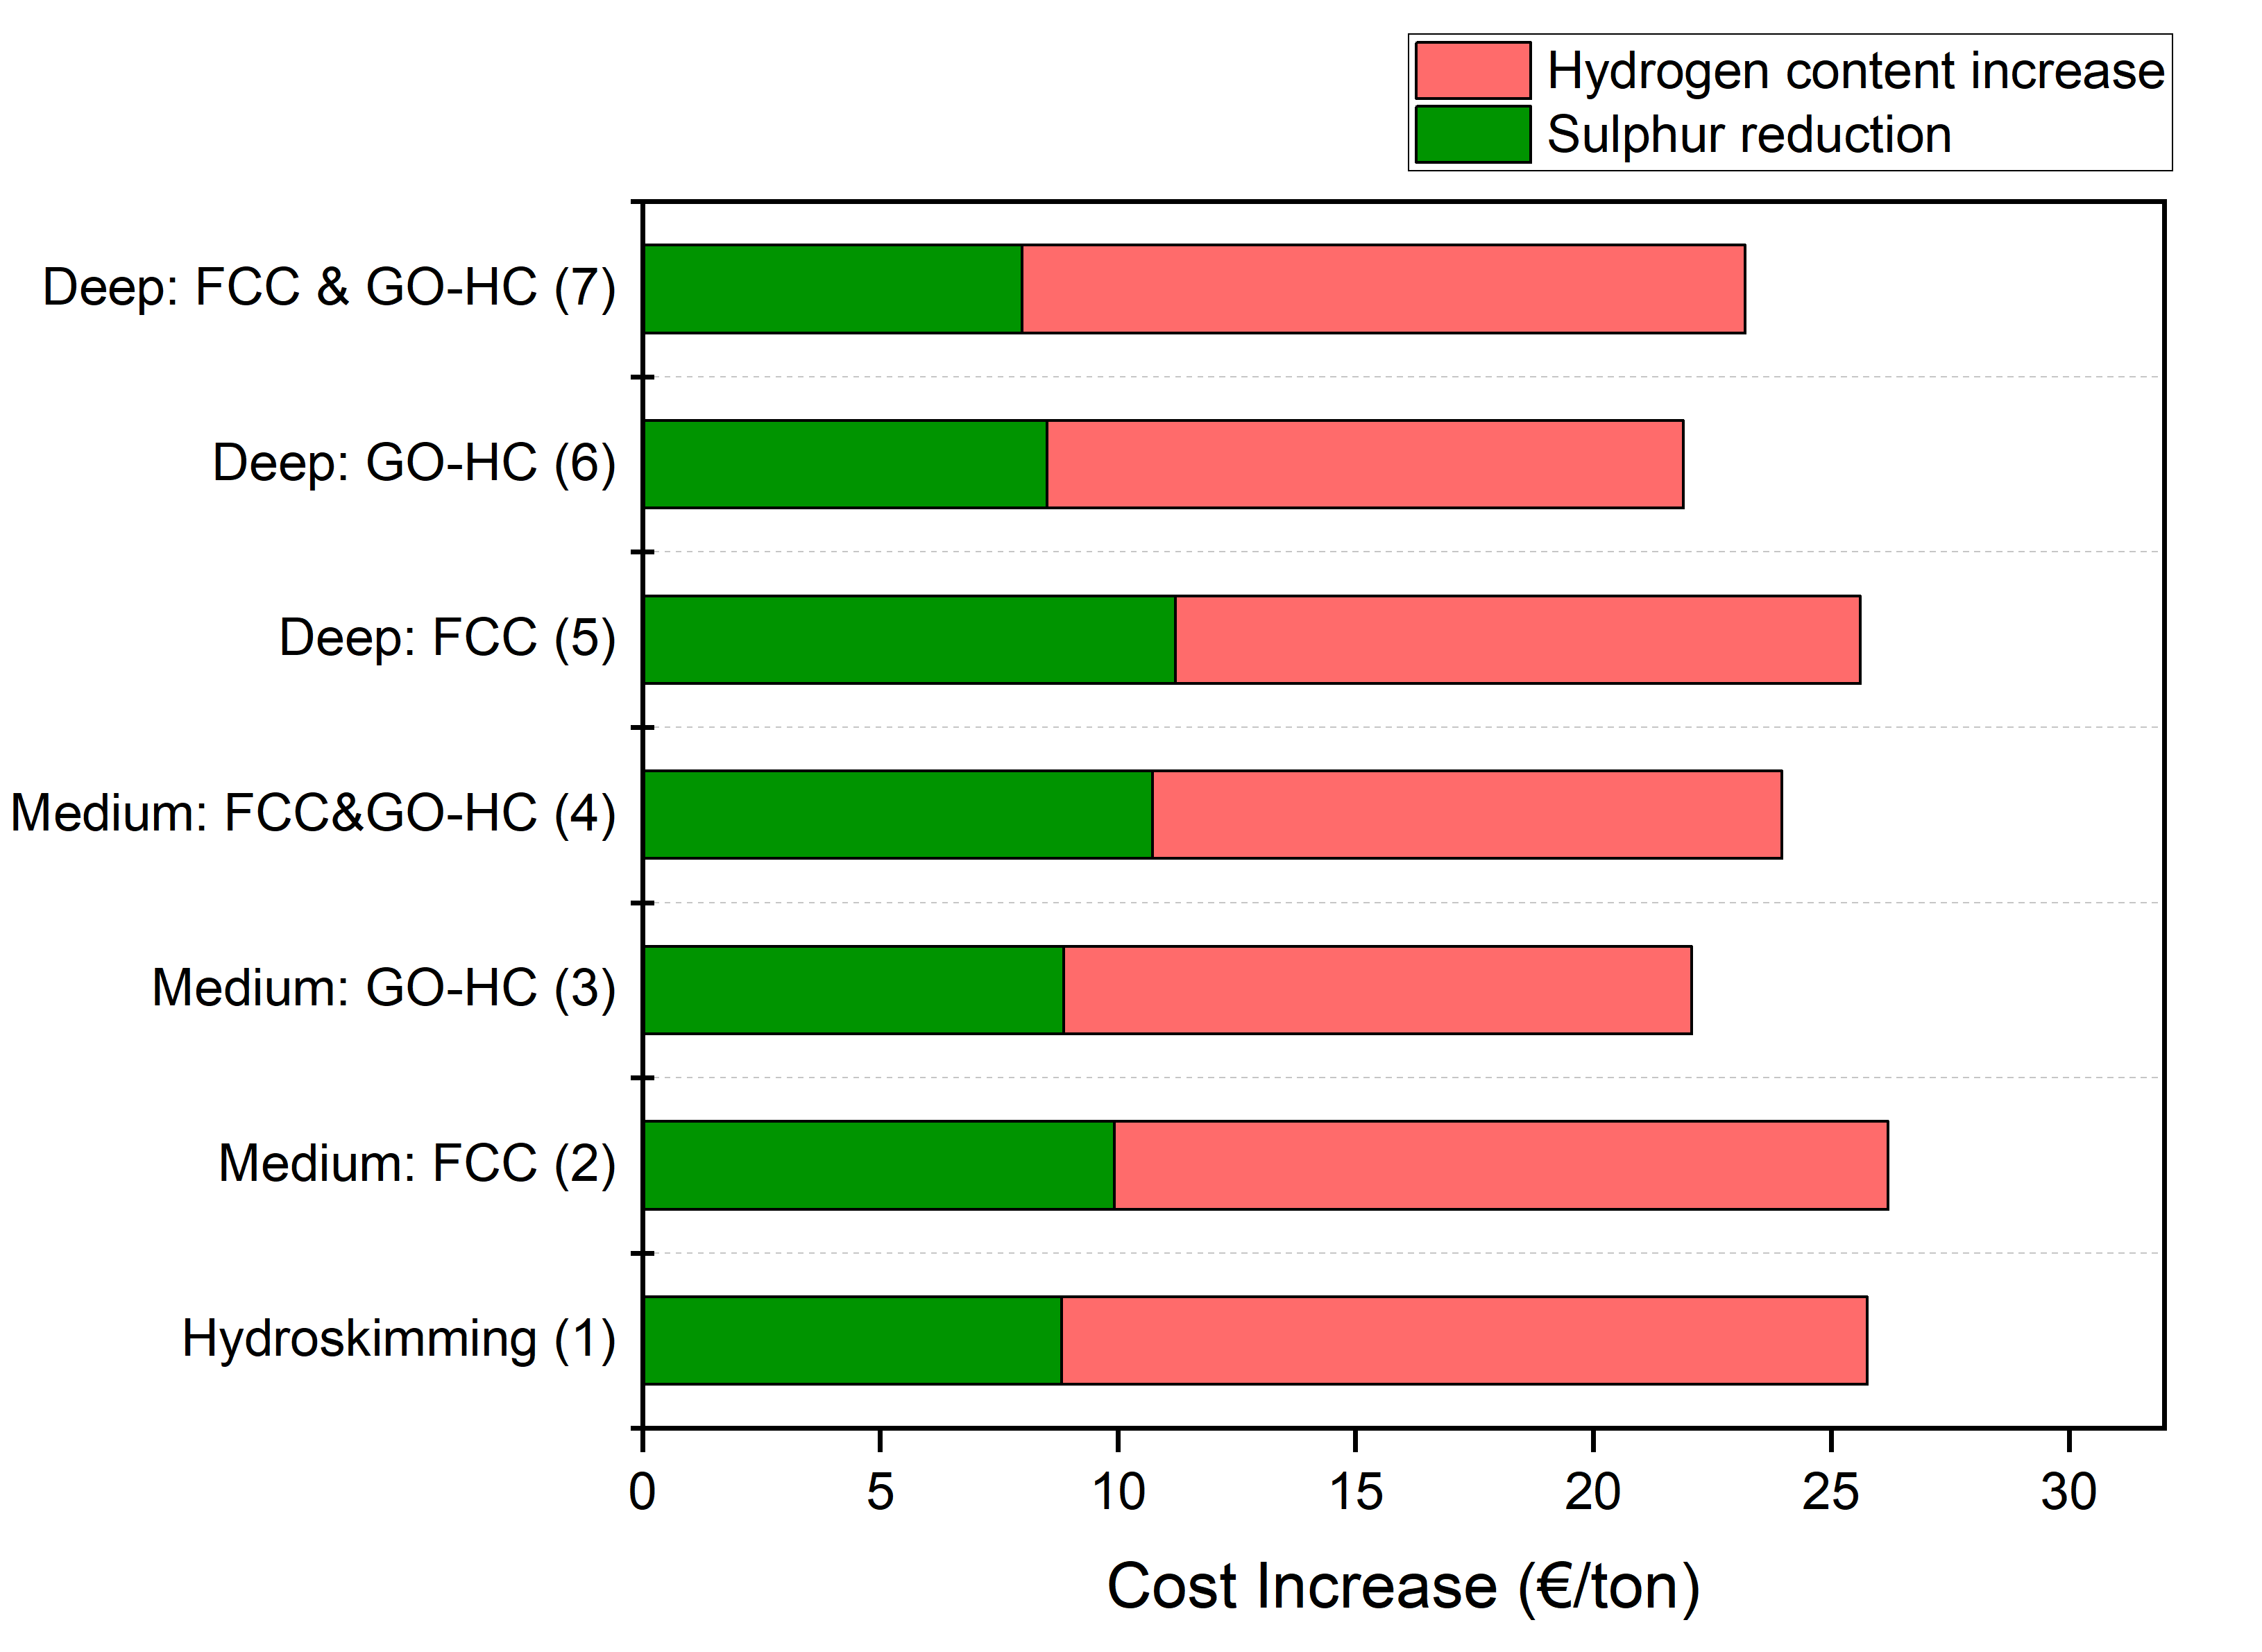
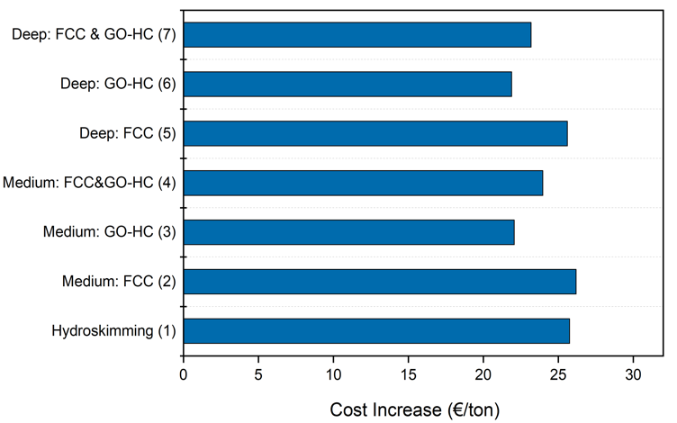
First-order refinery cost analysis - Results
Operational cost increase range = +21.90 to +26.20 €/ton of jet fuel
Corresponding jet fuel price increase range = +2.98% to +3.57%
  Hydrogen content increase accounts for 55-66% of increased costs depending on refinery configuration

Slide 14
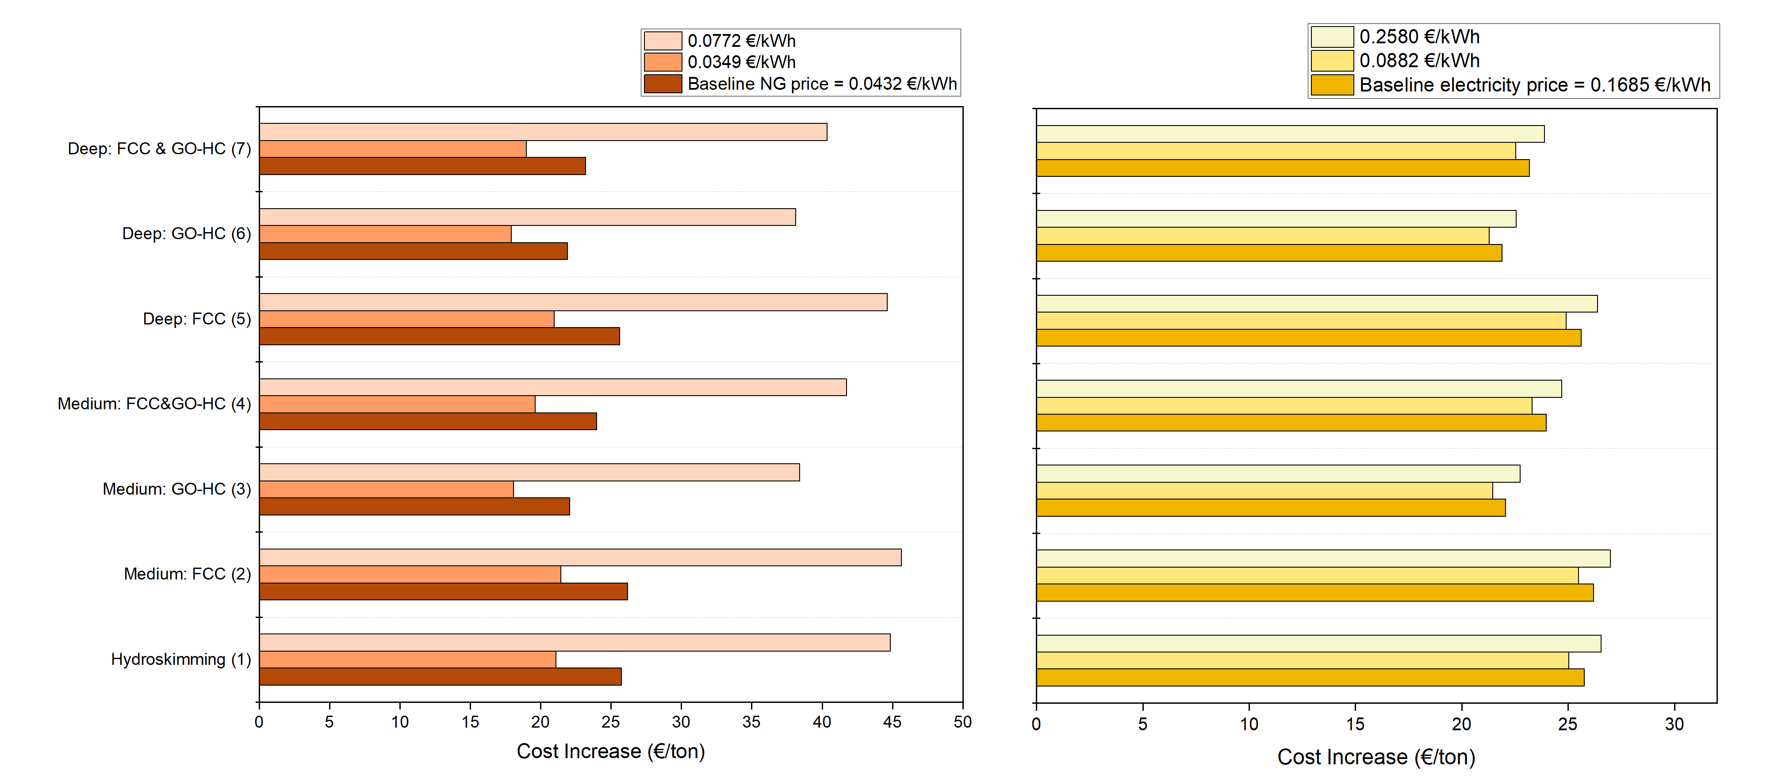
First-order refinery cost analysis - Results
Sensitivity Analysis: Natural Gas and Electricity Price
Min and max are defined by NG and the electricity price in EU countries.
An 80% rise in natural gas prices compared to the baseline results in a 74% increase in additional production costs.
Minor cost changes due to the electricity price variation

Slide 15
First-order refinery cost analysis - Results
Additional CAPEX in hydroskimming and medium conversion refineries
Parameter | Cost increase due to OPEX (No additional CAPEX, €/ton jet fuel) | Cost Increase with additional Hydrogen CAPEX (€/ton jet fuel) | Cost Increase with additional Hydrotreat CAPEX, €/ton) | Total Cost Increase (with additional Hydrotreat and H production CAPEX, €/ton jet fuel) | Jet Fuel Price increase (baseline jet fuel price = 734 €/ton)
Hydroskimming | 25.76 | 2.68 | 6.49 | 34.92 | 4.76%
Medium – FCC | 26.20 | 2.94 | 6.33 | 35.47 | 4.83%
Medium – GO-HC | 23.09 | 2.61 | 5.58 | 31.27 | 4.26%
Medium – FCC & GO-HC | 23.96 | 2.86 | 5.96 | 32.78 | 4.47%
Deep – FCC | 25.61 | / | / | 25.61 | 3.49%
Deep – GO-HC | 21.90 | / | / | 21.90 | 2.98%
Deep – FCC & GO-HC | 23.19 | / | / | 23.19 | 3.16%
Max
Min

Slide 16
First-order refinery cost analysis
Takeaways and limitations

Slide 17
First-order refinery cost analysis - Conclusions
Jet fuel refining costs increase due to OPEX changes, ranging from 21.60 € to 26.20 €/ton.
Assuming an average value of 734 €/ton, this is an increase of 3.0%-3.6% on the jet fuel price
When additional capital investments (CAPEX) are included—such as for hydrogen production or hydrotreatment units—the total refining cost increases, ranging from 21.90 € to 35.47 €/ton of jet fuel. This translates to a 3.0% to 4.8% increase reference price of jet fuel
Overall, the increase in hydrogen content leads to a larger cost increase than the sulphur reduction. Natural Gas prices are a major factor influencing the cost increase.

Slide 18
Limitations of the first-order refinery cost analysis
Deep-dive analysis could
Modeling based on EU-wide crude oil blend
Only major input changes are considered
Only modified two largest fractions of final jet fuel
Only the cost side of refinery changes is considered
CAPEX based on blanket approach per refinery type
Match the crude oil assays with appropriate refinery configurations to reflect European real-world operations.
Include additional processing inputs and costs would provide a more comprehensive assessment of the operational costs.
Evaluate the trade-off of modifying other fractions than those modified in this study and the effects on the overall cost increase
Match specific jet fuel outputs to refinery configurations and jet fuel selling prices and study revenue impact
Identify the installed capacity of units for each refinery type and more accurately define the needed CAPEX

Slide 19
Thank you very much.
European Aviation Fuel Stakeholder Forum
Brussels, February 3rd 2026
alessandro.martulli@uhasselt.be
robert.malina@uhasselt.be

