Slide 1
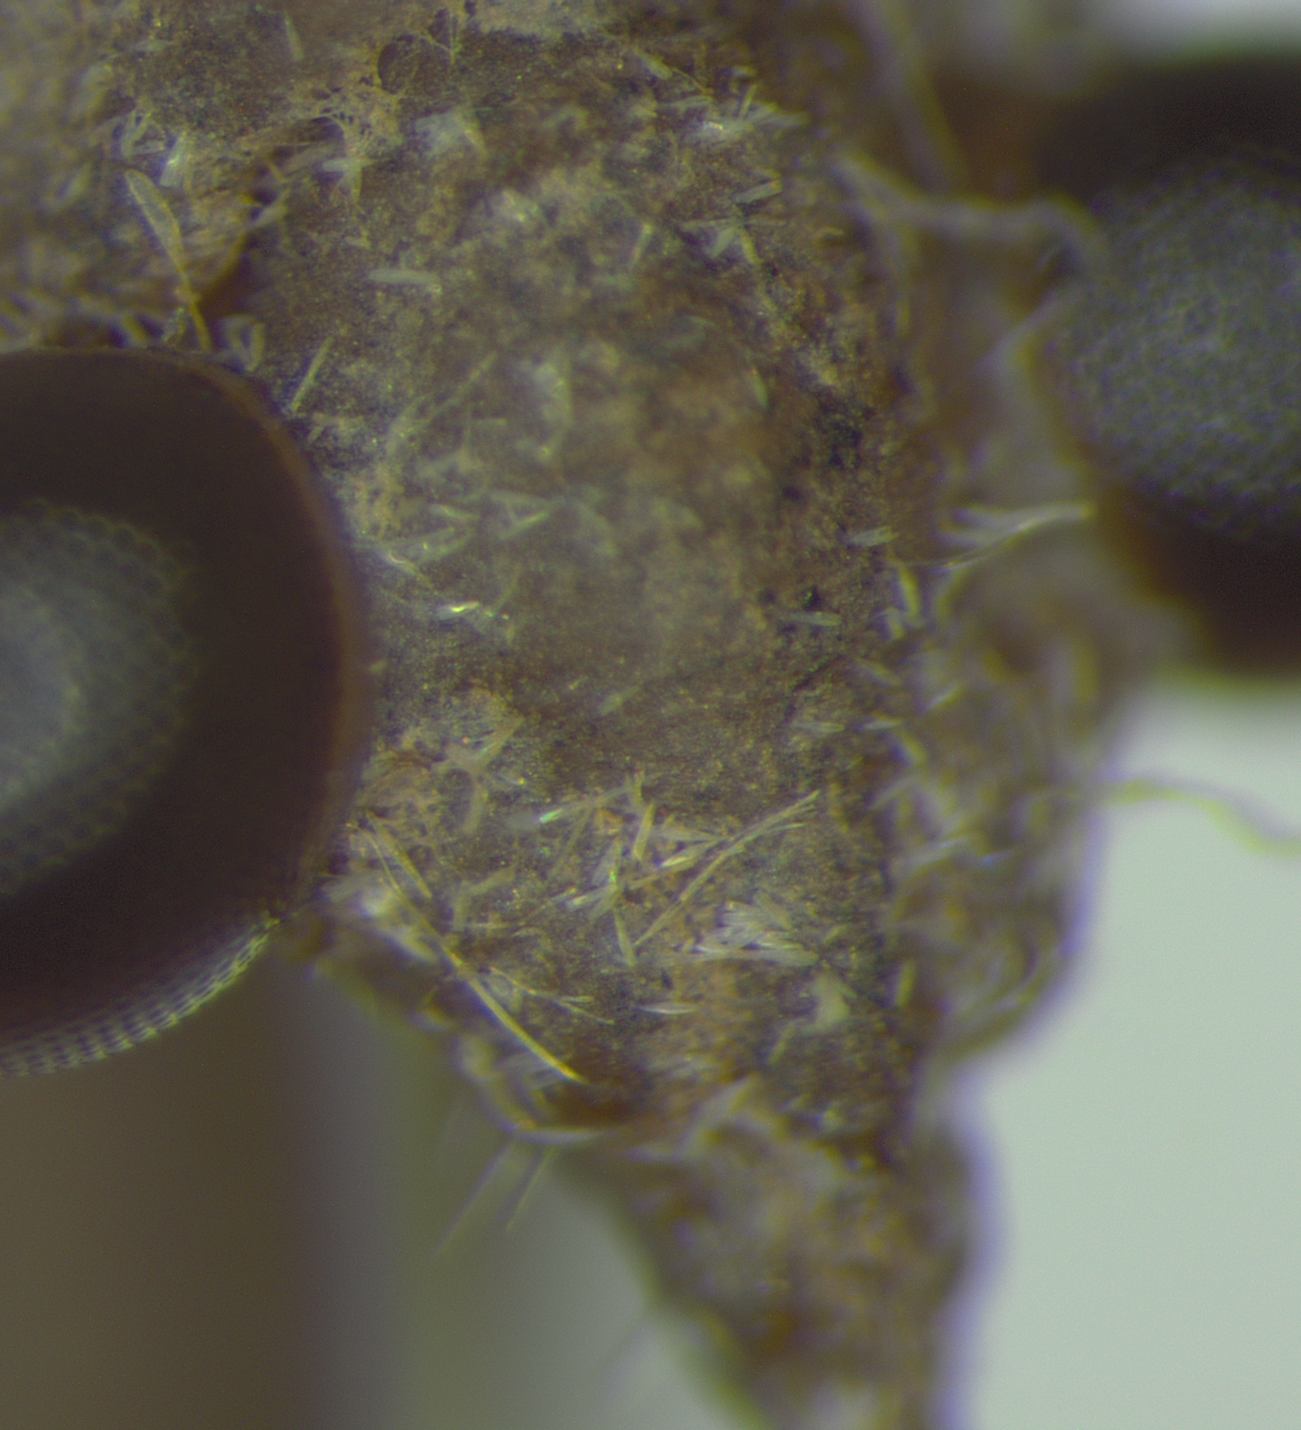
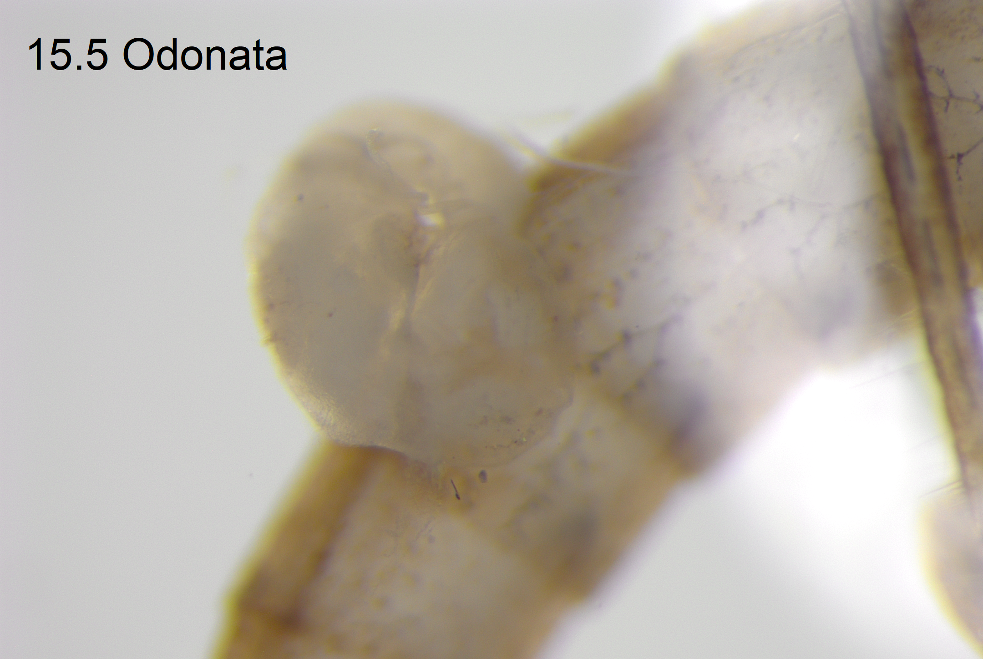
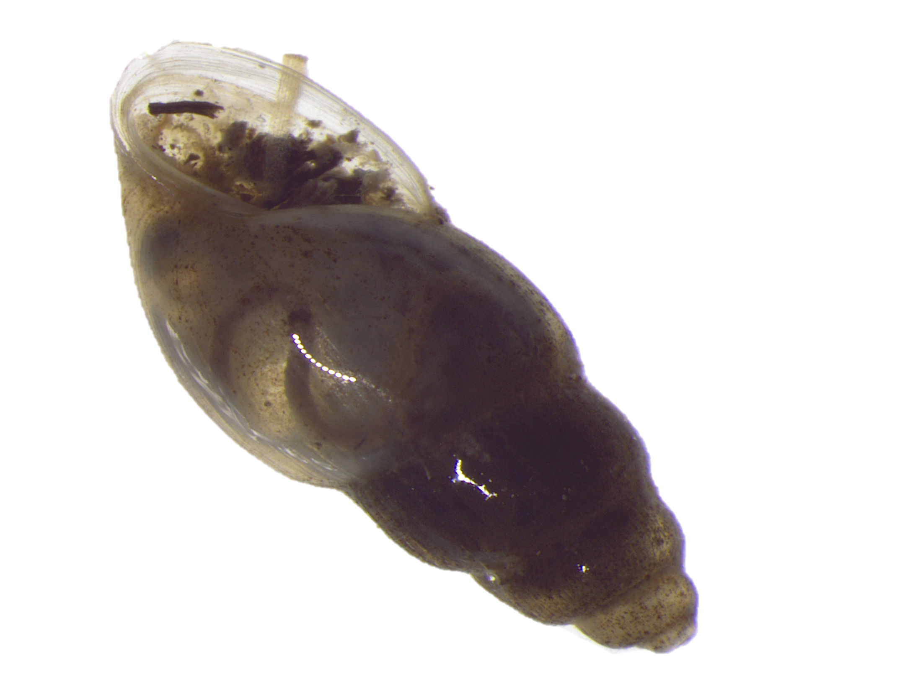
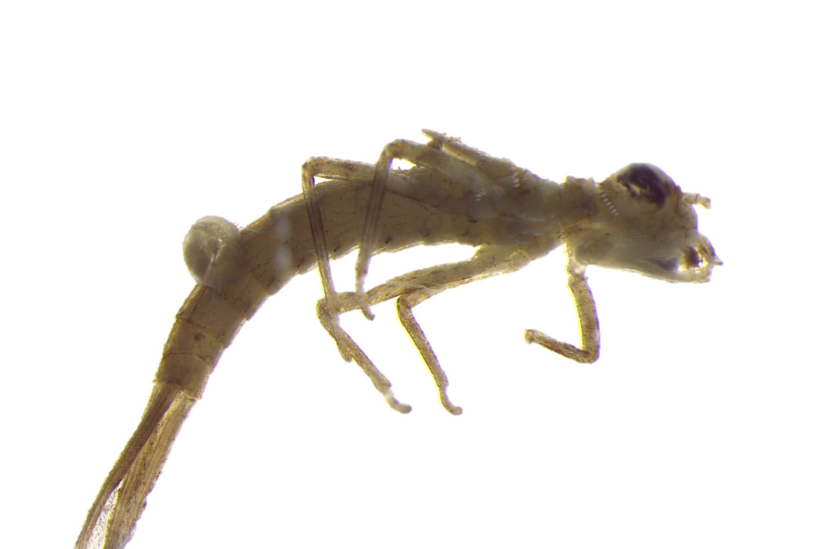
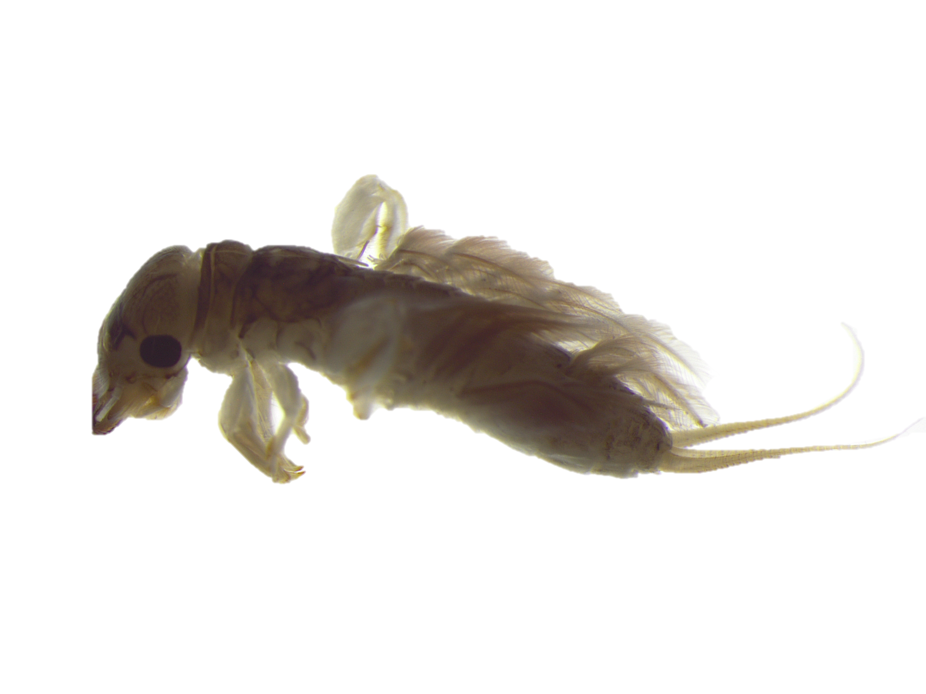
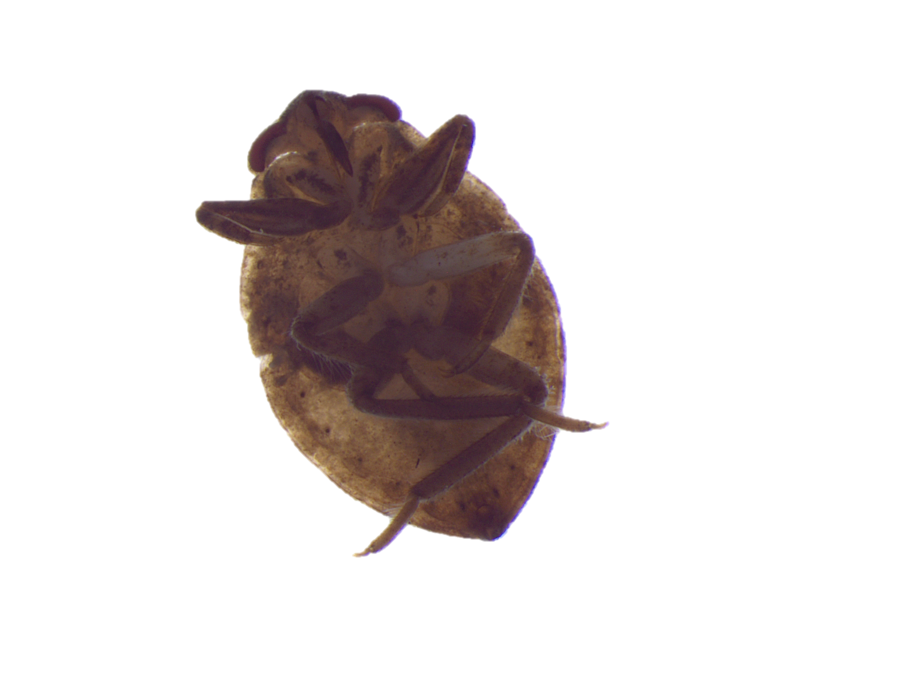
THE BIOINDICATION POTENTIAL OF PARASITIC FAUNA INFECTING MACROINVERTEBRATES IN AFRICAN WETLANDS
Linde “Leo” Cools
Notes:
Did you know that parasites can serve as a powerful magnifying lens for changes in the natural world? In the recent years, it’s become apparent that parasites can be suitable indicators of ecosystem quality. Take for instance those with a complex life cycle and multiple hosts: a parasite’s presence in a certain host (some parasites typically infect macroinvertebrates like snails or insects in an intermediary stage) often reveals that there must be hosts for the previous and next life stages to exist, or how else would we observe this life stage? Parasites as bioindicators, especially in the Global South, are still very understudied: which is something the AfroWetMaP project would like to address. We aim to improve knowledge on invertebrates and their associated parasites, and also improve the efficiency of the tools used to study these organisms. Please feel free to pay me a visit if this has piqued your interest!

