Slide 1
The importance of measured or estimated anaerobic threshold in training programs
Dominique Hansen, PhD, FESC
Hasselt University, Hasselt, Belgium

Slide 2
No conflicts of interest to be declared

Slide 3
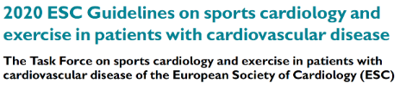
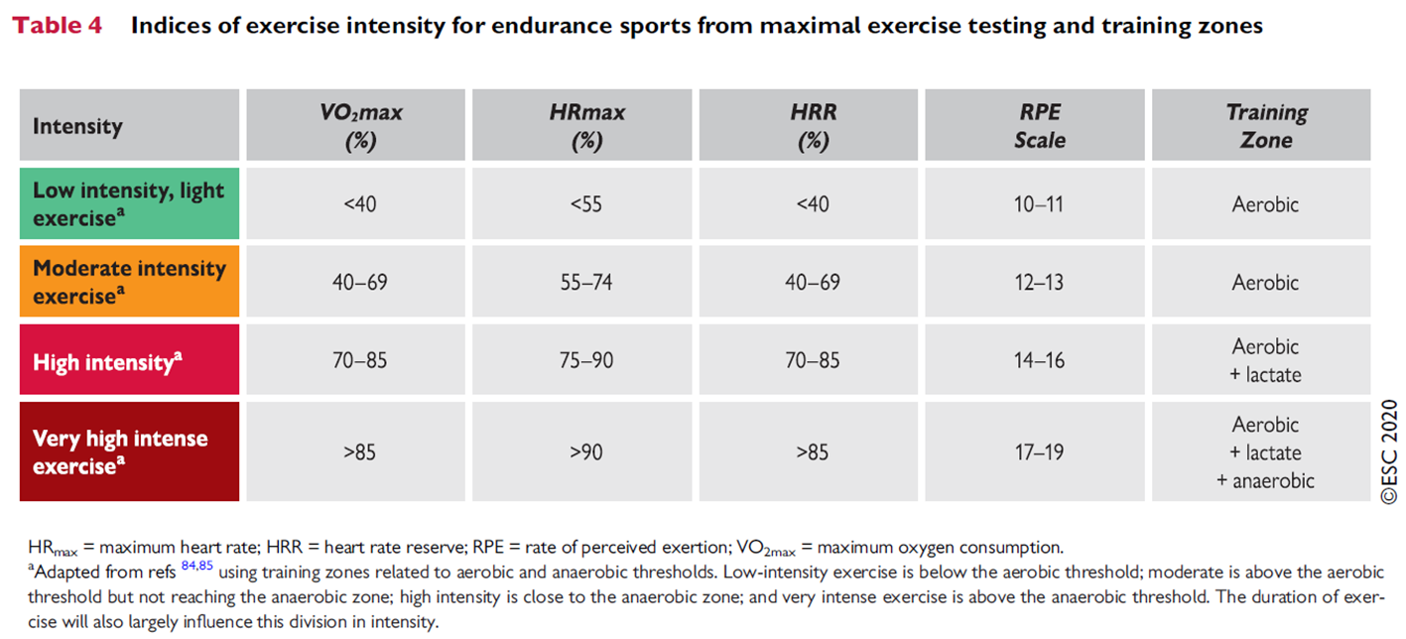
Setting the intensity of endurance exercise or physical activity: so easy…
Pelliccia A, et al. Eur Heart J. 2021;42:17-96.

Slide 4
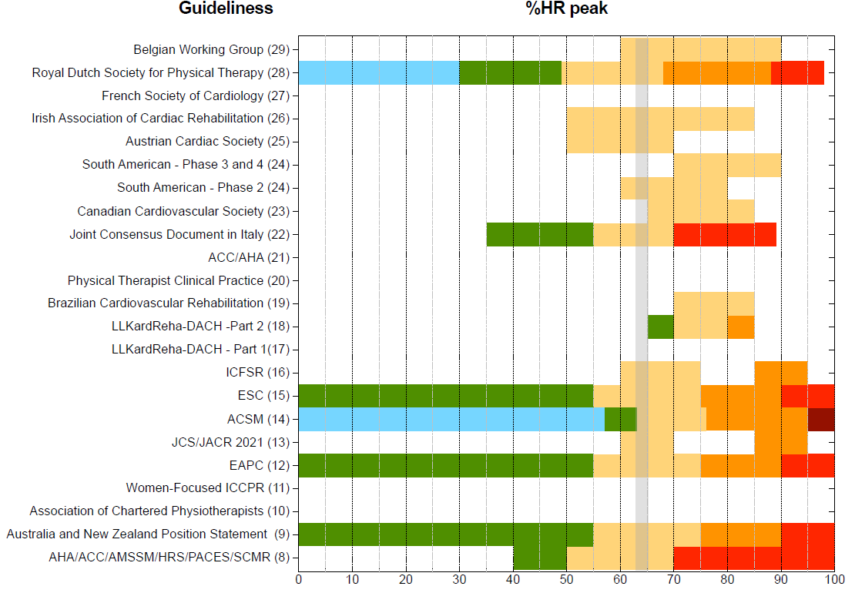
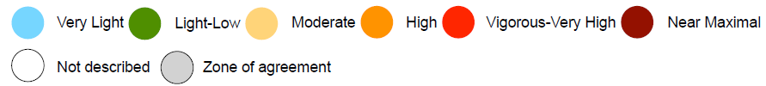
Setting the intensity of endurance exercise: which guideline to choose?
Hansen D, et al. Advancing Aerobic Exercise Training Intensity Prescription in Health and Disease Beyond Standard Recommendations: A Call to Action. Sports Med. 2025 Sep;55(9):2111-35.

Slide 5
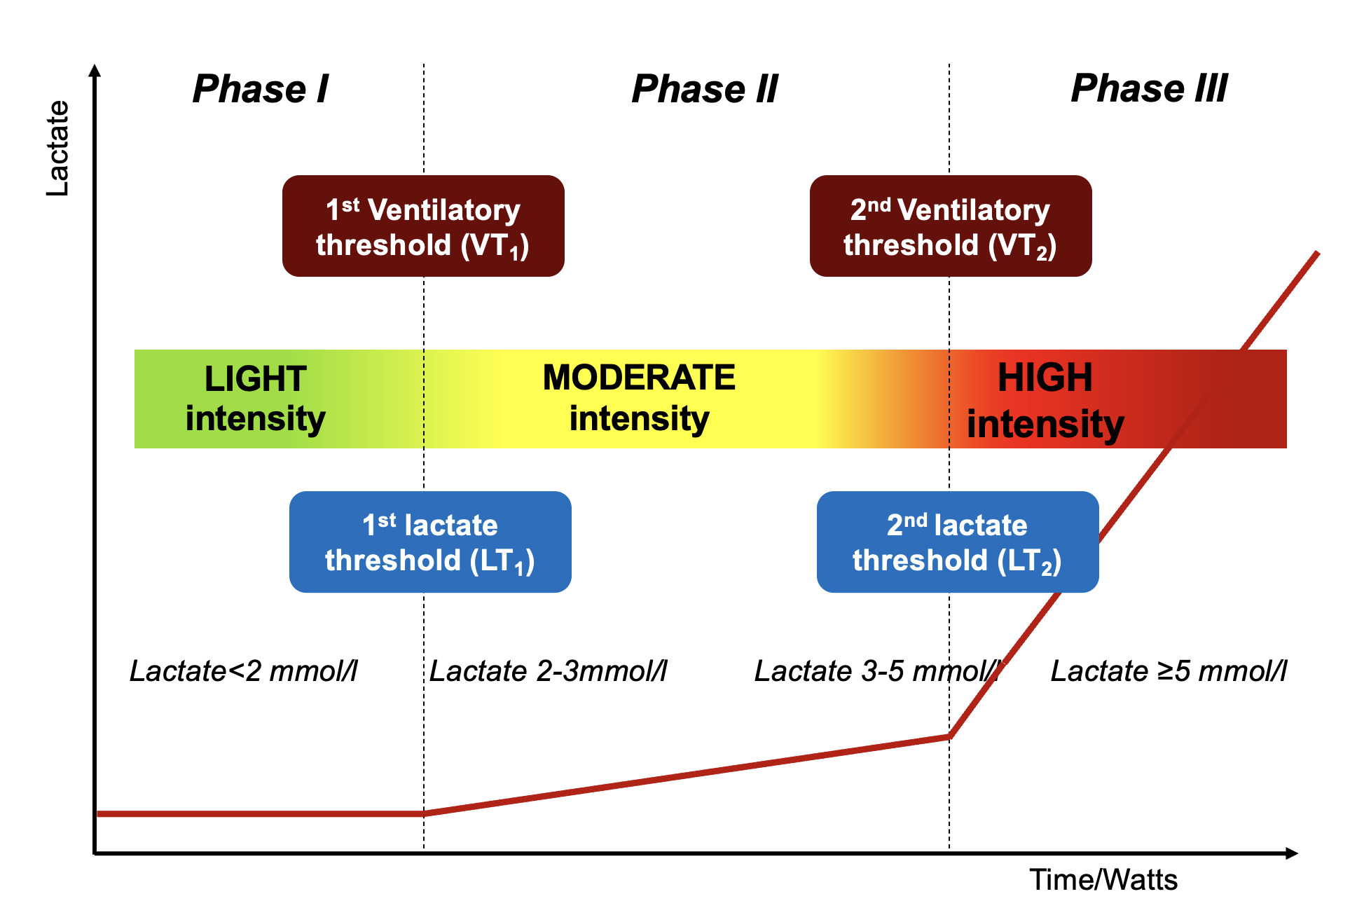
The concept of VT and AT
Hansen D, et al. Advancing Aerobic Exercise Training Intensity Prescription in Health and Disease Beyond Standard Recommendations: A Call to Action. Sports Med. 2025 Sep;55(9):2111-35.

Slide 6
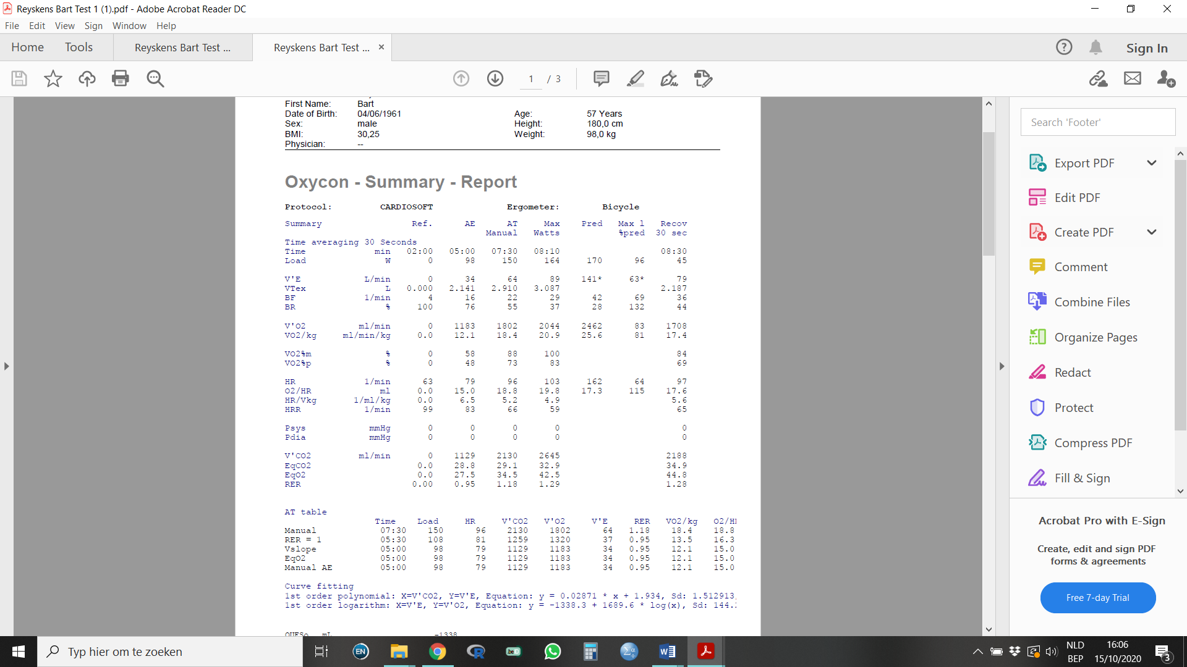
Let’s give it a try anyway…
CASE 1
CPET
General characteristics
Male, 57 years, 99.6 kg
Medical history
STEMI, for which urgent PCI on LAD & RAC (4 months ago)
Type 2 diabetes (>20 years ago)
Current status
Some coronary irregularities, no severe stenosis left over (full revascularisation achieved)
LVEF 61%
Current medication
Beta-blocker
ACE-inhibitor
Statin
Antiplatelet
Metformin & SGLT-2 inhibitor
Risk profile
Blood pressure: 125/70 mmHg
LDL cholesterol: 93 mg/dl (2.4 mmol/l)
HbA1c: 8.2%
BMI: 32.4 kg/m², waist circumference of 114 cm
VT1
VT2

Slide 7
Let’s give it a try anyway…
CASE 1
CPET
General characteristics
Male, 57 years, 99.6 kg
Medical history
STEMI, for which urgent PCI on LAD & RAC (4 months ago)
Type 2 diabetes (>20 years ago)
Current status
Some coronary irregularities, no severe stenosis left over (full revascularisation achieved)
LVEF 61%
Current medication
Beta-blocker
ACE-inhibitor
Statin
Antiplatelet
Metformin & SGLT-2 inhibitor
Risk profile
Blood pressure: 125/70 mmHg
LDL cholesterol: 93 mg/dl (2.4 mmol/l)
HbA1c: 8.2%
BMI: 32.4 kg/m², waist circumference of 114 cm
VT1
VT2
HR = 57-76 bts/min

Slide 8
Let’s give it a try anyway…
CASE 1
CPET
General characteristics
Male, 57 years, 99.6 kg
Medical history
STEMI, for which urgent PCI on LAD & RAC (4 months ago)
Type 2 diabetes (>20 years ago)
Current status
Some coronary irregularities, no severe stenosis left over (full revascularisation achieved)
LVEF 61%
Current medication
Beta-blocker
ACE-inhibitor
Statin
Antiplatelet
Metformin & SGLT-2 inhibitor
Risk profile
Blood pressure: 125/70 mmHg
LDL cholesterol: 93 mg/dl (2.4 mmol/l)
HbA1c: 8.2%
BMI: 32.4 kg/m², waist circumference of 114 cm
VT1
VT2
VO2 = 818-1410 ml/min

Slide 9
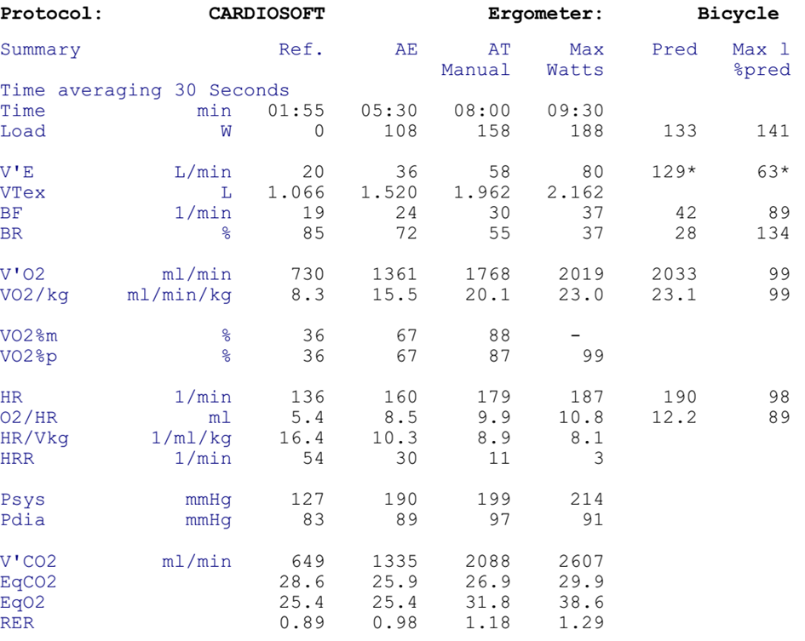
Let’s give it a try anyway…
CASE 2
CPET
General characteristics
Female, 30 years, 164 cm, 88 kg
Medical history
No major diseases/events to be reported
Current status
Known with obesity for several years
Normal hemodynamic and ECG response during exercise testing
Current medication
Statin
Risk profile
Blood pressure: 132/87 mmHg
LDL cholesterol: 143 mg/dl (3.7 mmol/l)
HbA1c: 4,5%
BMI: 32.7 kg/m²
VT1
VT2

Slide 10
Let’s give it a try anyway…
CASE 2
CPET
General characteristics
Female, 30 years, 164 cm, 88 kg
Medical history
No major diseases/events to be reported
Current status
Known with obesity for several years
Normal hemodynamic and ECG response during exercise testing
Current medication
Statin
Risk profile
Blood pressure: 132/87 mmHg
LDL cholesterol: 143 mg/dl (3.7 mmol/l)
HbA1c: 4,5%
BMI: 32.7 kg/m²
VT1
VT2
HR = 103-138 bts/min

Slide 11
Let’s give it a try anyway…
CASE 2
CPET
General characteristics
Female, 30 years, 164 cm, 88 kg
Medical history
No major diseases/events to be reported
Current status
Known with obesity for several years
Normal hemodynamic and ECG response during exercise testing
Current medication
Statin
Risk profile
Blood pressure: 132/87 mmHg
LDL cholesterol: 143 mg/dl (3.7 mmol/l)
HbA1c: 4,5%
BMI: 32.7 kg/m²
VO2 = 808-1393 ml/min
VT1
VT2

Slide 12
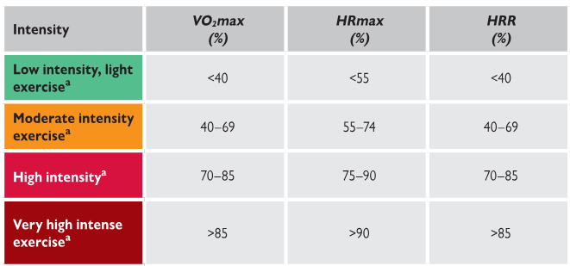
Is this a coincidence?
272 CPETs
%HRpeak
%HRR
%VO2peak
VT1
VT2
%HRpeak
%HRR
%VO2peak
?
Hansen D, et al. Exercise training intensity determination in cardiovascular rehabilitation: Should the guidelines be reconsidered? Eur J Prev Cardiol. 2019;26(18):1921-1928.

Slide 13
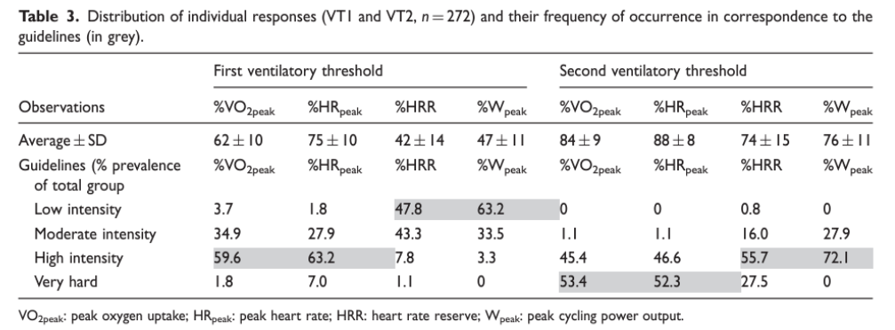
No, it is not: it is a pattern…
Others confirm:
Pymer S, et al. Does exercise prescription based on estimated heart rate training zones exceed the ventilatory anaerobic threshold in patients with coronary heart disease undergoing usual-care cardiovascular rehabilitation? A United Kingdom perspective. Eur J Prev Cardiol 2020;27:579-589.
Iannetta D, et al. A Critical Evaluation of Current Methods for Exercise Prescription in Women and Men. Med Sci Sports Exerc 2020;52:466-473.
Jamnick NA, et al. An Examination and Critique of Current Methods to Determine Exercise Intensity. Sports Med 2020;50:1729-1756.
Anselmi F, et al. The importance of ventilatory thresholds to define aerobic exercise intensity in cardiac patients and healthy subjects. Scand J Med Sci Sports. 2021;31(9):1796-1808.
Milani JGPO, et al. Exercise intensity domains determined by heart rate at the ventilatory thresholds in patients with cardiovascular disease: new insights and comparisons to cardiovascular rehabilitation prescription recommendations. BMJ Open Sport Exerc Med. 2023;9(3):e001601.
Hansen D, et al. Exercise training intensity determination in cardiovascular rehabilitation: Should the guidelines be reconsidered? Eur J Prev Cardiol. 2019;26(18):1921-1928.

Slide 14
Newest CR guideline from the USA
Recommendations on setting the intensity of endurance training
Moderate-intensity
40%–59% of heart rate reserve
Rating of perceived exertion of 12 or 13 on 6–20 Borg Scale
Vigorous-intensity
60%–89% of heart rate reserve
Rating of perceived exertion of 14–17 on 6–20 Borg Scale
10 beats/min below heart rate associated with any of the following criteria:
Onset of angina or other symptoms of cardiovascular insufficiency
Plateau or decrease in SBP, SBP >240 mm Hg, or DBP >110 mm Hg
>1 mm or horizontal or downsloping ST-segment depression
Radionuclide evidence of reversible myocardial ischemia or echocardiographic evidence of moderate to severe wall motion abnormalities during exertion
Increased frequency of ventricular dysrhythmias
Other substantial electrocardiographic disturbances (eg, second- or third-degree atrioventricular block, atrial fibrillation, supraventricular tachycardia, complex
ventricular ectopy)
Other signs or symptoms of exertional intolerance
Brown TM, et al. Core Components of Cardiac Rehabilitation Programs: 2024 Update: A Scientific Statement From the American Heart Association and the American Association of Cardiovascular and Pulmonary Rehabilitation. Circulation 2024;150:e328–e347.
Brown TM, et al. Core Components of Cardiac Rehabilitation Programs: 2024 Update: A Scientific Statement From the American Heart Association and the American Association of Cardiovascular and Pulmonary Rehabilitation: Endorsed by the American College of Cardiology. J Cardiopulm Rehabil Prev 2025;45:E6–E25.

Slide 15
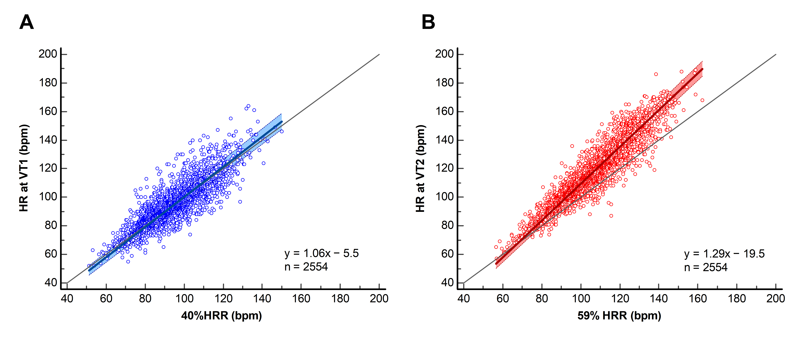
A reality check…
2,554 individuals from 12 centres across 9 countries
The AHA/AACVPR %HRR-based recommendations accurately reflect the lower boundary of moderate-intensity exercise (VT1) but underestimate the transition to higher intensities (VT2)
Milani JGPO, et al. Cardiorespiratory Exercise Intensity Prescription in Cardiovascular Rehabilitation: Do Updated Guideline Recommendations Reflect Real Individual Effort Responses? Eur J Prev Cardiol 2026; in press.

Slide 16
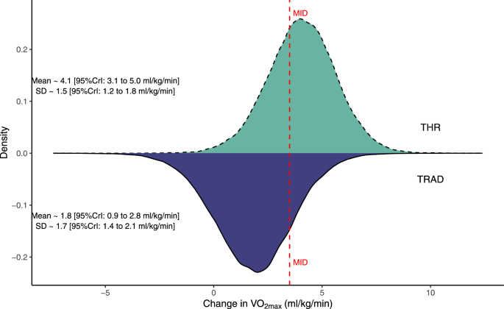
And it gets even worse…
In 1,544 healthy individuals from 42 studies
Exercise training
based on
VT or AT
Difference of
2.3 ml/kg/min
or
%peak effort
Individuals were approximately four times more likely to experience an increase in VO2max greater than the minimally important difference (MID) with exercise training by VT or LT (64%) compared with %peak effort (16%)
Meyler SJR, et al. Changes in Cardiorespiratory Fitness Following Exercise Training Prescribed Relative to Traditional Intensity Anchors and Physiological Thresholds: A Systematic Review with Meta-analysis of Individual Participant Data. Sports Med. 2025 Feb;55(2):301-23.

Slide 17
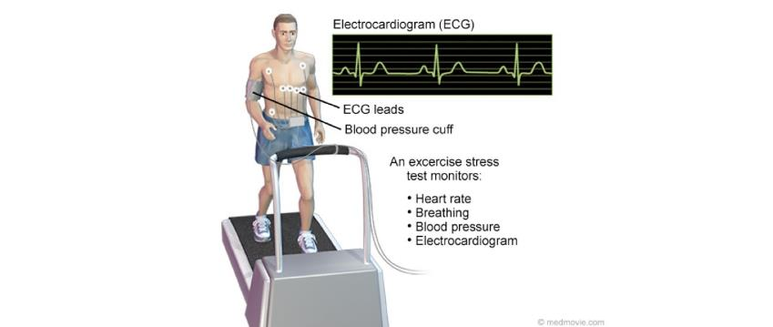
Oops…now what?
No gas exchange
analysis!

Slide 18
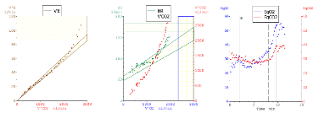
No gas exchange analysis? No worry…
N = 975 CMD patients from 8 EU countries
N = 1893 CMD patients from Brazil
External validation
mean absolute percentage error (MAPE)
Equations
VT1: 7.1%
VT2: 5.0%
%HRpeak (guidelines)
VT1: 21.3%
VT2: 16.7%
Prediction equation for HR @VT1
= 4.866+(0.405 𝑥 𝐻𝑅𝑝𝑒𝑎𝑘)+(0.542 𝑥 𝐻𝑅𝑟𝑒𝑠𝑡)
Prediction equation for HR @VT2
= −2.606+(0.773 𝑥 𝐻𝑅𝑝𝑒𝑎𝑘)+(0.254 𝑥 𝐻𝑅𝑟𝑒𝑠𝑡)
Milani JGPO, et al. Accurate Prediction Equations for Ventilatory Thresholds in Cardiometabolic Disease When Gas Exchange Analysis is Unavailable: Development and Validation. Eur J Prev Cardiol. 2024;31(16):1914-24.

Slide 19
Further finetuning…
STEP 3
STEP 1
STEP 2
CPET
sessions
Re-assess W or HR at VTs
Set the W or HR from VTs
Finetune by Borg RPE or talk test
Exercise intervention or CR program

Slide 20

E-mail: Dominique.hansen@uhasselt.be
https://www.researchgate.net/profile/Dominique_Hansen2

