Slide 1


Slide 2

Unpacking family CEO profiles in bifurcation-biased family firms:
A fuzzy set qualitative comparative analysis
Hanne Kreemers, Hasselt University (RCEF)
Tensie Steijvers, Hasselt University (RCEF)
Ine Umans, Hasselt University (RCEF)
Nadine Lybaert, Hasselt University (RCEF)
2026 SPGC – FERC Global Family Business Summit
IPAG Business School – Nice, France (May 26 -29, 2026)
(IN)STABILITY AT THE FRONTIERS
Family Business in an Age of Shifting Grounds
Notes:
Good morning everyone, and thank you for being here.
My name is Hanne Kreemers from the Research Center for Entrepreneurship and Family Firms at Hasselt University.
Today, I will present our work-in-progress paper titled: “Unpacking family CEO profiles in bifurcation-biased family firms: A fuzzy set qualitative comparative analysis.”
This is a developmental paper, and the main goal of this presentation is to receive feedback on our configurational logic, our fsQCA design, and the way we conceptualize and measure bifurcation bias.

Slide 3
Reseach objective
Starting point: Why do some family CEOs create bifurcation bias?
  Bifurcation bias = unequal HR treatment of family vs. non-family managers
Limited understanding of:
  who drives bifurcation bias
  why different directions of bias emerge across family firms
Existing literature mainly studied:
  firm-level antecedents
  favoritism always toward family members
Need for a configurational perspective
Which family CEO profiles lead to different forms of bifurcation bias?
“CEOs occupy a uniquely powerful position within the FF”
“CEOs embody multiple characteristics simultaneously”
“BB can favor non-family managers as well”
2026 SPGC – FERC Global Family Business Summit
IPAG Business School – Nice, France (May 26 -29, 2026)
(IN)STABILITY AT THE FRONTIERS
Family Business in an Age of Shifting Grounds
Notes:
The literature has traditionally framed this bias as favoritism toward family members, often linked to nepotism and socioemotional wealth preservation. However, more recent conceptual work suggests that bias can also operate in the opposite direction, where non-family managers are favored over family managers.
Our paper therefore aims to better understand who actually drives bifurcation bias and why different directions of bias emerge across family firms.
The starting point of our study is that the family CEO occupies a uniquely powerful position within private family firms.
Family CEOs are not only responsible for strategic decision-making, but they also often oversee HR management directly. This makes them key architects and implementers of bifurcation bias.
However, existing literature mainly studies bifurcation bias at the firm level and often ignores the role of the individual decision-maker.
At the same time, prior studies generally examine CEO characteristics separately. For example, they look at the isolated effect of education, tenure, or age.
We argue that this is too simplistic because family CEOs embody multiple characteristics simultaneously.
A CEO can, for example, be highly educated, strongly family-identified, and also have long tenure and CEO duality at the same time.
Therefore, bifurcation bias likely emerges from combinations of characteristics rather than single variables.
Additionally, we also move beyond the traditional assumption that bifurcation bias always favors family members.
Recent conceptual work by Daspit and colleagues as well as Jennings and colleagues suggests that family firms can also display reverse favoritism, where non-family managers receive preferential treatment because they are perceived as more competent or objective.

Slide 4
Theoretical framework
Family firm context
Balanced vs. unbalanced family system
Cognitive capacity
(= what the CEO knows)
CEO education
CEO age
CEO external experience
Structural & generational power
(= what the CEO can do)
CEO tenure
CEO duality
Generation of the CEO
Family-centered orientation
(= what the CEO wants)
Family identification
Upper echelons theory
Bifurcation bias
Non-family Family
2026 SPGC – FERC Global Family Business Summit
IPAG Business School – Nice, France (May 26 -29, 2026)
(IN)STABILITY AT THE FRONTIERS
Family Business in an Age of Shifting Grounds
Notes:
Upper echelons theory argues that organizations become reflections of their top managers because CEOs interpret strategic situations through their own experiences, values, and cognitive frames.
In private family firms, this CEO effect becomes even stronger because family CEOs often operate with high discretion and relatively limited external monitoring.
1st dimension : higher education and external career experience may broaden the CEO’s cognitive frame and increase openness toward professionalized and merit-based HR practices.
2nd dimension : family CEO duality may reduce board monitoring and strengthen the CEO’s ability to privilege family members.
^{3nd} dimension : Strongly family-identified CEOs may be more likely to prioritize family-centered goals and socioemotional wealth preservation.
At the same time, Picone and colleagues argue that biases in family firms cannot be understood solely through observable CEO characteristics. Instead, these biases emerge at the intersection of the CEO’s personal background and the broader family context.
Context: Balanced systems are characterized by moderate cohesion and flexibility, while unbalanced systems can become overly rigid, chaotic, disengaged, or enmeshed.

Slide 5
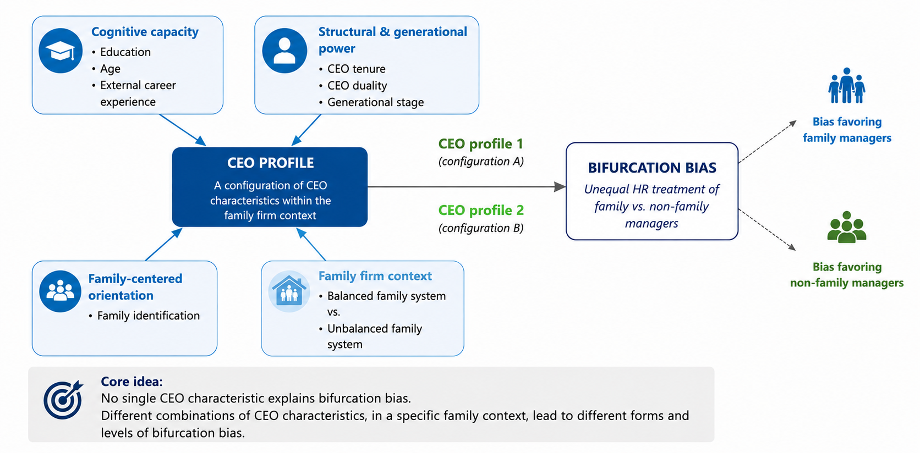
Conceptual model
2026 SPGC – FERC Global Family Business Summit
IPAG Business School – Nice, France (May 26 -29, 2026)
(IN)STABILITY AT THE FRONTIERS
Family Business in an Age of Shifting Grounds
Notes:
Our first proposition is that no single CEO characteristic is sufficient to explain bifurcation bias on its own.
For example, long CEO tenure can either reinforce entrenched family-centered routines or provide the legitimacy needed to professionalize HR systems.
Similarly, younger CEOs may be more innovative and merit-oriented, but they may also rely heavily on trusted family insiders.
This means that the same characteristic can function differently depending on the broader configuration in which it appears.
Our second proposition is that distinct configurations of CEO characteristics are associated with different forms of bifurcation bias.
And third, the family context shapes how these configurations operate.
Because our logic focuses on combinations and causal complexity, we believe that fsQCA is the most appropriate methodological approach

Slide 6



Methodology (1)
Survey-based study
Sample
  Belgian private family firms
  Family CEO
  Both family & non-family managers present in TMT
fsQCA
  Identifies combinations of conditions (= CEO profile) associated with an outcome
  Does not assume linearity → allows for equifinality
  Acknowledges causal asymmetry (low bifurcation bias ≠ reverse of high bifurcation bias)
2026 SPGC – FERC Global Family Business Summit
IPAG Business School – Nice, France (May 26 -29, 2026)
(IN)STABILITY AT THE FRONTIERS
Family Business in an Age of Shifting Grounds
Notes:
Regarding the analytical approach, we use fuzzy-set Qualitative Comparative Analysis, or fsQCA.
FsQCA is particularly suitable because it allows us to identify combinations of conditions associated with an outcome.
Unlike regression analysis, fsQCA does not assume linearity or one best solution.
Instead, it allows for equifinality, meaning that multiple different CEO profiles may lead to the same form of bifurcation bias.
Additionally, fsQCA acknowledges causal asymmetry, meaning that the conditions leading to low bifurcation bias are not simply the opposite of those leading to high bifurcation bias.

Slide 7
Methodology (2)
Outcome: bifurcation bias (BB)
  Continuum from favoring non-family to favoring family
  Measurement logic:
    Difference scores: (Non-family managers – family managers)
The extent to which BB favoring non-family managers is present in the firm
No BB is present in the firm
The extent to which BB favoring family managers is present in the firm
2026 SPGC – FERC Global Family Business Summit
IPAG Business School – Nice, France (May 26 -29, 2026)
(IN)STABILITY AT THE FRONTIERS
Family Business in an Age of Shifting Grounds
Notes:
We conceptualize bifurcation bias as a continuum ranging from favoritism toward family managers to favoritism toward non-family managers.
To do this, family CEOs evaluate several HR practices for both family and non-family managers separately.
These HR practices include recruitment, selection, training and development, compensation, and appraisal.
We then calculate difference scores between the treatment of family and non-family managers.
Positive scores indicate bias favoring family managers.
Negative scores indicate bias favoring non-family managers.
And scores around zero indicate little or no bifurcation bias.

Slide 8
Expected contributions
THEORETICAL | METHODOLOGICAL | PRACTICAL
First configurational perspective on bifurcation bias | Introduces fsQCA to bifurcation bias research | Helps identify risky CEO configurations
Identify distinct family CEO profiles → “Who drives BB” | Captures causal complexity & equifinality | Supports HR professionalization
 | Low bifurcation bias ≠ reverse of high bifurcation bias | Highlights importance of family context
2026 SPGC – FERC Global Family Business Summit
IPAG Business School – Nice, France (May 26 -29, 2026)
(IN)STABILITY AT THE FRONTIERS
Family Business in an Age of Shifting Grounds
Notes:
Theoretically, we provide the first configurational perspective on bifurcation bias.
Rather than treating CEOs as isolated bundles of independent variables, we identify holistic CEO profiles.
This allows us to explain who drives bifurcation bias and under which contextual conditions.
Second, we contribute to the growing literature emphasizing causal complexity in family firms.
Our study shows that bifurcation bias does not emerge through simple linear relationships, but through interacting combinations of characteristics.

Slide 9
Feedback welcome on:
Configurational logic
fsQCA setup
Measurement of bifurcation bias
2026 SPGC – FERC Global Family Business Summit
IPAG Business School – Nice, France (May 26 -29, 2026)
(IN)STABILITY AT THE FRONTIERS
Family Business in an Age of Shifting Grounds
Notes:
As this is still a work-in-progress paper, we would greatly appreciate your feedback.
In particular, we are looking for feedback on three aspects.
First, the configurational logic and whether the selected dimensions and antecedents make theoretical sense together.
Second, the fsQCA setup
And third, the way we conceptualize and measure bifurcation bias as a continuum ranging from favoritism toward family managers to favoritism toward non-family managers.
Thank you very much for your attention, and I look forward to your questions and suggestions.

Slide 10
Thank You
2026 SPGC – FERC Global Family Business Summit
IPAG Business School – Nice, France (May 26 -29, 2026)
(IN)STABILITY AT THE FRONTIERS
Family Business in an Age of Shifting Grounds

Slide 11
Back-up: measurement of Bifurcation bias
Calculation of the (continuous) dependent variable:
Family CEOs will rate the 5 HR practices for family managers on a 5-point Likert scale, and the average of the items is calculated for each HR practice
Next, the same questions will be repeated for non-family managers
This will yield two sets of responses: one for family managers and one for non-family managers
Calculate a single variable for each bifurcated HR practice by subtracting the score for family managers from the score for non-family managers
5 final variables: bifurcated recruitment, bifurcated selection, bifurcated training and development, bifurcated compensation and bifurcated appraisal
2026 SPGC – FERC Global Family Business Summit
IPAG Business School – Nice, France (May 26 -29, 2026)
(IN)STABILITY AT THE FRONTIERS
Family Business in an Age of Shifting Grounds
Notes:
For instance, a positive score for bifurcated recruitment (i.e., a high score for non-family managers minus a low score for family managers) indicates a bias favoring family managers in this HR practice.
On the other hand, a negative score (i.e., a low score for non-family managers minus a high score for family managers) indicates a bias favoring non-family managers for the respective HR practice.

