Slide 1



PAIN SCIENCE IN MOTION VI
BRUSSELS | 28-30 MAY 2026 #PSiM26
Preconception, prenatal, and postpartum psychological risk factors for pregnancy-related lumbopelvic pain: a systematic review
Dra. Myrthe Gregoor
UHasselt, REVAL Rehabilitation Research Center, Diepenbeek, Belgium
© We thank vzw Atomium for the permission.

Slide 2


Background
Pregnancy-related lumbopelvic pain (PLPP)
Affects up to 86% of pregnant women
Impacts daily activities & work ability
Can persist for many years postpartum
Gutke et al. Womens Health. 2018; Backhausen et al. Women Birth. 2019;
Noren et al. Eur Spine J. 2002; Elden et al. BMC Musculoskelet Disord. 2016

Slide 3

Background
Known risk factors
Wuytack et al. BMC Pregnancy Childbirth. 2020; Wiezer et al.
Musculoskelet Sci Pract. 2020; Burani et al. Medicina. 2023

Slide 4

Background
Known risk factors
Wuytack et al. BMC Pregnancy Childbirth. 2020; Wiezer et al.
Musculoskelet Sci Pract. 2020; Burani et al. Medicina. 2023

Slide 5

Background
Research gap in existing reviews
  No explicit focus on psychological risk factors
  Inclusion of cross-sectional studies
  Reliance on univariable data pooling
  Prenatal vs. postpartum PLPP studied separately
  Timing of psychological factors often overlooked
Wuytack et al. BMC Pregnancy Childbirth. 2020; Wiezer et al. Musculoskelet Sci Pract. 2020;
Burani et al. Medicina. 2023; Halliday et al. Health Sci Rep. 2024

Slide 6
Aim
  Overview of psychological risk factors for PLPP across preconception, prenatal, and postpartum stages.

Slide 7
Methods
  Search: Systematic search of 5 databases, up to July 2025
  Eligibility criteria
  Prospective observational studies only
  Psychological factors + PLPP outcomes
  Longitudinal, multivariable analyses
Page et al. BMJ. 2021

Slide 8




Methods
  Quality assessment: QUIPS tool
  Certainty of evidence: GRADE criteria
  Data synthesis:
  High heterogeneity → Narrative synthesis
  3 categories:
Hayden et al. Ann Intern Med. 2013; Balshem et al. J Clin Epidemiol. 2011

Slide 9
Results
Included studies
13 prospective cohort studies (2010 - 2023)
13 psychological factors, 6 PLPP outcomes
No preconception studies
Study quality: Moderate (n= 9) to high (n= 4) risk of bias
Overall certainty of evidence: Low to very low

Slide 10
Results
Risk factor
No risk factor
Inconsistent results
Presence of PLPP | PLPP intensity | Disability | PLPP interference | PLPP frequency | PLPP provocation
Emotional distress
Depression
Anxiety
Previous
psychological
difficulties
Pain catastrophizing
Emotional distress
Depression
Pain-related fear
Perceived stress
Anxiety
Coping
Pain-related fear
Emotional distress
Depression
Pain catastrophizing
Depression
Bjelland et al. Am J Obstet Gynecol. 2010; Ertmann et al. Acta Obstet Gynecol Scand. 2023; Chang et al. J Adv Nurs. 2014; Robinson et al. BMC Musculoskelet Disord. 2010; Bakker et al. Acta Obstet Gynecol Scand. 2013; Algard et al. Acta Obstet Gynecol Scand. 2023

Slide 11
Results
Risk factor
No risk factor
Inconsistent results
Presence of PLPP | PLPP intensity | Disability | PLPP interference | PLPP frequency | PLPP provocation
Neuroticism
Extraversion
Conscientiousness
Openness
Agreeableness
Depression
Anxiety
Coping
Emotional distress
Pain catastrophizing
Pain-related fear
Emotional distress
Pain-related fear
Emotional distress
Pain-related fear
Xiangsheng et al. BMC Pregnancy Childbirth. 2021; Stomp-van den Berg et al. Pain. 2012; Bjelland et al. Bjog. 2013;
Olsson et al. Disabil Rehabil. 2012; Fernando et al. Physiother Res Int. 2020; Robinson et al. Man Ther. 2010

Slide 12
Results
Risk factor
No risk factor
Inconsistent results
Presence of PLPP | PLPP intensity | Disability | PLPP interference | PLPP frequency | PLPP provocation
Emotional distress
Depression
Anxiety
Anxiety
Pain-related fear
Anxiety
Pain-related fear
Anxiety
Pain-related fear
Stomp-van den Berg et al. Pain. 2012; Girard et al. J Manipulative Physiol Ther. 2020

Slide 13
Interpretation of findings
Most findings are based on limited evidence
Most associations examined in only one study
→ No consistent patterns
Overall pattern
When examined more than once: results are inconsistent

Slide 14
Interpretation of findings
Possible explanation: methodological heterogeneity
Variation in baseline PLPP status (with/ without/ mixed)
Additional sources of variability
Differences in measurement tools and timing
Variations in statistical models and covariate adjustment

Slide 15
Conclusion
Evidence for prenatal and postpartum psychological risk factors for PLPP remains inconclusive
No evidence for the preconception stage
Future research
Use a standardized assessment tool
Preconception + pre-symptom assessment
Comprehensive psychological profiling alongside known risk factors

Slide 16
Conclusion
Clinical recommendations
Early screening of psychological risk factors
Multidisciplinary approaches within a biopsychosocial framework

Slide 17
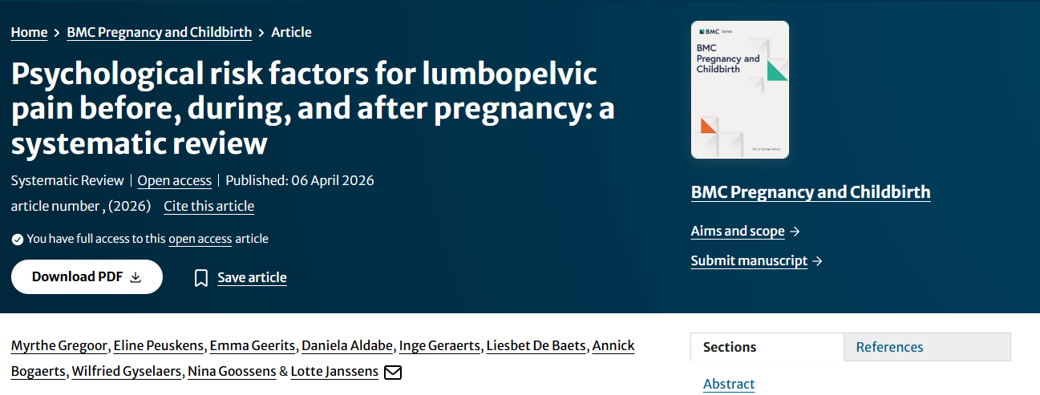







Thank you!
SCAN ME

