Slide 1
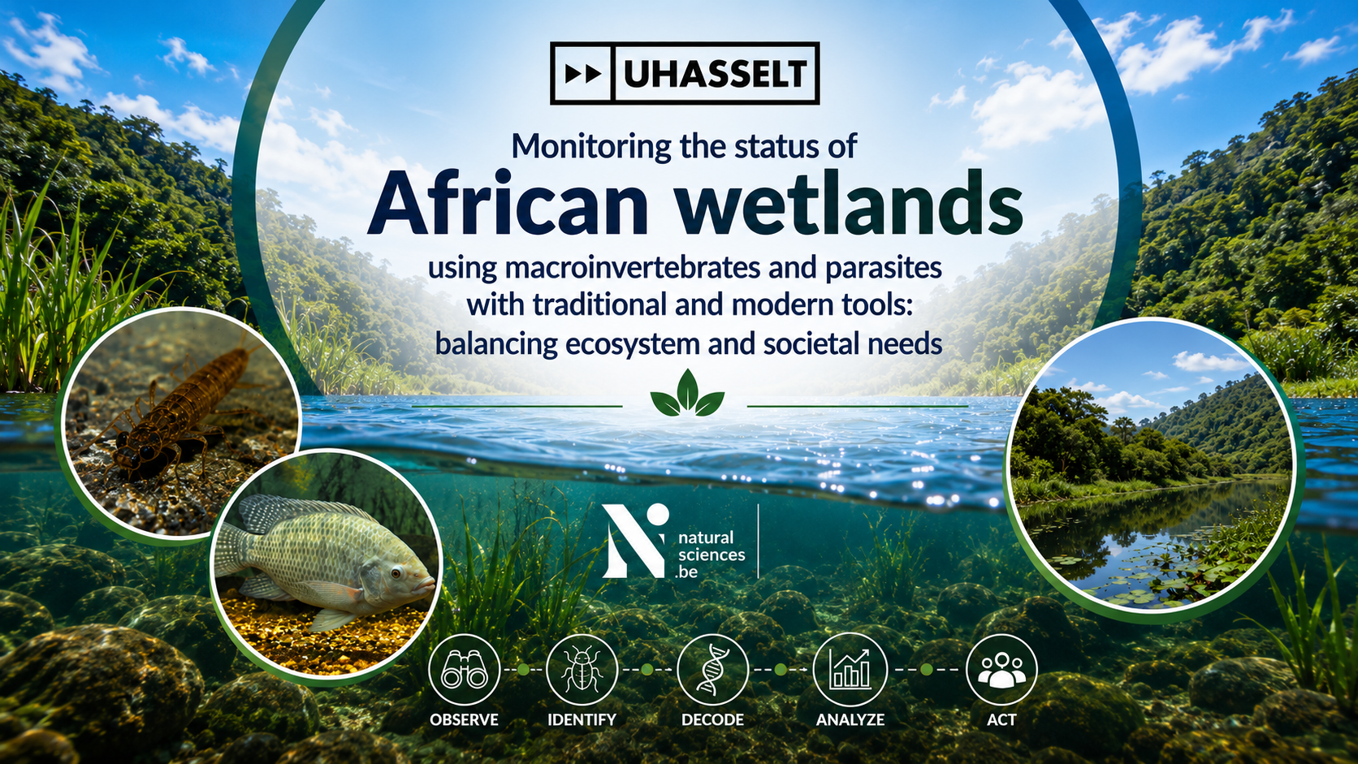
N. Kmentová, L. Cools, L. Janssens de Bisthoven, I. Schön, C. Sibomana, E. Abwe, K. Martens, M. Vanhove
Notes:
We are gonna move to the wetlands in Africa and one of the regions which has been pointed out several times during the conference being knowledge gaps. So lets have a look at this topic in African wetlands

Slide 2
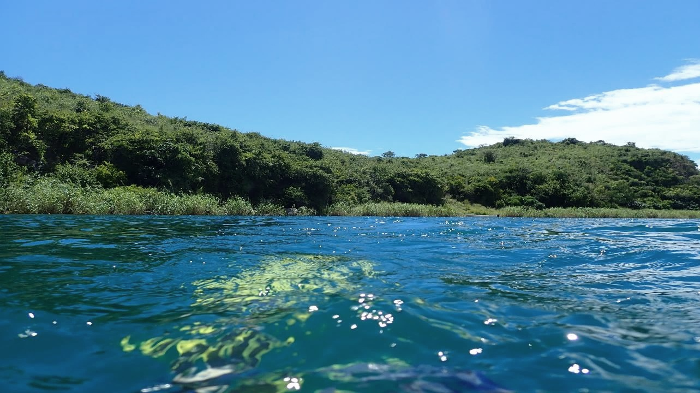
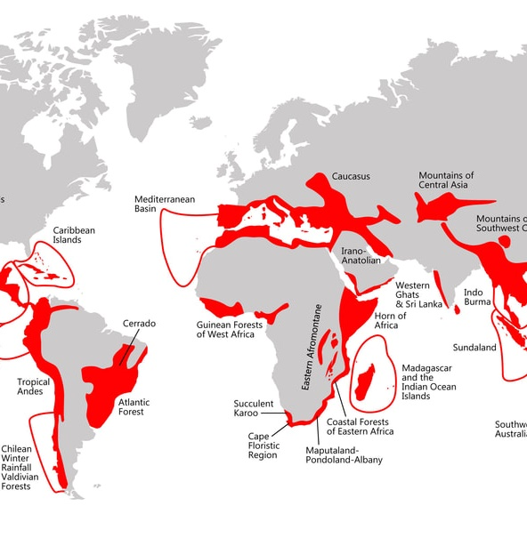
Biodiversity hotspots
High levels of diversity, assessed by species richness and levels of endemism
Biogeographic unit
Indicator groups
Eastern Afromontagne
Notes:
We are gonna zoom into the region considered as a biodiversity hotspot ticking all these boxes being the Eastern Afromontagne region.

Slide 3
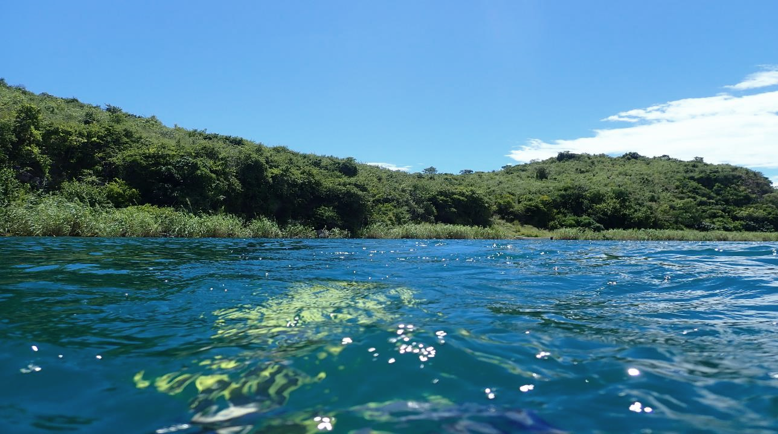
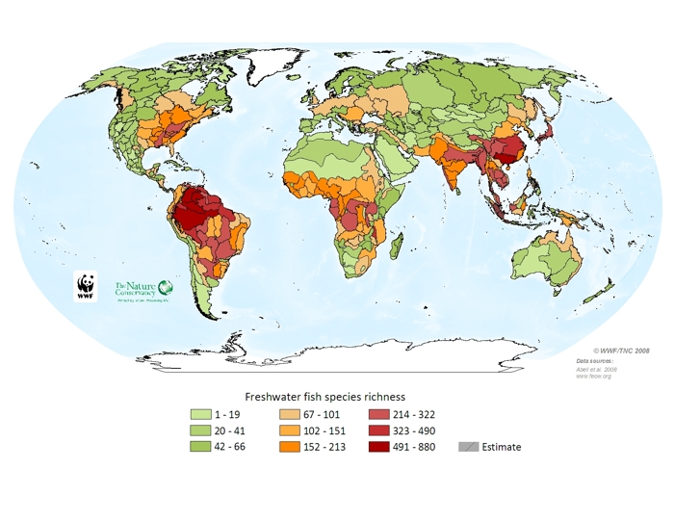
Eastern Afromontagne
Notes:
Specficially we are going to look at the freshwater biodiversity and as you can see on this global map of distributed by WWF, the fish diversity is particularly high in the tropical regions including the Eastern Afromontagne region we are gonna zoom into today.

Slide 4
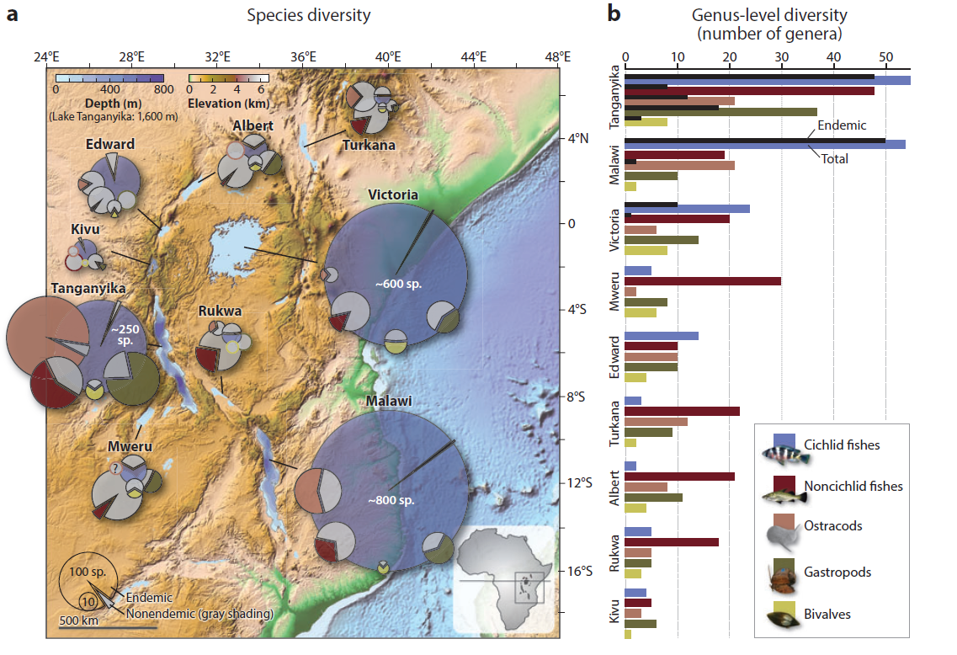
East African Great Lakes
>90% of Africa’s surface freshwater
Local adaptations driven by ecological speciation and natural selection
Diversification impacted by repeated lake level changes (formation 300 MYA)
Evolution in real-time (10% of world species diversity)
High level of endemism
Salzburger et al., 2014
Notes:
The freshwater diversity in this region is concentrated in the African Great Lakes also known as natural experiments in terms of evolutionary adaptations being present. These places actually aggregate 90% of the Africa’s surface water and are famous for their high level of endemism.

Slide 5









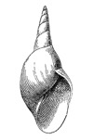






AfroWetMap
Biodiversity monitoring
Ecosystem services
Science-based ecosystem health monitoring
Environmental gradient
Societal needs
Disease monitoring
Knowledge transfer
Capacity building
Eco-toxicology
Conservation
Remote sensing
Science-policy interface
Notes:
In the recently launched programme being funded by both federal and Flemish level in Belgium (if you know Belgium you are maybe surprised that this is actually possible) but this co-funding across the countries entities actually shows the importance and ambition. I am coordinating the AfroWetMap programme with the ultimate goal of development of science-based monitoring approaches for freshwater ecosystems in African particularly targeting RAMSAR wetlands being intertwined with capacity building and co-ownerships with local scientific bodies and communities. Currently, the two main partners are University of BUrundi and University of Lubumbashi in Democratic Republic of the Congo.

Slide 6
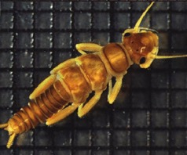
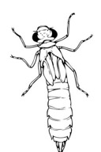





AfroWetMap
Target taxa: macroinvertebrates and their metazoan parasites
Environmental gradient
Baseline establishment
collection material and field-work
systematic overview based on literature
engangement with experts
Biodiversity monitoring
Species-distribution patterns
intergrative pipeline
hologenophore
reference library
Disease monitoring
eDNA-based monitoring
cost-effective
upscaling
Eco-toxicology
Remote sensing
Genome-wide associtation studies
differential population sensitivity
Notes:
The programme targets macroinvertebrates and their parasites as primer taxa being used to access ecosystem health following the steps mentioned here. This is how the plan in the project looks like…

Slide 7
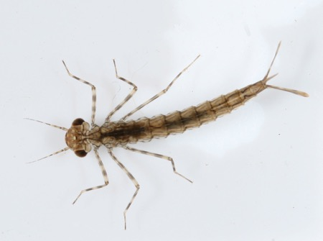
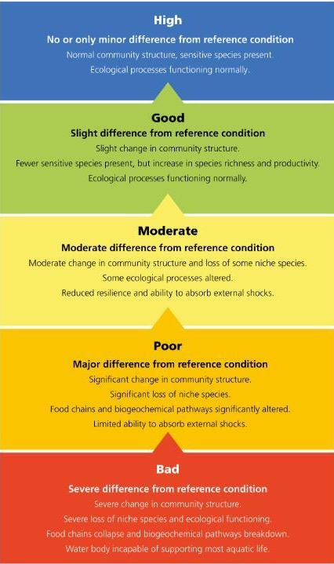
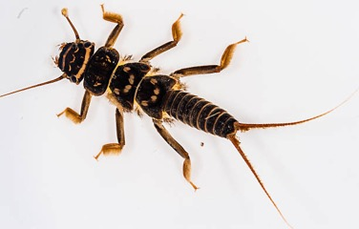
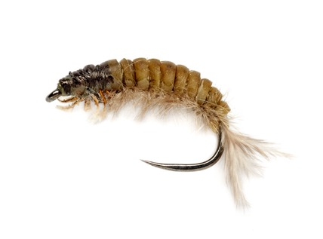
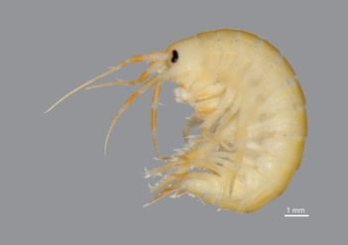
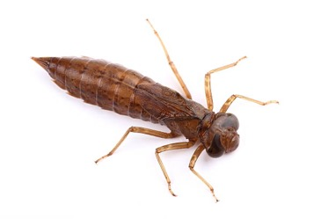
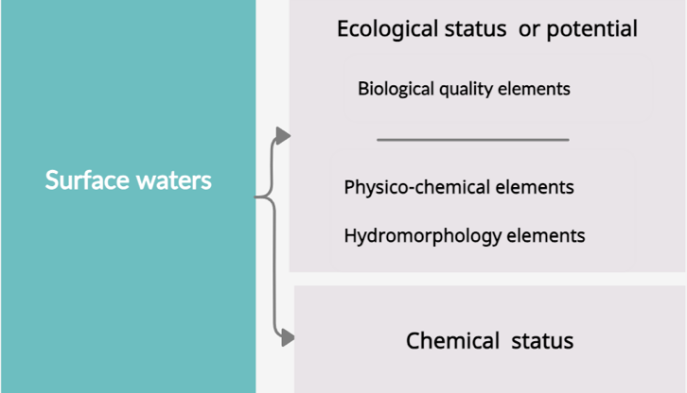

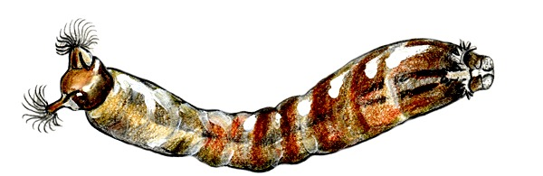
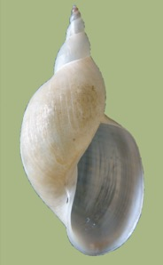
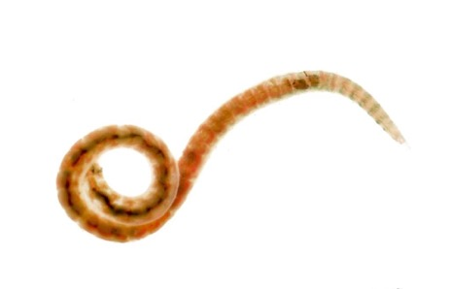
Monitoring of freshwater ecosystems
Water Framework Directive (2000)
“Requires EU Member States to achieve good status in all bodies of surface water and groundwater by 2027”
Notes:
I would hope that this scheme rings a bell referring to the water framework directive of the EU with monitoring of macroinvertebrate playing role as biological quality elements with specific indices being applied informing us about the status of certain freshwater ecosystem. This was also an idea for the AfroWetMap but this is Europe. How does it look like in the African Great Lakes or the whole Eastern Afromontagne region?

Slide 8
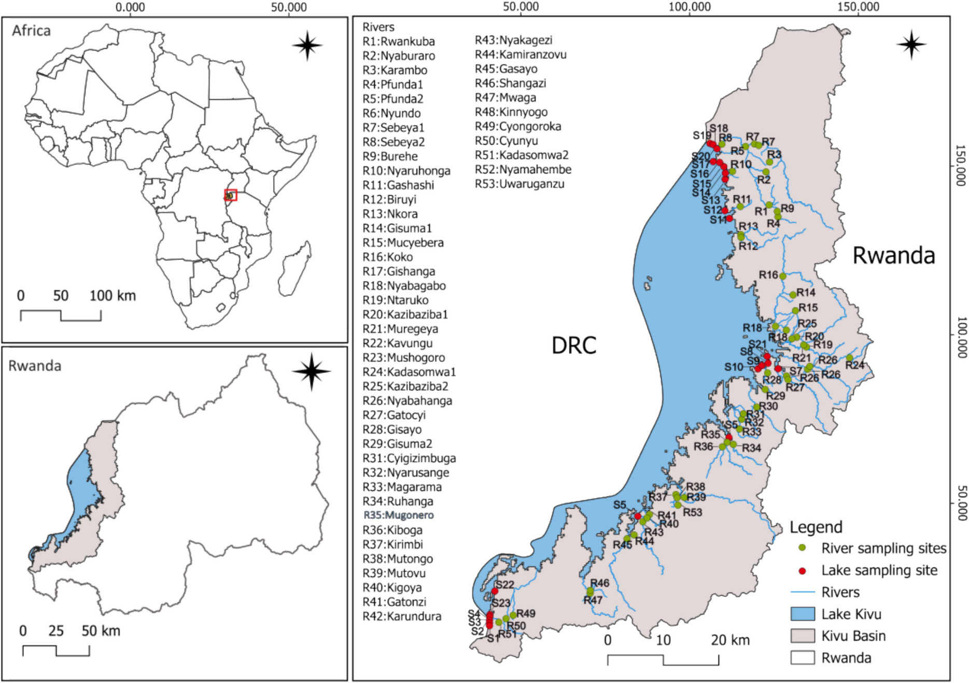
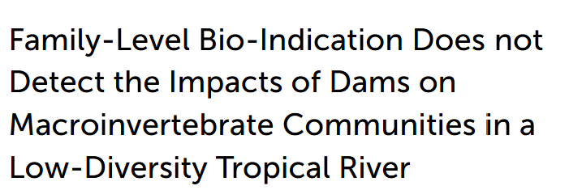
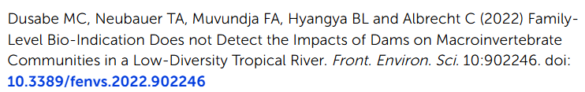
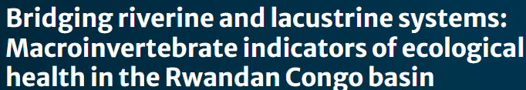
Monitoring of freshwater ecosystems
SASS (South African Scoring System)
TARISS (Tanzania River Scoring System)
Notes:
Well, there are some scoring systems applied in the countries with the South African one being adopted by other countries. But as you can see in these two recent studies, we do lack the resolution while using macroinvertebrates as the indicators of freshwater ecosystem health in this region.

Slide 9
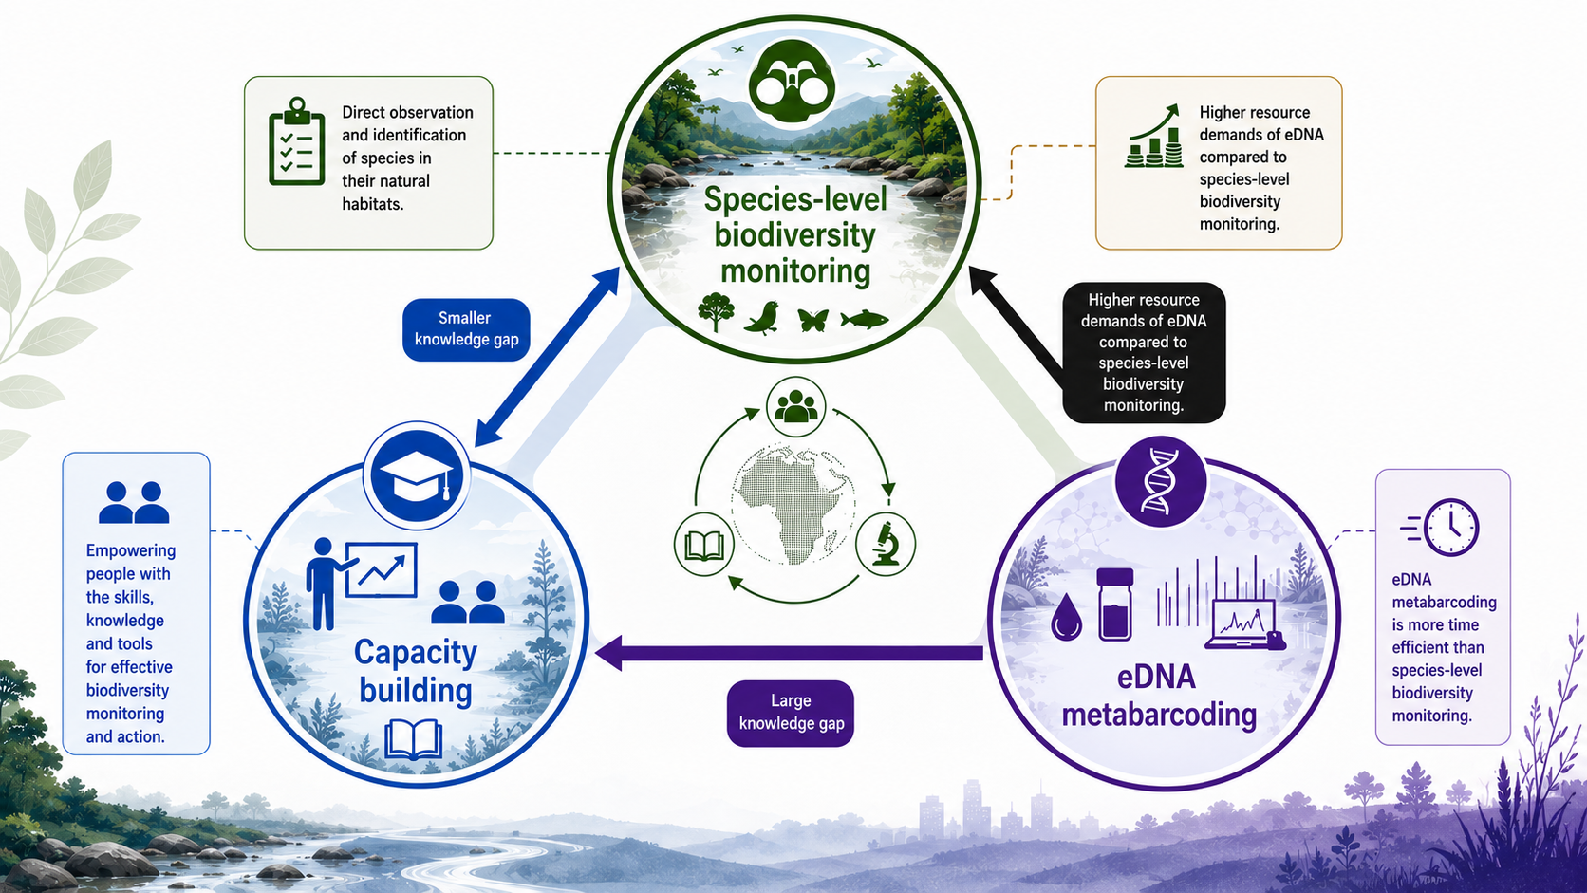
Baseline dilemma
Higher spatial and temporal resolution of traditional methods.
Notes:
So there is actually something we have named and being recognized as a baseline dilemma. We can admit that for the African Great Lakes or the Eastern Afromontagne region in general, we lack the taxonomic baseline being crucial to apply biomonitoring approaches. Why do I call this a dilemma? Well, we have all the fancy approaches such as the eDNA metabarcoding which should in theory provide a reliable and fast assessment of the biodiversity in the region but without any reliable baseline this is not a trivial task especially in the biodiversity hotspots such as this particular region. There is an emphasis on building capacities and the monitoring being done by the local authorities which brings another challenge mainly a technological one. SO that is why we call this a baseline dilemma because without the baseline, any biodiversity based monitoring of the ecosystem health is impossible. It is time to show you what do we know in terms of macroinvertebrates in this region but this dilemma is something I would like to have your opinion on.
Species-level biodiversity monitoring, Capacity building, eDNA metabarcoding – make a triangle with these three components. Add arrow between species-level biodiversity monitoring and eDNA biomonitoring indicating higher resources demands of eDNA compared to species-level biodiversity monitoring, add arrow between eDNA metabarcoding and Capacity building indicating a knowledge gap, this knowledge gap should be bigger than between species-level biodiversity and capacity building

Slide 10
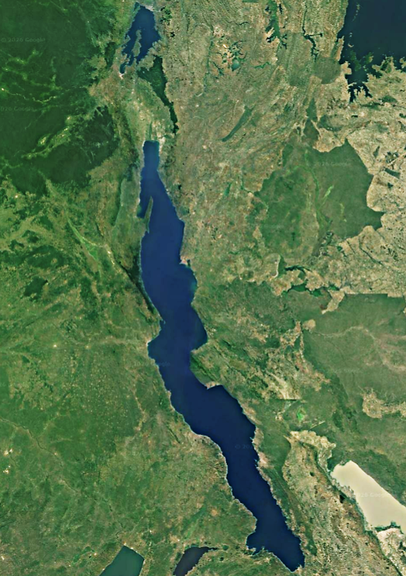
Lake Tanganyika – Rusizi River – Lake Kivu region
Lake Kivu
Rusizi River
Lake Tanganyika
Notes:
So lets look at the region, in particular the Lake Tanganyika, being connected via Rusizi River to Lake Kivu as biodiversity hotspots.

Slide 11
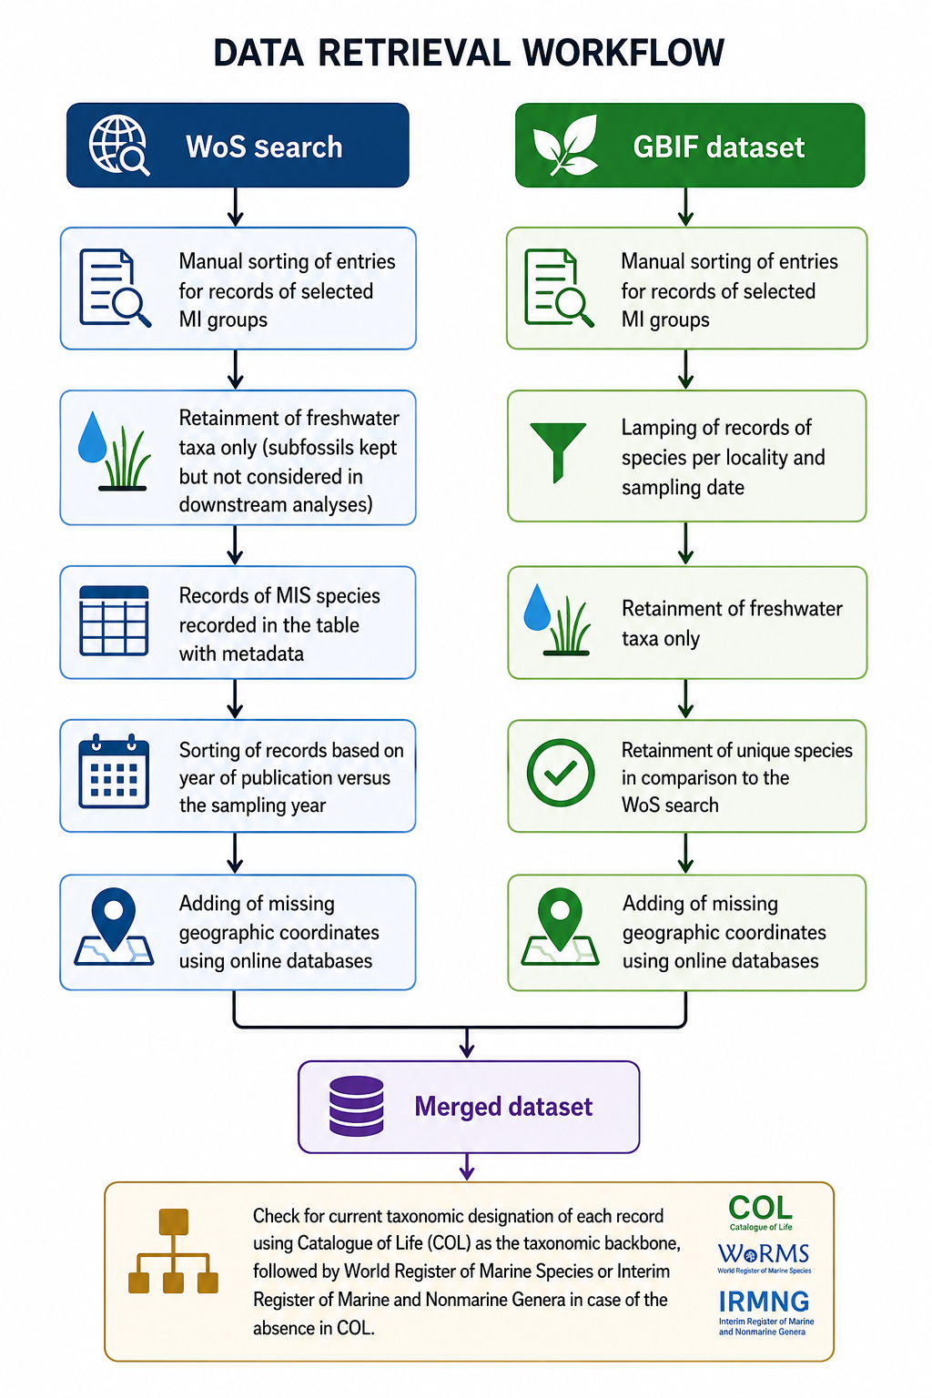
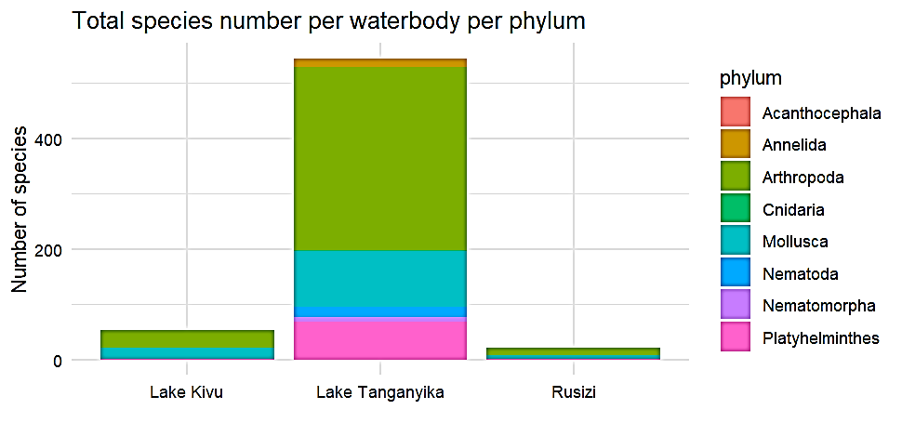
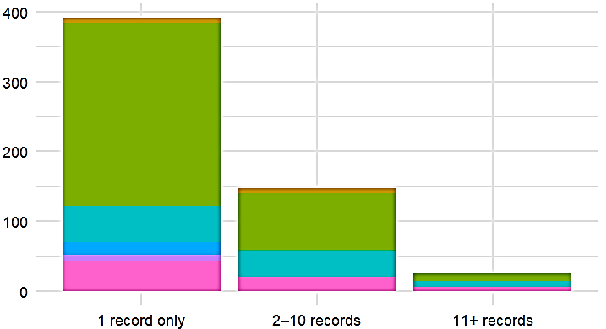

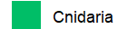
Baseline establishment
Notes:
Recently, we have conducted a review to actually define that baseline using this methodology even though we know it is far from being complete in this region. I don’t have time to go through the methodology in details but please ask if interested. What you can see here is the number of macroinvertebrate species but what is actually important is that a majority of those species have been reported only a single time. THInk od the high level of endemism I mentioned before, this result actually means that most of these species have been reported once in total worldwide.

Slide 12
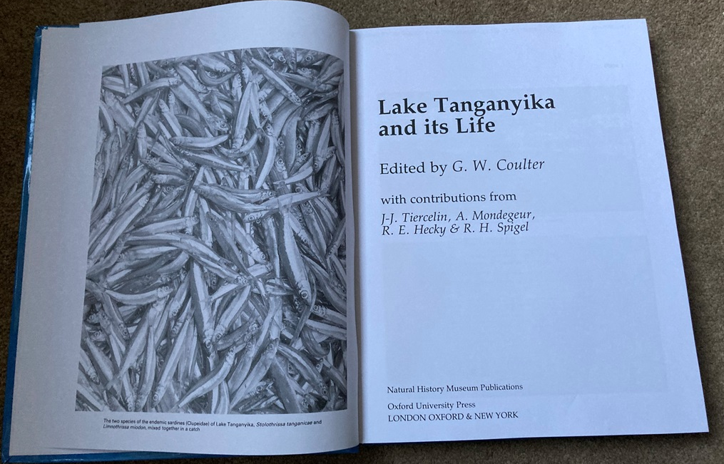
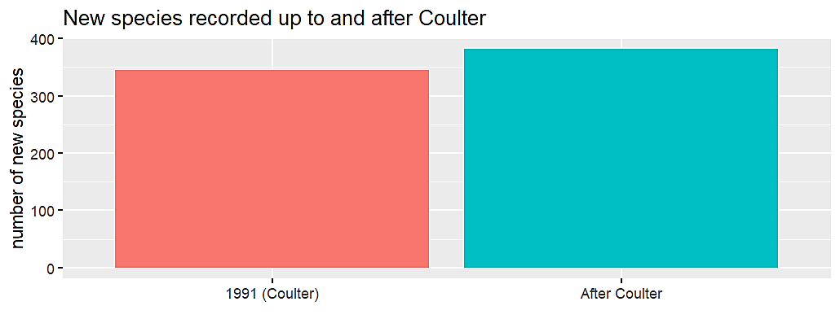
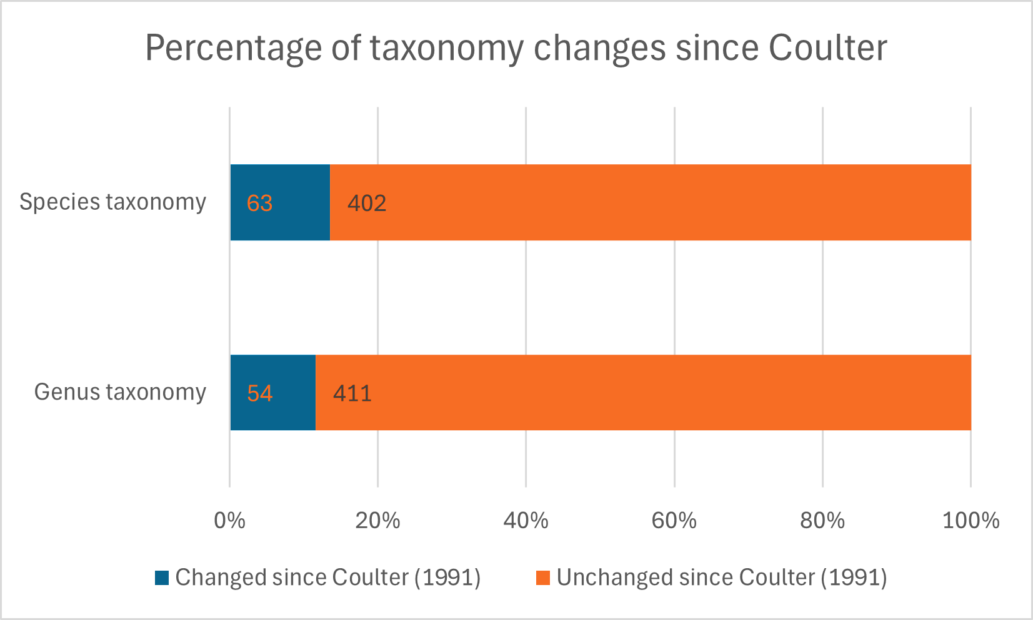
Baseline establishment
Lake Kivu
A
Rusizi River
Lake Tanganyika and its life. Rev Fish Biol Fisheries 2, 180–181 (1992). https://doi.org/10.1007/BF00042885
B
Lake Tanganyika
Notes:
Other measures we looked at was how many new species have been reported since the last review published in 1991 and as you can see the number of species more than doubled with another twist being the changes in taxonomy we also quantified.

Slide 13
Baseline establishment
Lake Kivu
Phylum | Lake Kivu | Lake Tanganyika | Rusizi River | Total % Species ID
Acanthocephala | 0 | 2/1 | 0 | 50%
Annelida | 20/0 | 41/28 | 20/0 | 45.7%
Arthropoda | 593/311 | 959/682 | 272/34 | 64.7%
Cnidaria | 0 | 2/2 | 0 | 100%
Mollusca | 120/115 | 571/493 | 77/19 | 82.2%
Nematoda | 7/4 | 18/17 | 0 | 88%
Nematomorpha | 0 | 9/9 | 0 | 100%
Platyhelminthes | 5/4 | 235/211 | 20/3 | 89.6%
Porifera | 0 | 2/0 | 0 | 0%
Rusizi River
Understanding of knowledge/expertise gaps
Lake Tanganyika
Notes:
The number are not so important per phylum but there are in particular two of these annelids and arthropods, with a lower proportion of species identification, this we used to identify knowledge gaps or lack of expertise.

Slide 14
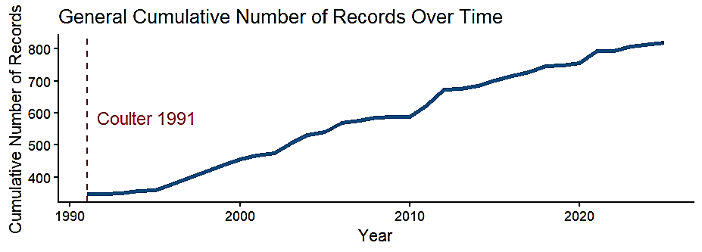
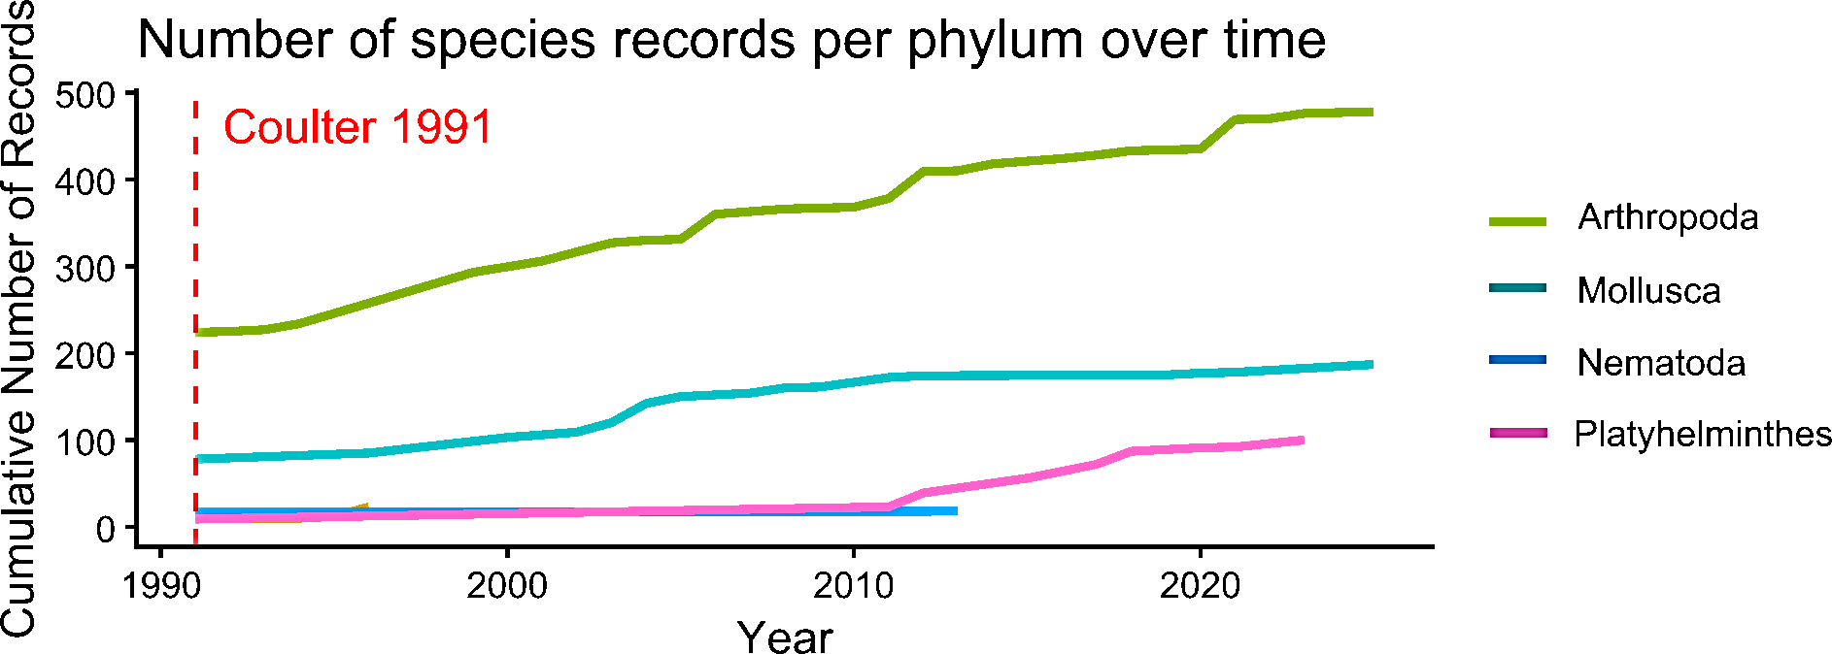
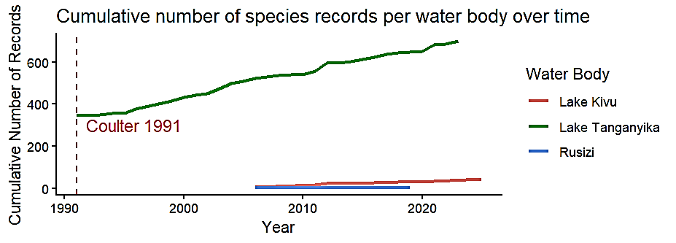
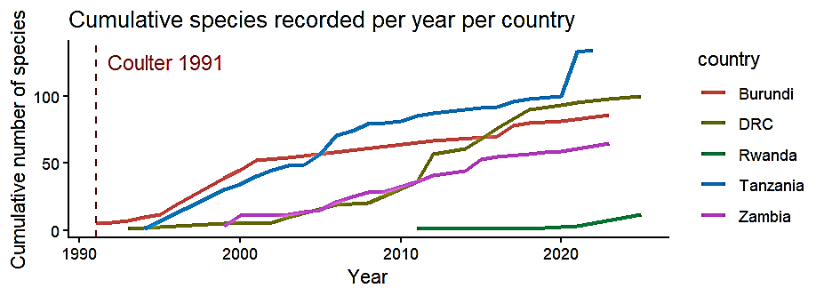
Baseline establishment
A
B
C
D
Notes:
We also looked at the trends over time across phyla, water body and countries and what is striking is that some phyla have not been even reported following the last review…imagine that there is no report of e..g the annelids sine 1991.

Slide 15
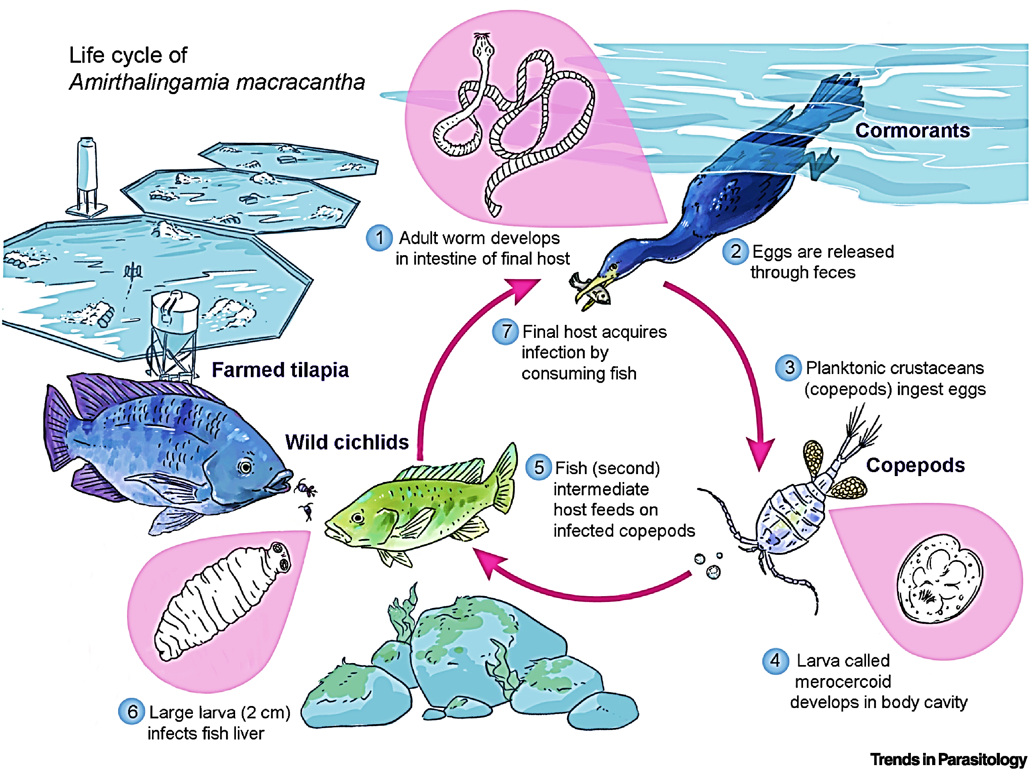
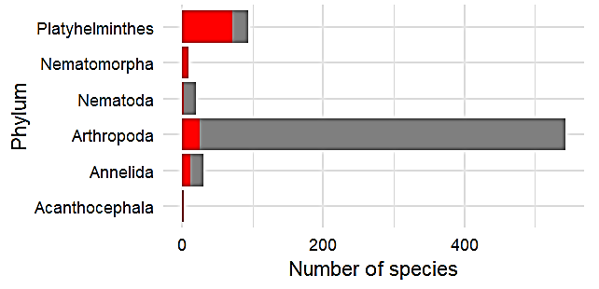
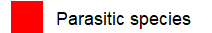
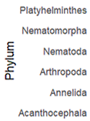
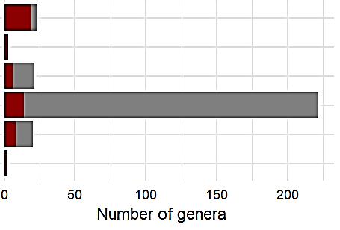
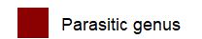
Baseline establishment – why parasites?
A
B
Schols et al 2021, BMC Biol
Notes:
You heard me mentioned parasites at the beginning as potential bioindicator species. I guess that is rather surprising for most of you but they actually could be great indicators given their dependence on multiple hosts in the ecosystems bridging different trophic layers, I don’t have time now but if someone is interested, I would be more than happy to discuss this.

Slide 16
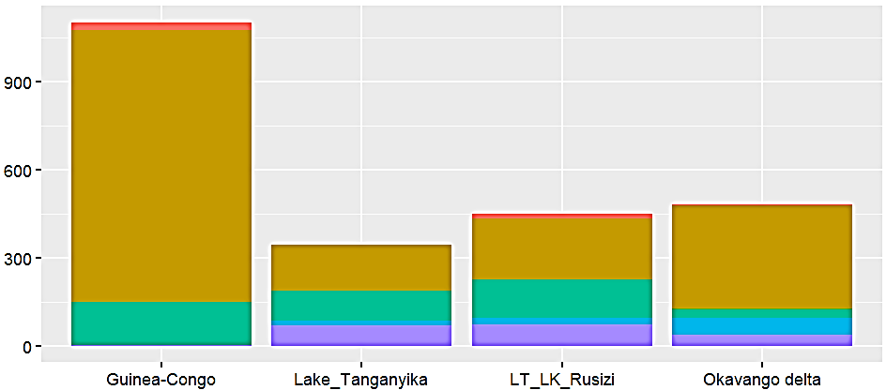

Worldwide comparison
 | Okavango Deltaª | Guineo-Congolese region^{b} | LT-Rusizi-LK | Lake Tanganyika
Annelida | 5 | 25 | 18 | 18
Arthropoda | 348 | 926 | 373 | 339
Arachnida | 3 | 3 | 9 | 9
Ephemeroptera | 3 | 32 | 5 | 5
Odonata | 96 | 499 | 11 | 10
Diptera | 83 | 17 | 40 | 32
Decapoda | not covered | 78 | 42 | 31
Coleoptera | 69 | 162 | 2 | 2
Hemiptera | 40 | 45 | 4 | 4
Hydrarachnida | 16 | not covered | not covered | not covered
Crustacea | 37 | not covered | 218 | 204
Trichoptera | 1 | 87 | 42 | 42
Plecoptera | not covered | 3 | 0 | 0
Nematoda | 57 | not covered | 18 | 17
Mollusca | 30 | 148 | 103 | 94
Porifera | 1 | not covered | 0 | 0
Platyhelminthes | 36 | 3 | 70 | 69
 | Pantanal | Kakadu | Okavango Delta | Guineo-Congolian region | LT-Rusizi-LK | Lake Tanganyika
Macroinvertebrates ( Ostracoda, Bivalvia and Gastropoda only)/ km² | 80/0.0005 km² (Junk et al., 2006) | 512/0.02 km² (Finlayson et al., 2006) | 482/0.02 km² (Moliner Cachazo et al., 2023) | 149/0.00008 km² (Akindele et al., 2025) (ostracods not considered) | 427/0.01 km² (including the known number of ostracod species) | 177/0.02 km² (including the known number of ostracod species)
Notes:
In the worldwide perspective, the region shows similar species richness as e.g. the Okavango delta but what is more important to here I would like to highlight is actually the lack of such assessments of freshwater regional diversity published in reviews with data usually not being freely available. That is why the global comparison is actually restricterd to these few wetland but still, you can notice that the known diversity per square kilometer is surprisingly similar between the Lake Tanganyika Kivu region and the Kakadu and Okavango delta.

Slide 17
Conclusions - Baseline dilemma?
Identification of taxonomic expertise and interest in the studied region
Similar trend across the countries
Higher spatial and temporal resolution of traditional methods.
Stakeholder workshops on capacity building priorities and framework conceptualization
Notes:
What do we know after the first two years of this research and capacity building programme? Well, the study areas are understudied and we first need to provide the baseline before we develop biomonitoring protocols. We have already launched stakeholder workshops in the targeted regions on both scientific and users level to understand the local dynamics while already working on baseline for species-level biodiversity monitoring but also applying the eDNA metabarcoding approaches. So basically applying for very different funding to fund all these different elements.

