Slide 1

Prescription of safe exercise: aerobic (MICT or HIIT), strength, and inspiratory muscle training
Dominique Hansen, PhD, FESC, Hasselt University, Hasselt, Belgium
13/06/2026

Slide 2
Starting point for exercise prescription…
 | ACS and CCS | Chronic HF
Endurance exercise
Frequency | ≥3 up to 5 days per week | Up-titrating from 2–3 to 3–5 days per week
Session duration | 30–60 min | Up-titrating from 15–30 to 45–60 min
Intensity | Moderate and moderate-to-high | Moderate and moderate-to-high, but low in selected patients
Weekly energy expenditure (exercise volume) | 1000–2000 kcal/week | >1000 kcal/week
Resistance exercise
Frequency | ≥2 days per week | ≥2 days per week
Number of sets/repetitions | ≥2 sets per large muscle group, 12–15 repetitions per set | Up-titrating to ≥2 sets per large muscle group, 8–15 repetitions per set
Intensity | 30%–70% 1RM for upper extremities 40%–80% 1RM for lower extremities | Up-titrating to 40%–60% 1RM
Inspiratory muscle training
Frequency | - | 3–5 times per week up to daily exercise
Session duration | - | 20–30 min
Intensity | - | Up-titrating from 30% to 60% of maximal inspiratory pressure
Part 1
Part 2
Part 3
1RM, one-repetition maximum; ACS, acute coronary syndrome; CCS, chronic coronary syndrome; HF, heart failure.
Ambrosetti M, et al. Secondary prevention through comprehensive cardiovascular rehabilitation: From knowledge to implementation. 2020 update. A position paper from the Secondary Prevention and Rehabilitation Section of the European Association of Preventive Cardiology. Eur J Prev Cardiol. 2021;28(5):460-495.

Slide 3
Part 1
Aerobic/endurance exercise prescription

Slide 4
Volume of endurance exercise training: impact on outcomes
  On VO2peak:
    In CHF patients: every increment in weekly exercise energy expenditure by >460 kcal is associated with a greater mean increase in VO2peak by 2.6 mL/kg/min, p<0,05)
      Ismail H, et al. Exercise training program characteristics and magnitude of change in functional capacity of heart failure patients. Int J Cardiol 2014;171:62–65.
    In CCS patients: A greater total energy expenditure is significantly related to greater improvements in exercise capacity (0.91 mL/min/kg per 100J/kg, p<0,05)
      Kraal JJ, et al. The influence of training characteristics on the effect of exercise training in patients with coronary artery disease: Systematic review and meta-regression analysis. Int J Cardiol 2017;245:52–58
  On glycemic control in T2DM
    1,100 MET min/week (i.e., the optimal dose) is equivalent on average to 244 min/week of moderate-intensity aerobic physical activity (ranging from 183 to 367 min/week, depending on the intensity of the activity, from 3 to 6 MET/min)
      Gallardo-Gómez D, et al. Optimal Dose and Type of Physical Activity to Improve Glycemic Control in People Diagnosed With Type 2 Diabetes: A Systematic Review and Meta-analysis. Diabetes Care. 2024;47(2):295-303.
  On fat mass in obesity
    Exercise exerts a dose–response effect of −0.15 ((−0.23 to −0.07); p<0.001) on visceral fat mass per 1000 calories deficit per week (optimal dose of >2000 kcal/week)
      Recchia F, et al. Dose-response effects of exercise and caloric restriction on visceral adiposity in overweight and obese adults: a systematic review and meta-analysis of randomised controlled trials. Br J Sports Med. 2023 Aug;57(16):1035-1041.
Hansen D, et al. Appropriate exercise prescription in primary and secondary prevention of cardiovascular disease: why this skill remains to be improved among clinicians and healthcare professionals. A call for action from the EXPERT Network. Eur J Prev Cardiol. 2023 Dec 21;30(18):1986-1995.

Slide 5
Intensity of endurance exercise training: impact on outcomes
  On VO2peak:
    HIIT is more effective, or at least more time efficient, to increase VO2peak in patients with CVD (risk)
      Gomes-Neto M, et al. High-intensity interval training versus moderate-intensity continuous training on exercise capacity and quality of life in patients with coronary artery disease: A systematic review and meta-analysis. Eur J Prev Cardiol 2017;24:1696–1707.
      Gu S, et al. Effects of high intensity interval training versus moderate intensity continuous training on exercise capacity and quality of life in patients with heart failure: A systematic review and meta-analysis. PLoS One 2023;18:e0290362.
  On blood pressure in patients with hypertension
    Endurance exercise should minimally be of a moderate intensity
      Hanssen H, et al. Personalized exercise prescription in the prevention and treatment of arterial hypertension: a Consensus Document from the European Association of Preventive Cardiology (EAPC) and the ESC Council on Hypertension. Eur J Prev Cardiol. 2022;29:205-15.
Hansen D, et al. Appropriate exercise prescription in primary and secondary prevention of cardiovascular disease: why this skill remains to be improved among clinicians and healthcare professionals. A call for action from the EXPERT Network. Eur J Prev Cardiol. 2023 Dec 21;30(18):1986-1995.

Slide 6
HIIT in cardiovascular disease
Good news
  No evidence for greater risk of adverse events when compared with MICT, nor for greater drop-out rates
But…
  Mostly studied in male populations, with low(er) risk
  Mostly studied in supervised settings
  Participants were carefully screened/selected
Franklin, B.A., Zhu, W. High-Intensity Interval Training: Benefits, Risks, and Clinical Implications. J Sci Sport Exerc 2026; 8, 1–8

Slide 7
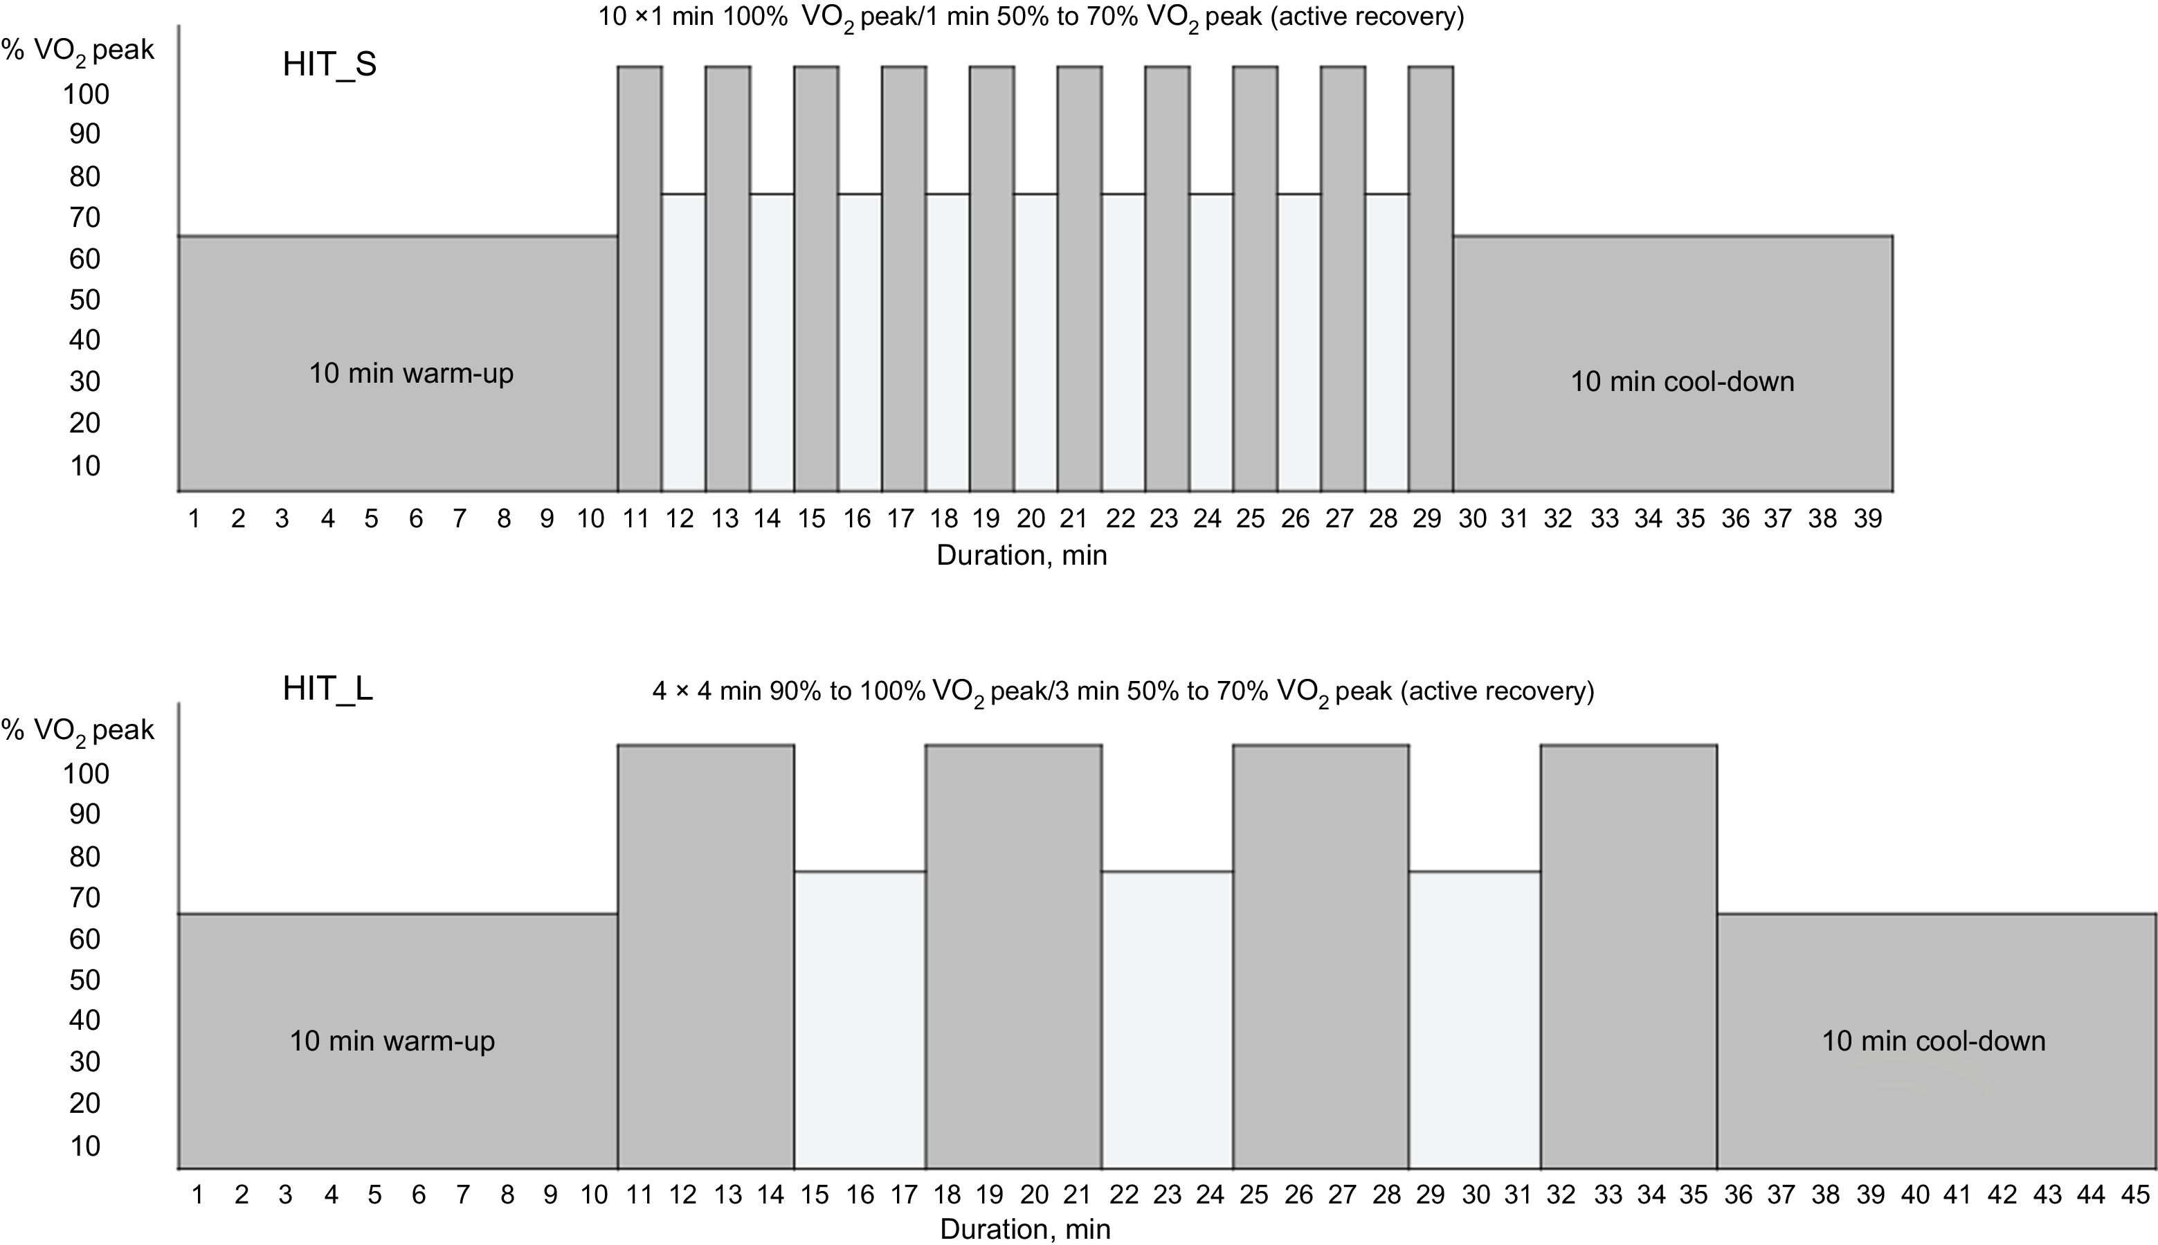
HIIT in cardiovascular disease
Which protocol to select?
Only the first steps are being made now:
Bi Z, et al. One Size Does Not Fit All: A Meta-Analysis of 115 Trials Comparing High-Intensity Interval and Moderate-to-Vigorous-Intensity Continuous Training Across Diverse Participants, Protocols, and Outcomes. Scand J Med Sci Sports. 2026 Mar;36(3):e70243.
Ballesta García I, Rubio Arias JÁ, Ramos Campo DJ, Martínez González-Moro I, Carrasco Poyatos M. High-intensity Interval Training Dosage for Heart Failure and Coronary Artery Disease Cardiac Rehabilitation. A Systematic Review and Meta-analysis. Rev Esp Cardiol (Engl Ed). 2019 Mar;72(3):233-243.

Slide 8
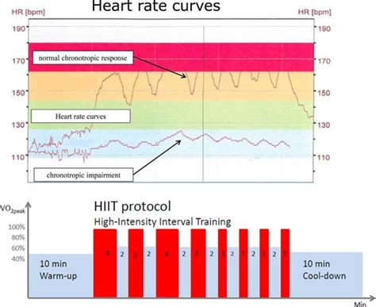
HIIT in cardiovascular disease
Which exercise parameter to select?

Slide 9
How to make the prescription safe?
Execute a thorough intake screening
  CVD risk, exercise-induced abnormalities
Foresee a good build-up in intensity and volume of exercise
  Not too fast but also not too slow
Use the right setting point and exercise parameter(s)

Slide 10
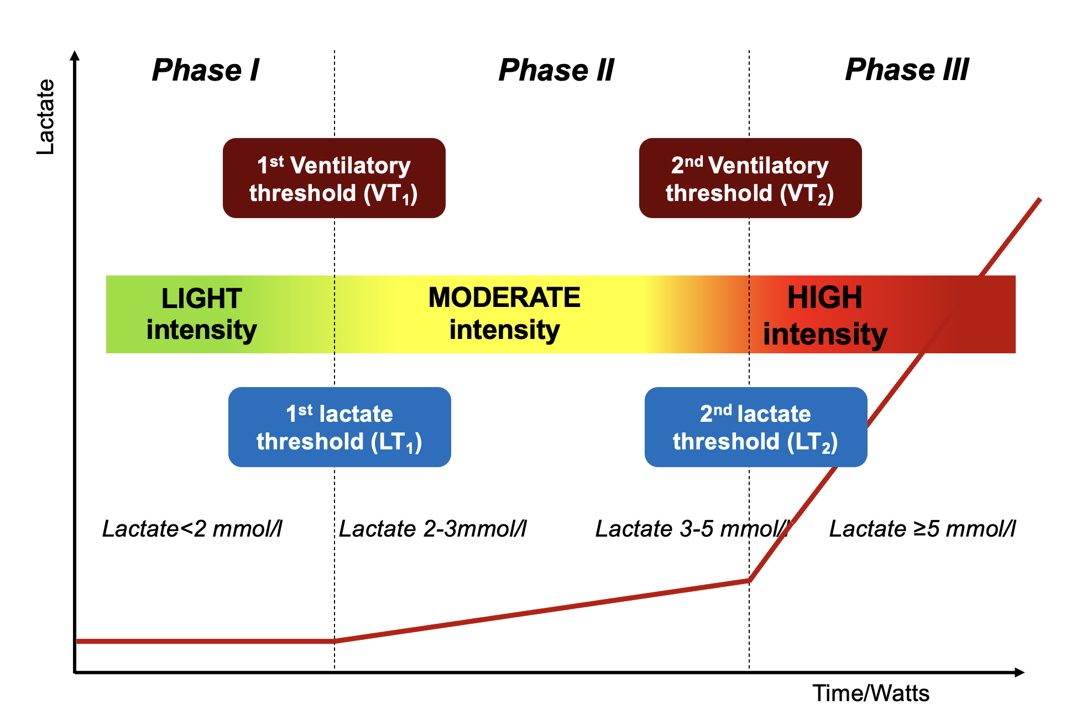
The concept of VT and AT
Hansen D, et al. Advancing Aerobic Exercise Training Intensity Prescription in Health and Disease Beyond Standard Recommendations: A Call to Action. Sports Med. 2025;55(9):2111-35.

Slide 11
The concept of VT and AT
Point of high feasibility with maximal energy expenditure
Greater medical safety
Hansen D, et al. Advancing Aerobic Exercise Training Intensity Prescription in Health and Disease Beyond Standard Recommendations: A Call to Action. Sports Med. 2025;55(9):2111-35.

Slide 12
The concept of VT and AT
+ combine with Borg RPE scale
Hansen D, et al. Advancing Aerobic Exercise Training Intensity Prescription in Health and Disease Beyond Standard Recommendations: A Call to Action. Sports Med. 2025;55(9):2111-35.

Slide 13
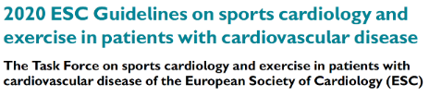
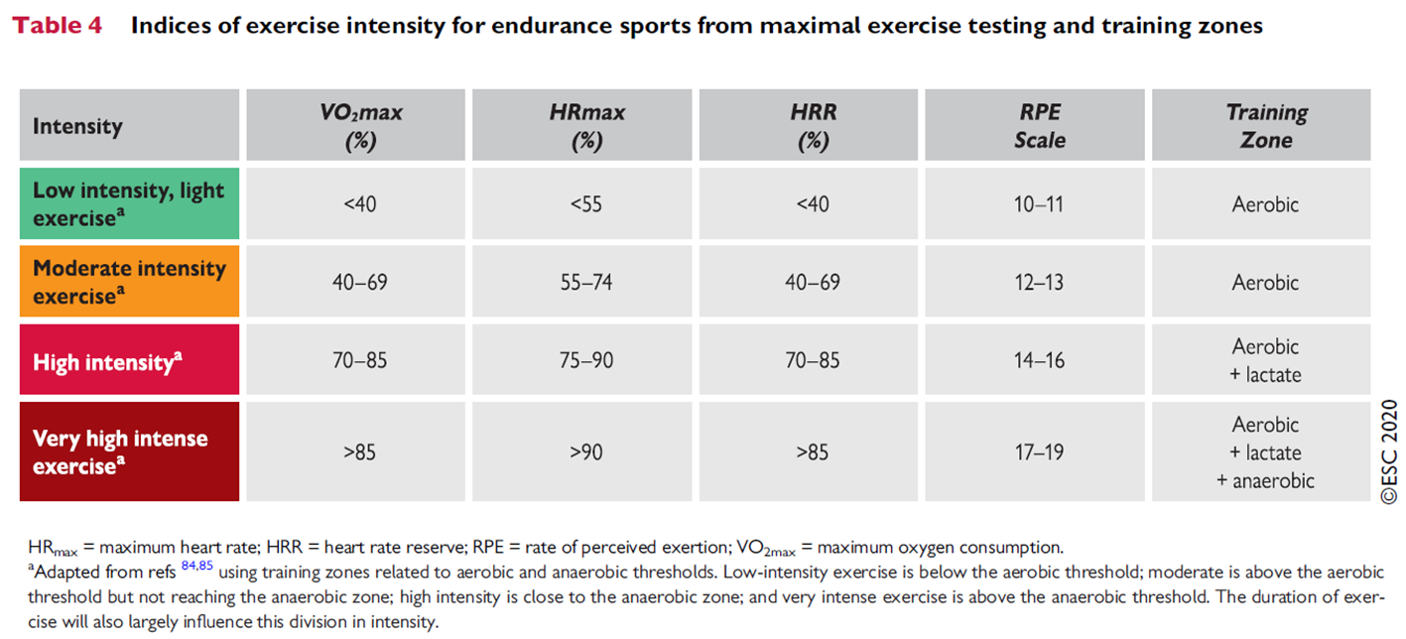
Or should we use %peak effort?
Pelliccia A, et al. Eur Heart J. 2021 Jan 1;42(1):17-96.

Slide 14
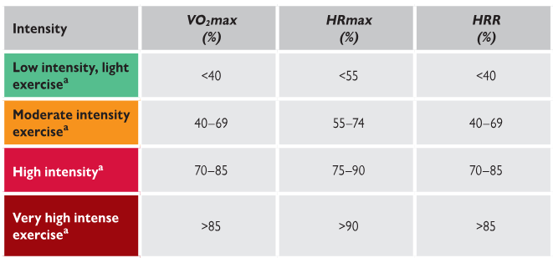
Or should we use %peak effort?
272 CPETs
%HRpeak
%HRR
%VO2peak
VT1
VT2
%HRpeak
%HRR
%VO2peak
?
Hansen D, et al. Exercise training intensity determination in cardiovascular rehabilitation: Should the guidelines be reconsidered? Eur J Prev Cardiol. 2019;26(18):1921-1928.

Slide 15
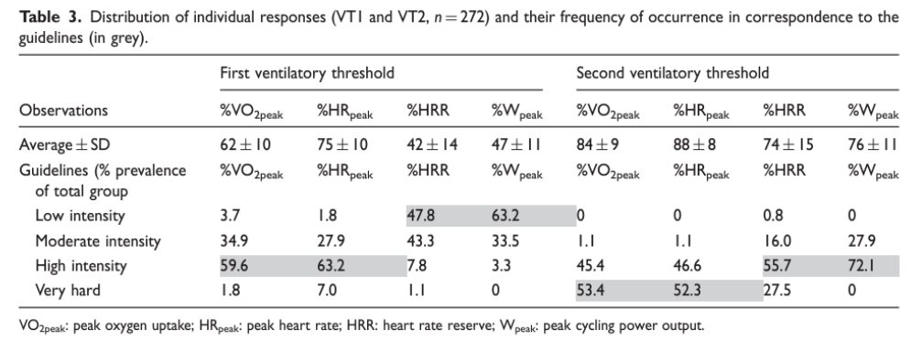
Or should we use %peak effort?
Others confirm:
Pymer S, et al. Does exercise prescription based on estimated heart rate training zones exceed the ventilatory anaerobic threshold in patients with coronary heart disease undergoing usual-care cardiovascular rehabilitation? A United Kingdom perspective. Eur J Prev Cardiol 2020;27:579-589.
Iannetta D, et al. A Critical Evaluation of Current Methods for Exercise Prescription in Women and Men. Med Sci Sports Exerc 2020;52:466-473.
Jamnick NA, et al. An Examination and Critique of Current Methods to Determine Exercise Intensity. Sports Med 2020;50:1729-1756.
Anselmi F, et al. The importance of ventilatory thresholds to define aerobic exercise intensity in cardiac patients and healthy subjects. Scand J Med Sci Sports. 2021;31(9):1796-1808.
Milani JGPO, et al. Exercise intensity domains determined by heart rate at the ventilatory thresholds in patients with cardiovascular disease: new insights and comparisons to cardiovascular rehabilitation prescription recommendations. BMJ Open Sport Exerc Med. 2023;9(3):e001601.
Hansen D, et al. Exercise training intensity determination in cardiovascular rehabilitation: Should the guidelines be reconsidered? Eur J Prev Cardiol. 2019;26(18):1921-1928.

Slide 16
Part 2
Strength/resistance exercise prescription

Slide 17
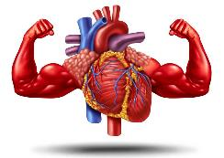
Why resistance exercise training?
In CCS
23 studies (N=916)
Combined training is more effective in increasing CRF (SMD 0.26, 95% CI 0.02 to 0.49, p=0.03) compared with aerobic training alone.
Terada T, et al. Effects of muscle strength training combined with aerobic training versus aerobic training alone on cardiovascular disease risk indicators in patients with coronary artery disease: a systematic review and meta-analysis of randomised clinical trials. Br J Sports Med. 2024 Aug 30:bjsports-2024-108530. doi: 10.1136/bjsports-2024-108530. Epub ahead of print.
In CHF
82 studies (N=4574)
VO2peak increases by a greater magnitude when applying combined AET + HiRET (by +3.49 ml/kg/min)
vs. AET only (by + 2.19 ml/kg/min) or combined AET + MiRET (by + 2.77 ml/kg/min)
Li Y, et al. Non-Pharmacological Interventions in Patients With Heart Failure With Reduced Ejection Fraction: A Systematic Review and Network Meta-analysis. Arch Phys Med Rehabil. 2024 May;105(5):963-974.

Slide 18
Intensity vs. volume of resistance exercise: impact on outcomes
For muscle strength gains
  higher-load, multiset, thrice-weekly training
For muscle hypertrophy gains
  higher-load, multiset, twice-weekly training
RT with higher loads characterised the top-ranked strength prescriptions, and RT with more sets characterised the top-ranked hypertrophy prescriptions.
Currier BS, et al. Resistance training prescription for muscle strength and hypertrophy in healthy adults: a systematic review and Bayesian network meta-analysis. Br J Sports Med. 2023 Sep;57(18):1211-1220.

Slide 19
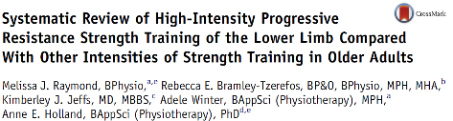
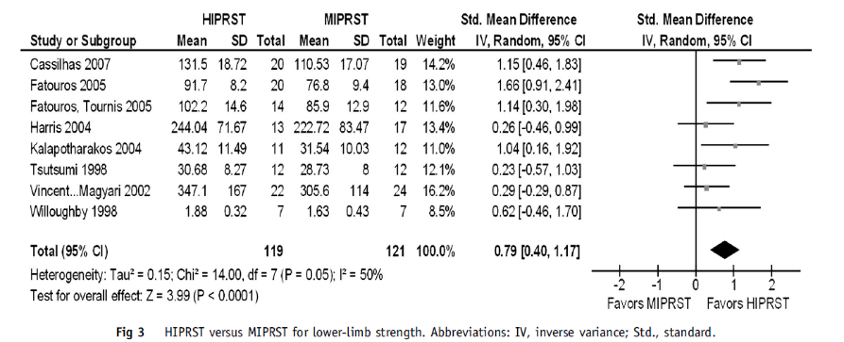

Slide 20

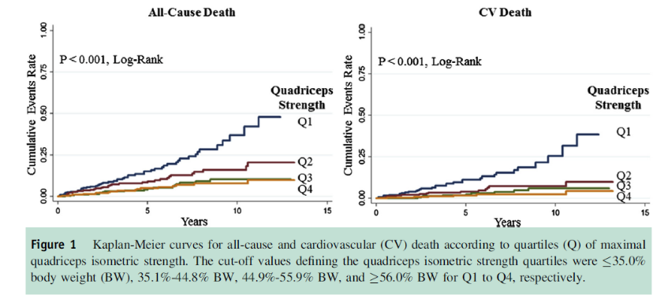

Slide 21
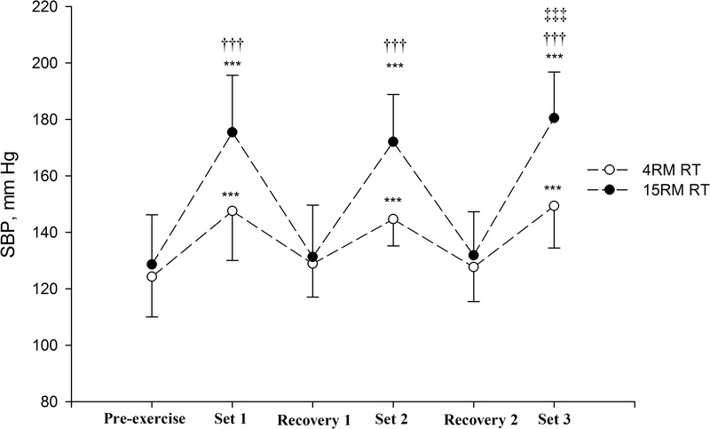
Intensity & safety
Systolic blood pressure (SBP) responses during preexercise and 4RM and 15RM resistance exercise (RE). Values are means ± SD. N = 15. Preexercise versus set 1, set 2, and set 3; ***P < 0.001. 4RM RE versus 15RM RE; †††P < 0.001. Set 2 versus set 3; ‡‡‡P < 0.001. The recovery periods are 4 min each
Gjøvaag TF, et al. Hemodynamic Responses to Resistance Exercise in Patients with Coronary Artery Disease. Med Sci Sports Exerc. 2016 Apr;48(4):581-8.

Slide 22
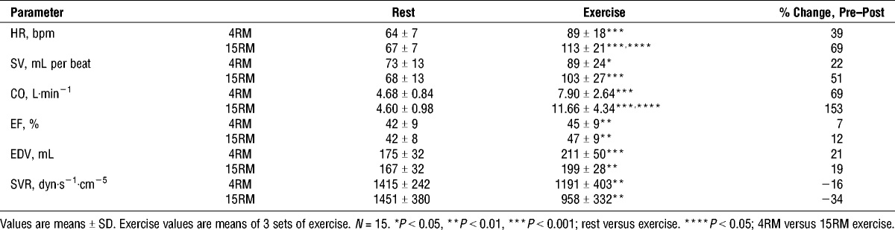
Intensity & safety
Responses of stroke volume (SV), left ventricular ejection fraction (EF), end diastolic volume (EDV), heart rate (HR), cardiac output (CO), and systemic vascular resistance (SVR) to 4RM and 15RM resistance exercise.
Gjøvaag TF, et al. Hemodynamic Responses to Resistance Exercise in Patients with Coronary Artery Disease. Med Sci Sports Exerc. 2016 Apr;48(4):581-8.

Slide 23
Prescribing resistance training anno 2026
Predict 1RM:
1RM= applied weight/(1.0278 - 0.0278 * repetitions)
1RM = (1 + 0.0333 * repetitions) * applied weight
Set the load (x% of 1RM)
Check perception
(OMNI-RES)
Hansen D, et al. Exercise intensity assessment and prescription in cardiovascular rehabilitation and beyond: why and how: a position statement from the Secondary Prevention and Rehabilitation Section of the European Association of Preventive Cardiology. Eur J Prev Cardiol. 2022;29(1):230-245.

Slide 24
Part 3
Inspiratory muscle exercise prescription

Slide 25
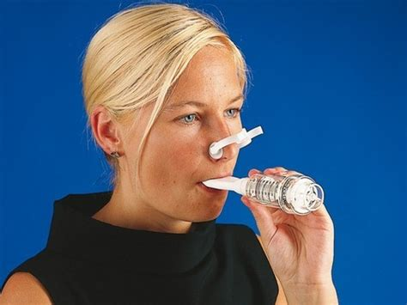
Inspiratory muscle training in CHF
When used in isolation
significantly improved:
PImax,
VE/VCO2 slope,
Quality of life,
Walking capacity,
VO2peak (in some studies),
Dyspnea
When combined with endurance training
Significantly (and additionally) improved:
PImax,
Dyspnea,
Walking capacity
Start at 30% of Pimax, and build up towards 60% of Pimax,
for 20-30 min/session, at 3-5 sessions/week
Azambuja ACM, et al. Inspiratory Muscle Training in Patients With Heart Failure: What Is New? Systematic Review and Meta-Analysis. Phys Ther. 2020;100(12):2099-2109.
Gomes Neto M, et al. The impact of high-intensity inspiratory muscle training on exercise capacity and inspiratory muscle strength in heart failure with reduced ejection fraction: a systematic review and meta-analysis. Clin Rehabil. 2018;32(11):1482-1492.
Gomes-Neto M, et al. Effects of Exercise Interventions on Aerobic Capacity in Patients With Heart Failure With Preserved Left Ventricular Ejection Fraction: Systematic Review and Network Meta-Analysis. Cardiol Rev. 2024;32(1):45-50.
Laoutaris ID, et al. Combined aerobic/resistance/inspiratory muscle training as the 'optimum' exercise programme for patients with chronic heart failure: ARISTOS-HF randomized clinical trial. Eur J Prev Cardiol. 2021 Dec 29;28(15):1626-1635.

Slide 26
Inspiratory muscle training in CHF
The use of IMT with progressive inspiratory loads:
- attenuates the respiratory muscle metaboreflex in patients with CHF. The attenuation of the respiratory
muscle metaboreflex subsequently improves perfusion to limb muscles during exercise by preventing the
redistribution of blood flow to the inspiratory muscles.
- can attenuate peripheral chemoreflex response and improve cardiac function, which is directly combined to a reduction in sympathetic excitation in patients with CHF, improving systemic vasodilation and peripheral muscle perfusion while increasing ventilatory efficiency and, subsequently, functional capacity.
Azambuja ACM, et al. Inspiratory Muscle Training in Patients With Heart Failure: What Is New? Systematic Review and Meta-Analysis. Phys Ther. 2020;100(12):2099-2109.

Slide 27
Other indications for IMT?
Patients with prolonged mechanical ventilation or after major cardiothoracic surgery?
  CABG, HTx, valve surgery,…
Patients with lowered inspiratory muscle strength?
  As solo-intervention, the impact of IMT on MIP is greater in CHF patients with lowered MIP
HFpEF?

Slide 28


