Slide 1




Dynamic activity – fatigue relationships in daily life in chronic fatigue syndrome: insights from ecological momentary assessment
Van Den Houte, M., Dooms, Y., Coppieters, I., Vergaelen, E., Claes, S., Bogaerts, K., & Van Oudenhove, L
Laboratory for Brain-Gut Axis Studies (LaBGAS), KU Leuven, Belgium
Rehabilitation Research Center (REVAL), Hasselt University, Belgium
Notes:
Translational project in our lab: The role of stress and the stress response system in disorders of gut-brain interactions

Slide 2
Chronic fatigue syndrome (CFS)
Debilitating condition characterized by persistent fatigue and post-exertional malaise (PEM)
PEM is defined by an exercerbation of symptoms following (even minimal) physical or cognitive activity
Patients report high fluctuations in fatigue levels
However, studies investigating real-time fluctuations in and triggers of fatigue remain scarce
Notes:
Persistent physical and cognitive fatigue
High fluctuation in fatigue levels from day to day and even within days, but very little studies …

Slide 3
Measuring PEM
Self-report questionnaires → Subject to memory bias
Following a standardized physical exertion task
  Often maximal exertion
  Only takes one type of trigger into account
Ecological momentary assessment provides unique opportunity to study inter-individual differences in real-time relationships between activity and fatigue
Notes:
Post-exertional malaise is reported by a lot of patients to be one of the most debilitating symptoms, so it’s very important to study. But, if we want to study it, we also need a good way to measure it
Triggers might differ from patient to patient

Slide 4
Research aims
Develop a measure capturing the real-time association between physical activity and fatigue in CFS
  Concurrent activity – fatigue relationship
  Lagged (4h) activity – fatigue relationships
Investigate the relationship between this measure and a measure of lab-based PEM in CFS
Notes:
Very rich dataset, but what I want to present for this talk today are my first attempts at…

Slide 5

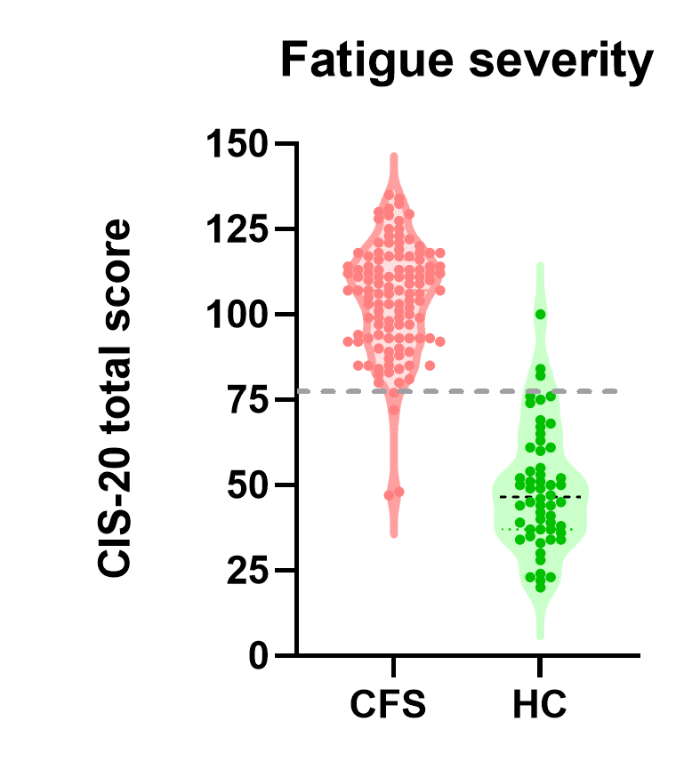


Sample
Ynse Dooms
PhD student
Part of larger study on biopsychosocial mechanisms of CFS
Patients with CFS
N = 117
Mean age = 41.4
85% women
Mean BMI = 26.1
Healthy controls
N = 56
Mean age = 41.5
82% women
Mean BMI = 24.1
Notes:
The analyses I will be presenting today are only a small part of a larger study on ….
The overall study sample consisted of…

Slide 6
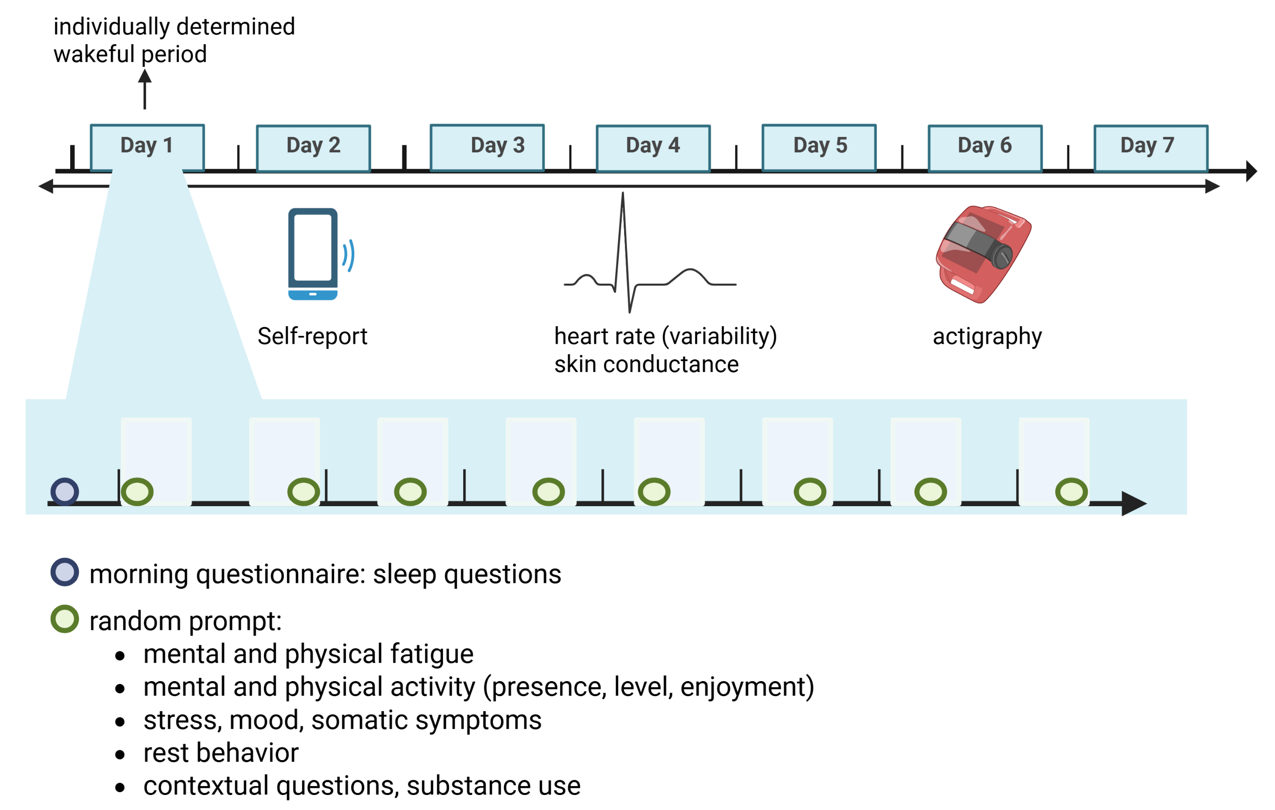
EMA protocol
Patients: N = 105
HC: N = 55
Notes:
7-day EMA protocol including self-report, and continuous measurement of heart rate and HRV and actigraphy
8 1-hour blocks were spread out equally across each participant’s personal wake window, and 1 prompt appeared at random in each block. Participants answered questions about….

Slide 7
Research aims
Develop a measure capturing the real-time association between physical activity and fatigue in CFS
  Concurrent activity – fatigue relationship
  Lagged (4h) activity – fatigue relationships
Investigate the relationship between this measure and a measure of lab-based PEM in CFS

Slide 8
EMA protocol
Patients: N = 105
HC: N = 55

Slide 9
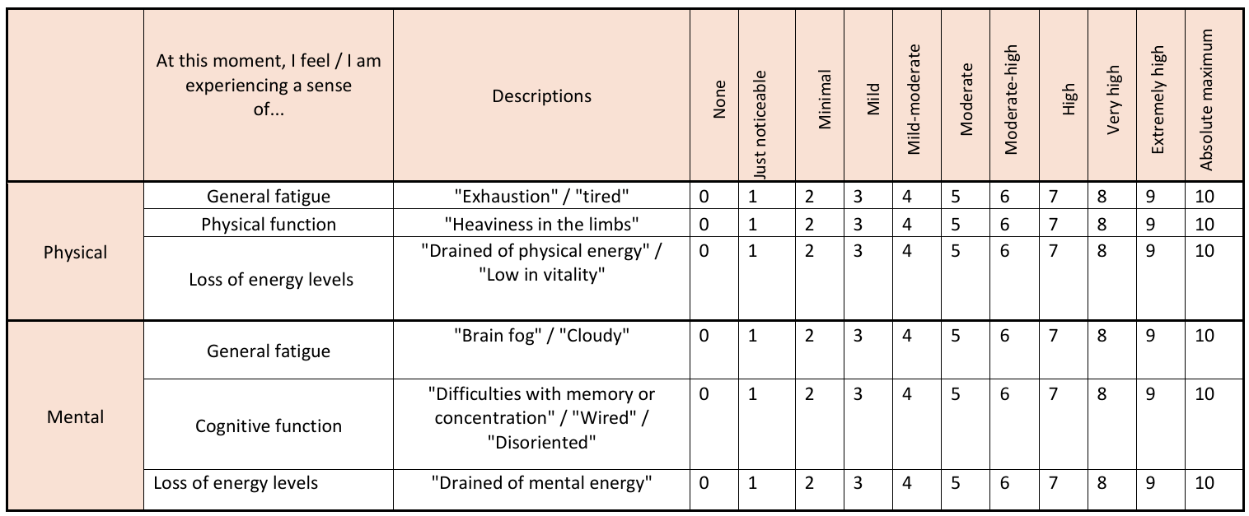
Fatigue ratings
Fatigue and Energy Scales; Keech et al., 2015
Notes:
Questions on momentary fatigue were derived from the Fatigue and Energy Scales, we made an average to have a singular measure of momentary physical fatigue

Slide 10
Physical activity ratings
Think about what you were doing 5 minutes or less before the beep:
I performed …
  No physical activity
  Light physical activity
  Moderate physical activity
  Strenuous physical activity
55%
36%
8%
Physical activity
1%
Notes:
Physical activity was assessed by asking participants ….
However, because we only asked about activity in a very limited time window, this was very zero-inflated …
So I decided to, for the analyses that I will present now, dichotomize between activity present and no activity present.

Slide 11
Analysis
Physical fatigue
Random intercept random slope linear mixed model
Outcome: physical fatigue
Fixed effects:
Group (CFS vs. HC)
Activity or no activity
Group * activity
βi = subject-specific slope
= estimation of the amount of fatigue that is added by doing an activity (1) vs. no activity (0) for subject i
High βi
Low βi
No activity
activity
concurrent
Lagged (4 hours later)
Notes:
We ran a random intercept random slope linear mixed model with physical fatigue as the outcome, and group, activity status, and the interaction between those 2 as the fixed effects. However, we also arrived subject-specific slopes for each subject, which the serves as a measure for each participant of the amount of fatigue that is added by having performed an activity in the past 5 minutes.

Slide 12
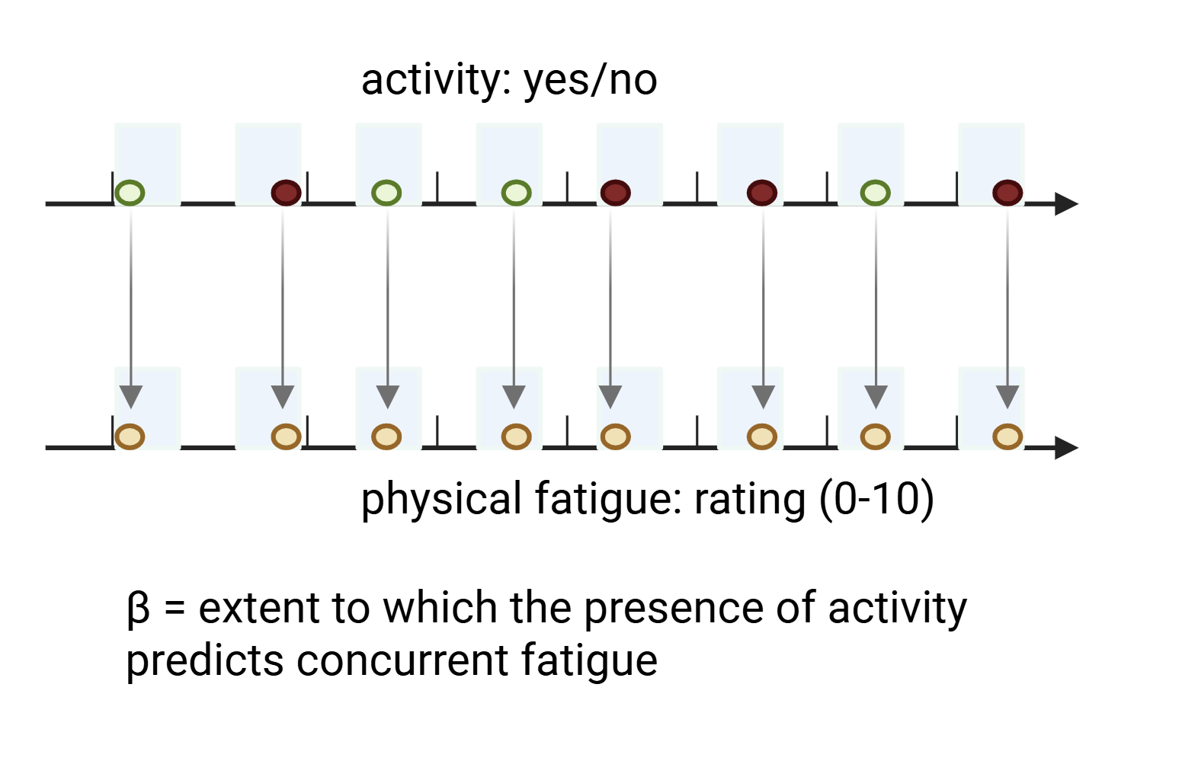
Analysis
β
Notes:
And we did this for concurrent fatigue, in which beta reflect the extent to which the presence of an activity predicts fatigue at the same time

Slide 13
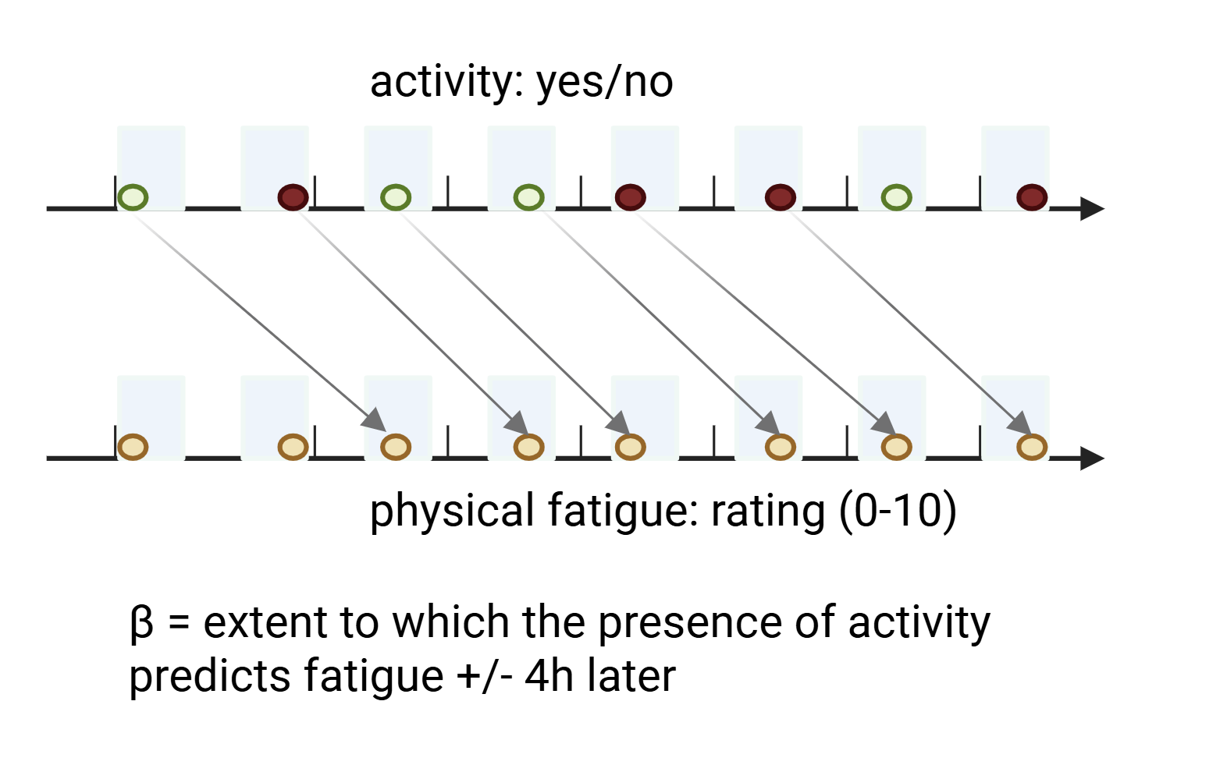
Analysis
β
Notes:
And for lagged fatigue, in which beta reflect the extent to which the presence of an activity predicts fatigue about 4 hours later

Slide 14
Results
  Similar proportion of “active” beeps in patients (44%) vs. HC (47%)
  Individuals with CFS/ME had higher self-reported fatigue (p < 0.001)
  Active beeps were related to more concurrent (p < 0.001) and lagged (p = 0.006) fatigue…
  … but this was similar in patients and HC
Notes:
When looking at the results of the overall model, we saw…

Slide 15
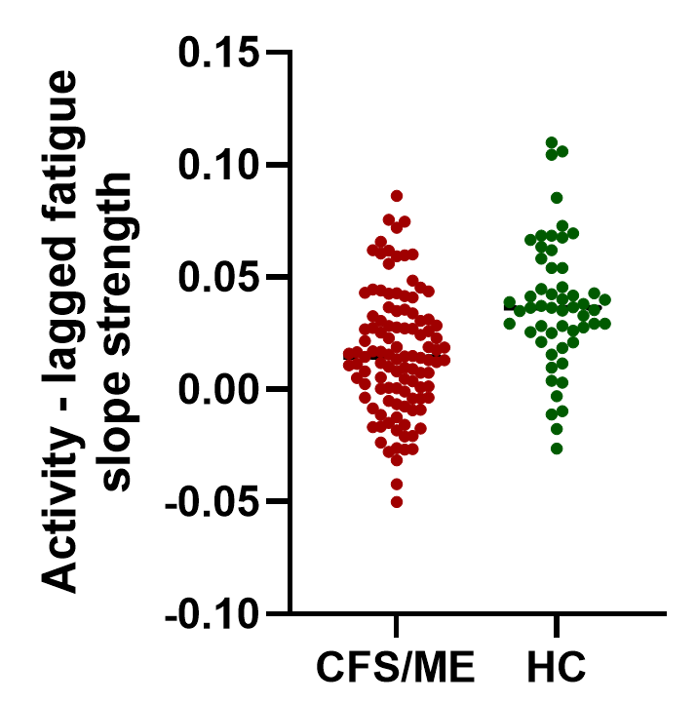
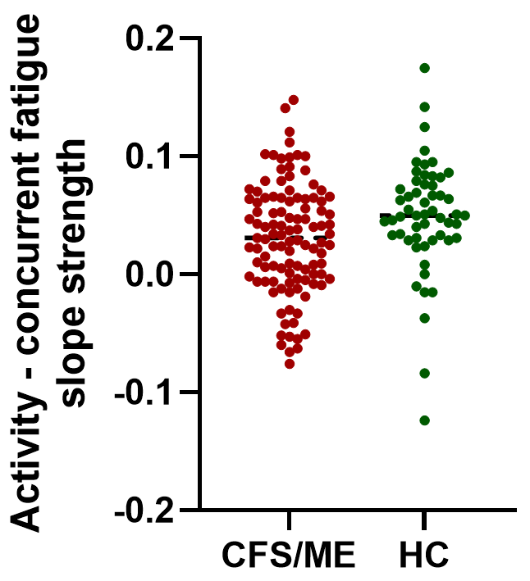
Individual activity – fatigue slopes
Notes:
When looking at the subject-specific slopes that we extracted as an individual measure of the strength of the relationship between activity and fatigue, we saw that these were similar for patients and HC, both for the concurrent and lagged slopes

Slide 16
Research aims
Develop a measure capturing the real-time association between physical activity and fatigue in CFS
  Concurrent activity – fatigue relationship
  Lagged (4h) activity – fatigue relationships
Investigate the relationship between this measure and a measure of lab-based PEM in CFS
Notes:
On to the second research question, we also looked whether EMA-derived measure of PEM was related to a lab-based measure of PEM

Slide 17
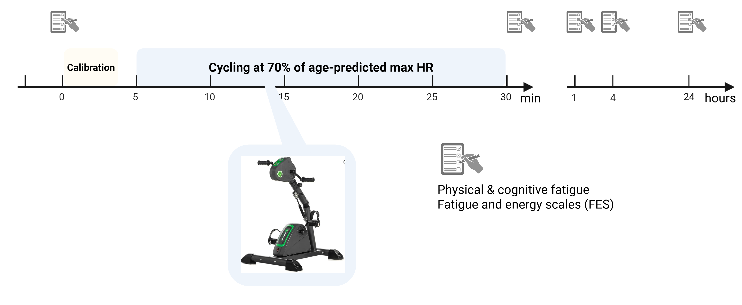
Lab-based physical exertion task
Notes:
PEM in the lab was quantified as the difference in fatigue between right after the task vs 4 hours later, with negative numbers indicating recovery, and positive numbers indicating symptom execerbation after physical exercise

Slide 18
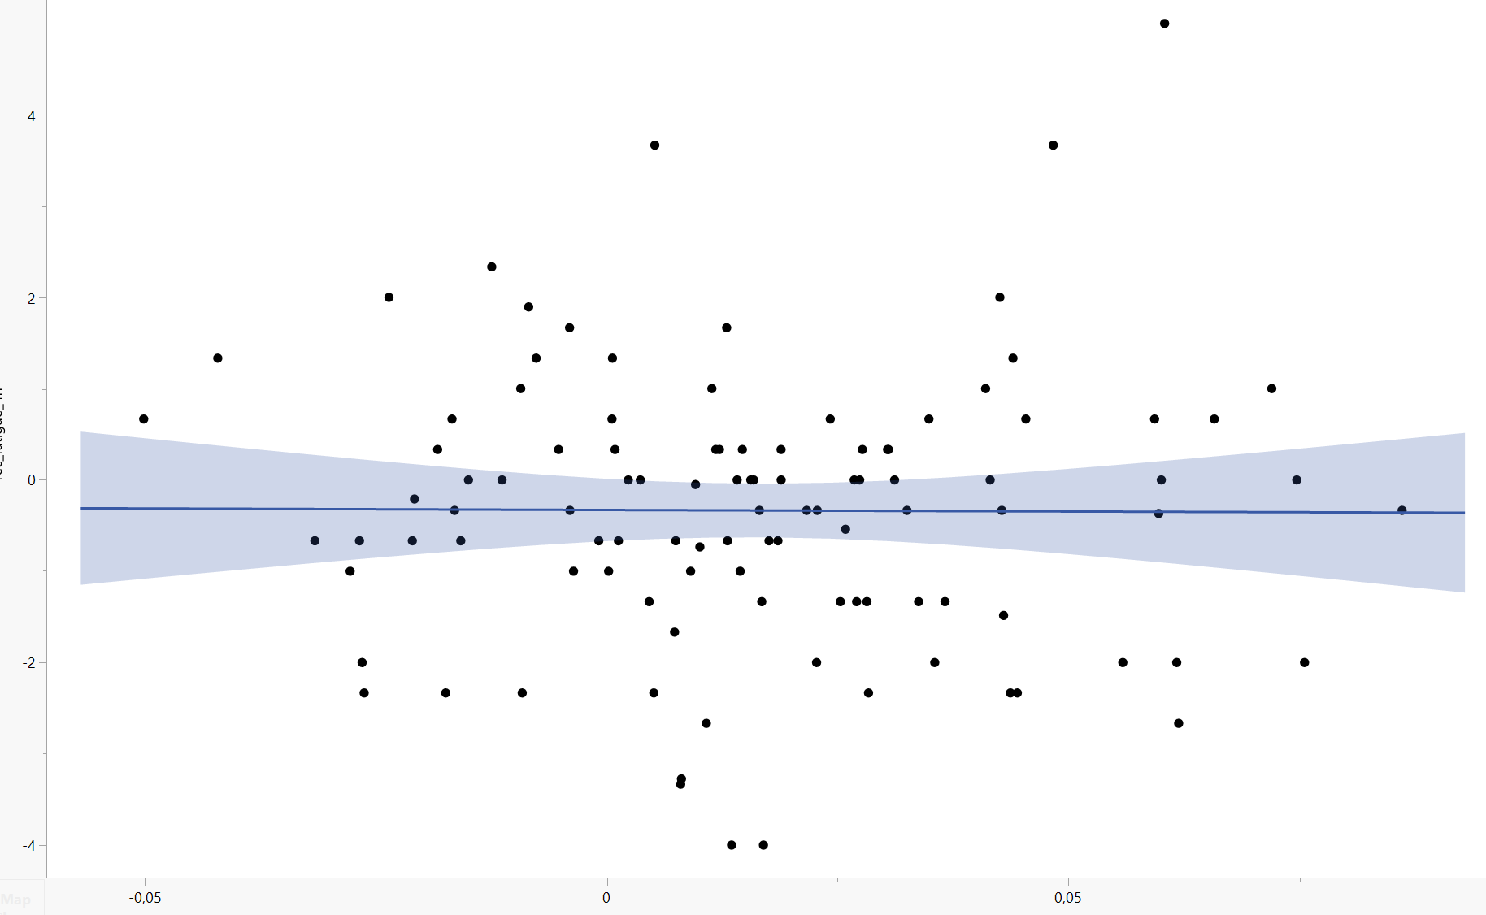
Relationship between ecological and lab-based 4h-activity-lagged fatigue
Recovery from exercise-induced fatigue after 4 hours
Activity – fatigue slope, 4 hours lag
Notes:
We then looked whether this measure was correlated with our EMA-derived measure of PEM, but it was not

Slide 19
Conclusions
  Individuals with CFS report elevated fatigue even in the absence of activity
  Activity-triggered fatigue increases were comparable between CFS patients and HC
  Individual slopes derived from EMA are a promising measure, but…
  ➔ Next time, choose a larger timeframe!
  Next step: link between actigraphy-based measure of physical activity and fatigue
Notes:
Because we asked only about activity levels right before the beep, we are missing a lot of information on what happened in between two beeps, and we also had too little beeps with moderate and strenous physical activity levels to make any meaningful conclusions out of this.
However, we live, we learn, so in our future studies, we will choose a longer timeframe for this question, and for this study, we will still have the opportunity to look at actigraphy levels throughout the entire period in between the beeps as an alternative measure of physical activity levels

Slide 20





Thank you!
CFS study team
Ynse Dooms
Lixin Qiu
Iris Coppieters
Katleen Bogaerts
Lukas Van Oudenhove
Stephan Claes
Elfi Vergaelen
Laboratory for Brain-Gut Axis Studies
KU Leuven
Health and Rehabilitation Psychology research group
Hasselt University
Research Foundation Flanders

