Slide 1
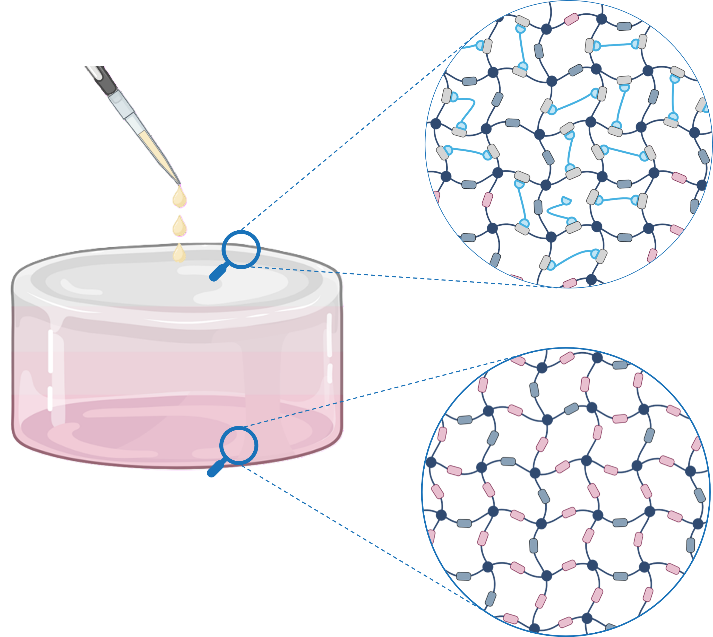
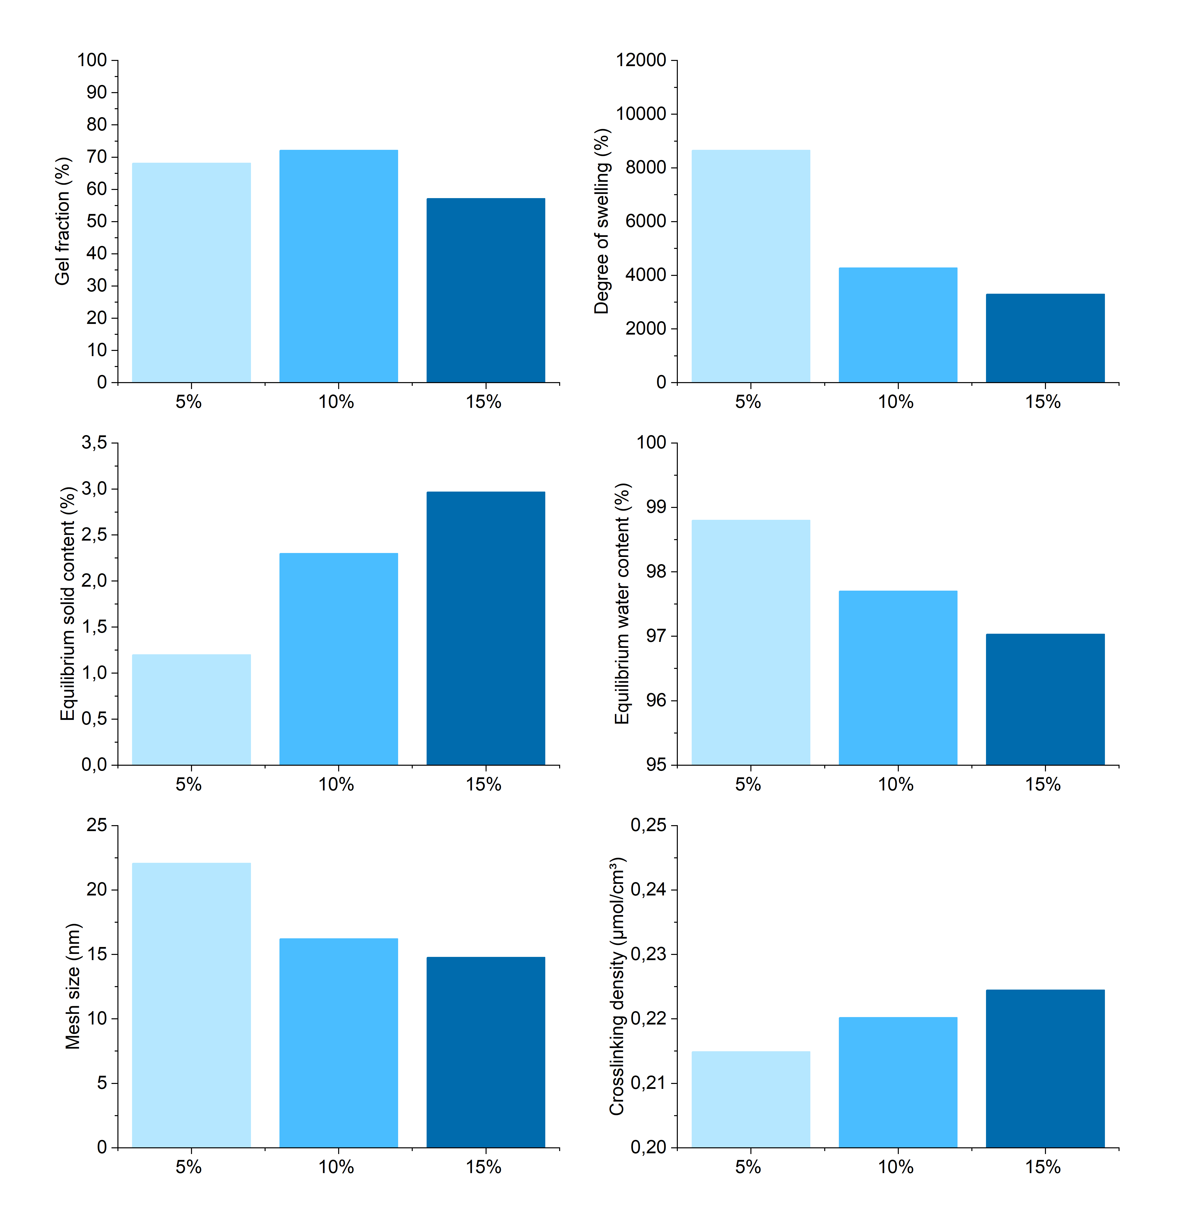




APPLYING DISSOCIATIVE CHEMISTRY TO OBTAIN GRADIENT HYDROGELS
Pancreatic Ductal Adenocarcinoma (PDAC)
5-year survival rate < 5%
4th cause of cancer-related deaths worldwide
Increasing prevalence
Brent Van Ballaer IM - D2 - F02

